Slide 1
EUMETSAT Nowcasting SAF products Applications and use of NWC SAF products
Pilar Rípodas (AEMET) , Xavier Calbet (AEMET), Llorenç Lliso (AEMET)
NWC SAF Team
Online, 16 October 2023

Slide 2
Outline of the presentation
Introduction to the EUMETSAT SAF Network and to the NWC SAF
NWC SAF Products: applications and limitations. Examples
Examples of NWC SAF products in Africa
New products coming based on new sensors/new channels in MTG
NWC SAF services.
Links to NWC SAF products

Slide 3
EUMETSAT SAF Network
EUMETSAT European Organization for the Exploitation of Meteorological Satellites
Purpose: to supply weather and climate-related satellite data, images and products to the National Meteorological Services of its Member and Cooperating States in Europe, and other users worldwide.
EUMETSAT HQ in Darmstadt, Germany.
SAFs (Satellite Application Facilities):
located at Weather Services in EUMETSAT Member and Co-operating States
complement production of standard meteorological products at EUMETSAT central facility

Slide 4
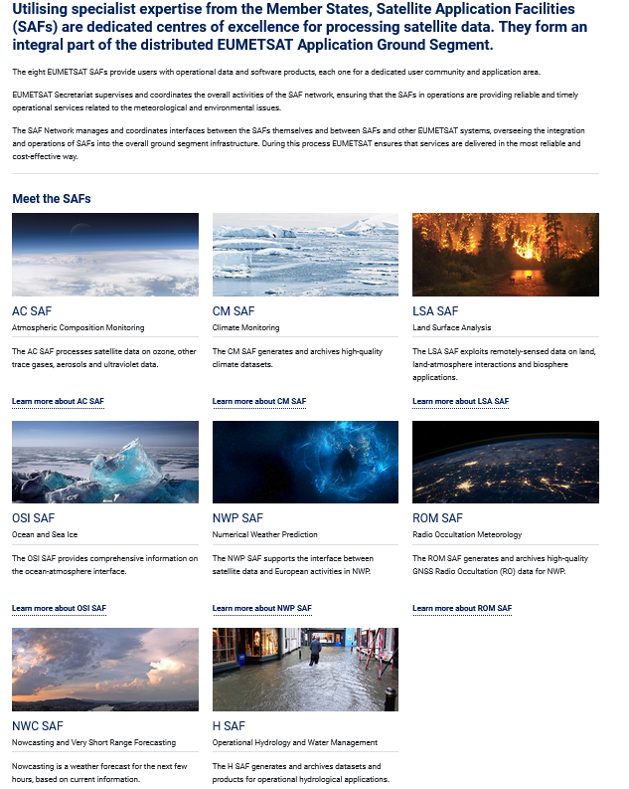
EUMETSAT SAF Network
SAFs are specialized on topics and themes
https://www.eumetsat.int/about-us/satellite-application-facilities-safs
The objective of the NWC SAF is to contribute to the optimum use of the meteorological satellites on their application to Nowcasting

Slide 5
NWC SAF concept
To ensure the optimum use of meteorological satellite data in Nowcasting and Very Short Range Forecasting
The NWC SAF develops and maintains software Packages (for GEOstationary and POLAR Satellites) freely distributed to registered users to generate satellite derived products with a direct application in Nowcasting
User support
Training
nwc-saf.eumetsat.int

Slide 6
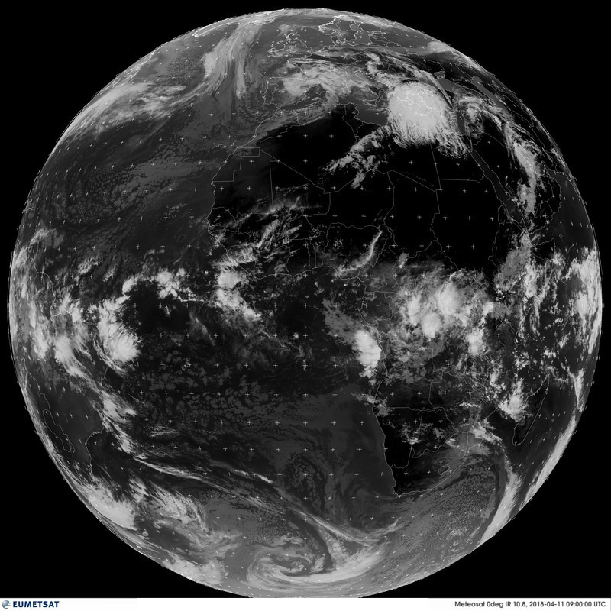
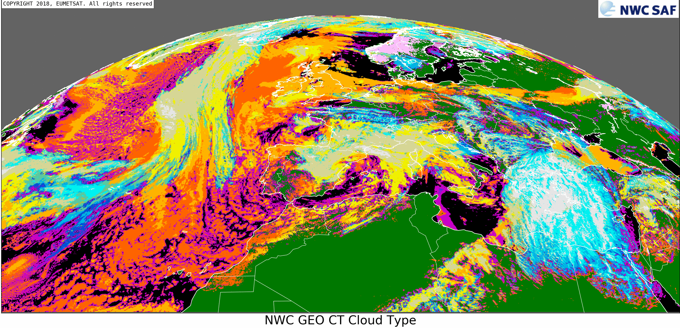
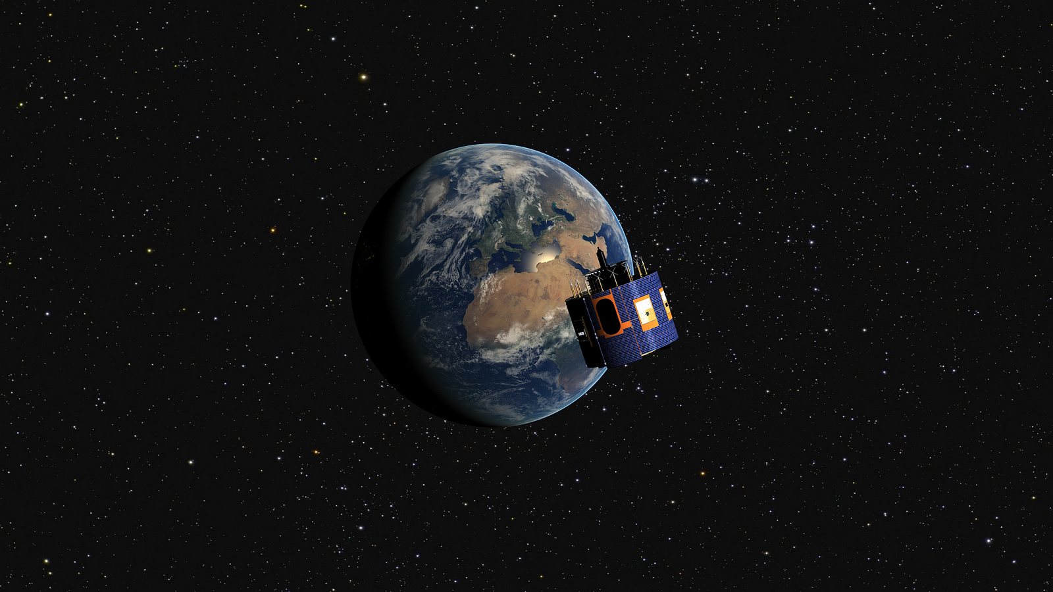
EUMETSAT NWC SAF: From Space to Nowcasting Products
Ground Segment
NWC SAF Software
NWC SAF Products
Satellite
Radiances

Slide 7
Current NWC SAF software packages
Geostationary satellites
NWC SAF GEO v2021.2
MSG 0 degree/primary Service
MSG Rapid Scan Service
MSG IODC
Himawari 8/9
GOES-16,GOES-17, GOES-18
Polar satellites
NWC SAF PPS v2021.3
Metop
NOAA
NPP
JPSS
EOS
FY-3D

Slide 8
NWC SAF software
The software is distributed freely to registered users of the meteorological community and is used for Nowcasting and as a development and research tool
The user runs the SW package and generates the products
Advantage: users can configure the SW to fit their needs ( e.g. the user define the area where the products are generated)
Potential problem: users need access to EUMETSAT satellite images and a NWP model output

Slide 9
Applicability of the NWC SAF products
Analysis of the meteorological situation
Nowcasting: Identification and tracking of adverse meteorological phenomena, including convection, fog, dust, snow …
Applications in Aeronautical meteorology
Assimilation in NWP models
As input to research and other operational chains

Slide 10
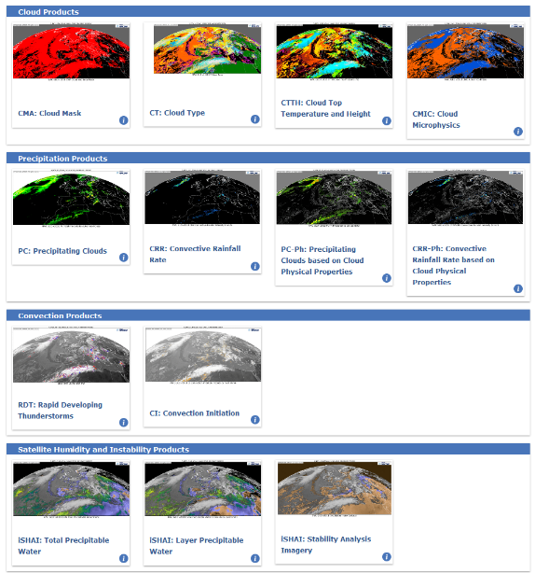
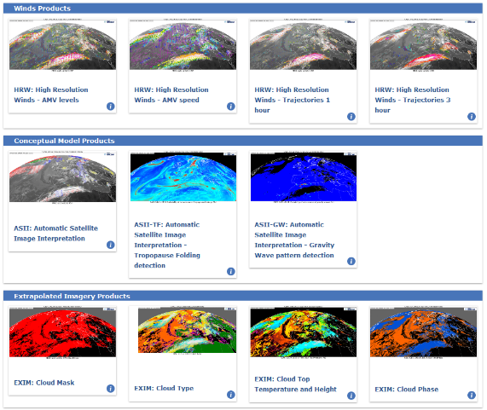
NWC SAF GEO Products
Available in NRT in nwc-saf.eumetsat.int

Slide 11
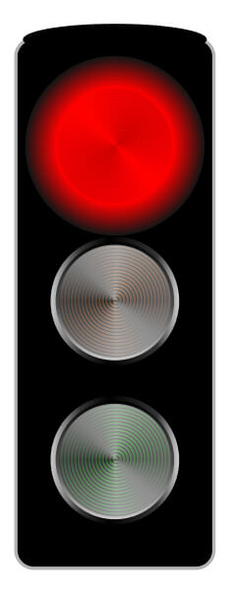
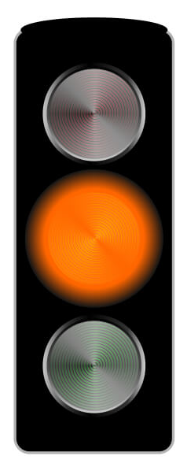
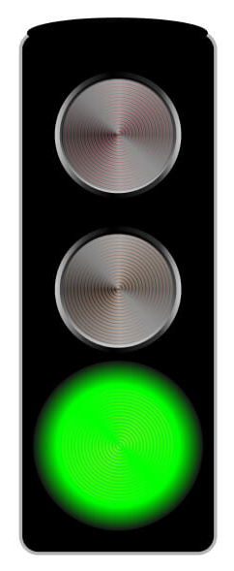
Product classification
Under Development
Use with great care
Use with care
Use with confidence

Slide 12
NWC SAF products useful in different situations
Products that can be useful in general in different meteorological situations
Cloud products: CMa, CT, CTTH, CMIC
Winds: HRW
Extrapolation of images: EXIM
Precipitation products

Slide 13
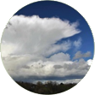
NWC SAF products useful in different situations
Convection
Preconvective environment (Refers to the 4-D thermodynamic and wind field present before the convective initiation occurs):
iSHAI: humidity and stability
Convective initiation (Refers to the process where an existing cumulus cloud begins rapid vertical growth):
CI
Mature Convective Storm (Refers to the presence of convective clouds with tops at or above their local equilibrium level):
RDT-CW, Precipitation products, HRW,
coming products based on MTG-LI
time

Slide 14
NWC SAF products useful in different situations
For Aviation:
ASII-TF
ASII-GW
Future: ASII-ICE (to be released in GEO- v2024)
Cloud Products
HRW
RDT-CW

Slide 15
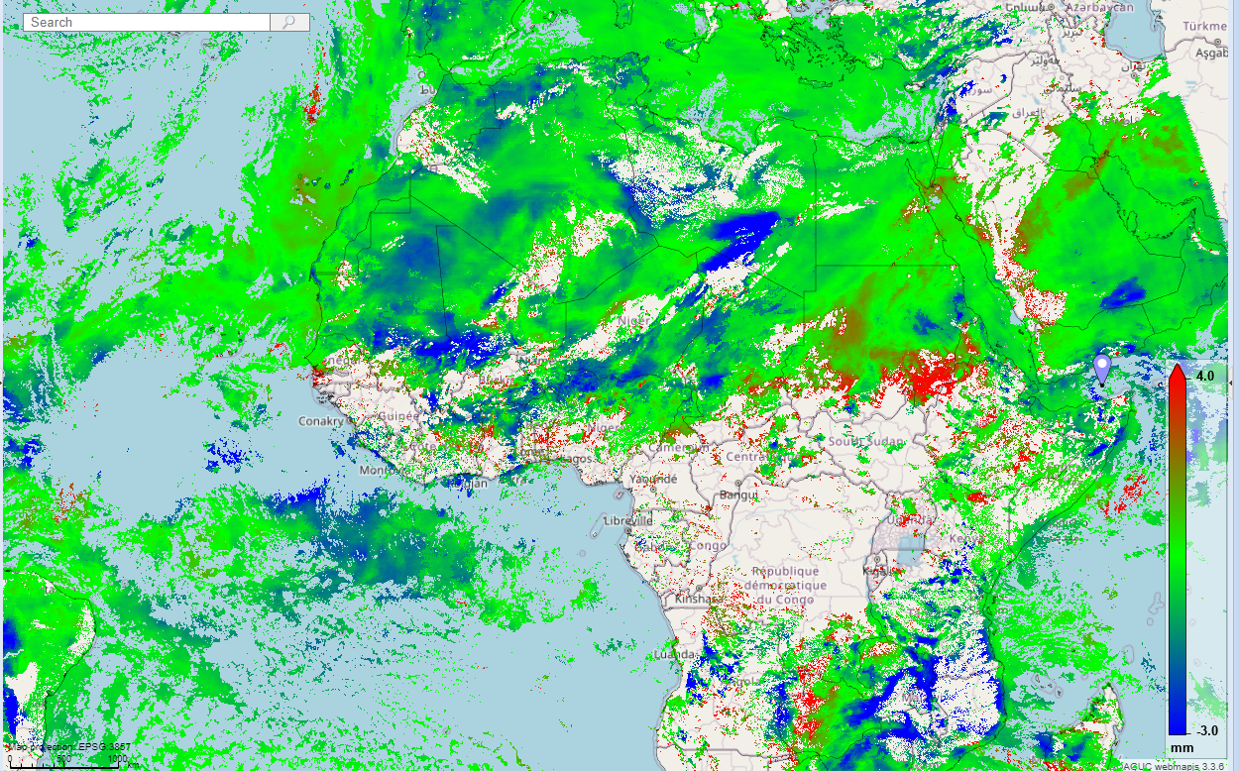
Practical Guide: iSHAI
iSHAI: imager Satellite Humidity And Instability. Provides total precipitable water, layer precipitable water, stability indices
Useful to track humidity differences with respect to the NWP model at any time there is a clear sky scene
Regions drier than the model are shown in blue. Regions more humid than the model are shown in red
Precipitable Water Differences in
Middle Layer (850-500 hPa) with respect to ECMWF
Use with Confidence
in Clear Sky Scenes
Use with Care
Close to Clouds:
Look for Persistence

Slide 16
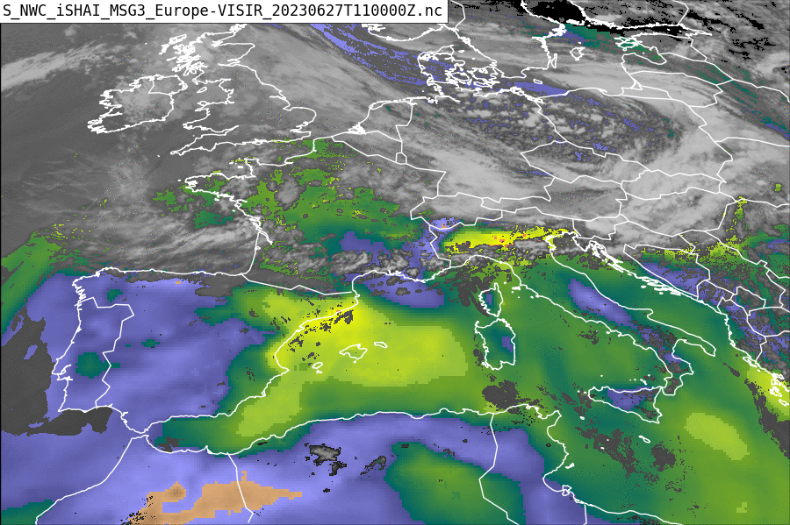
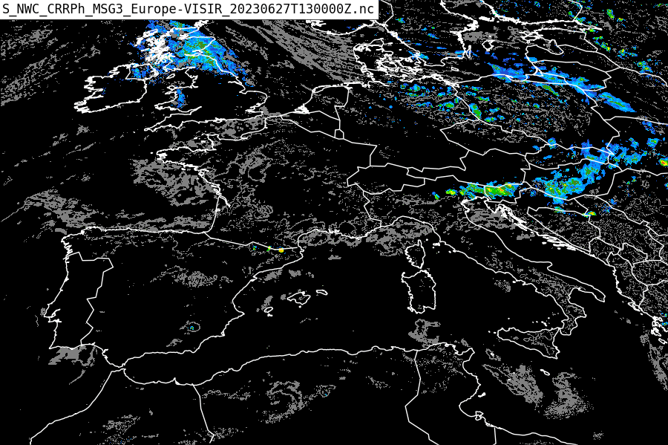
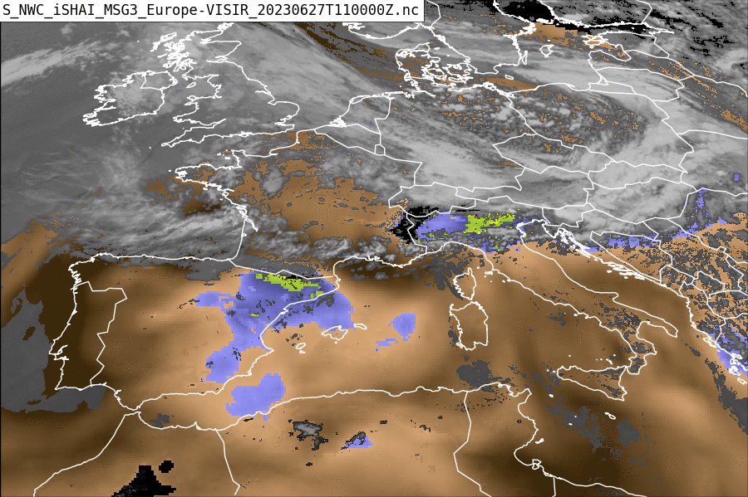
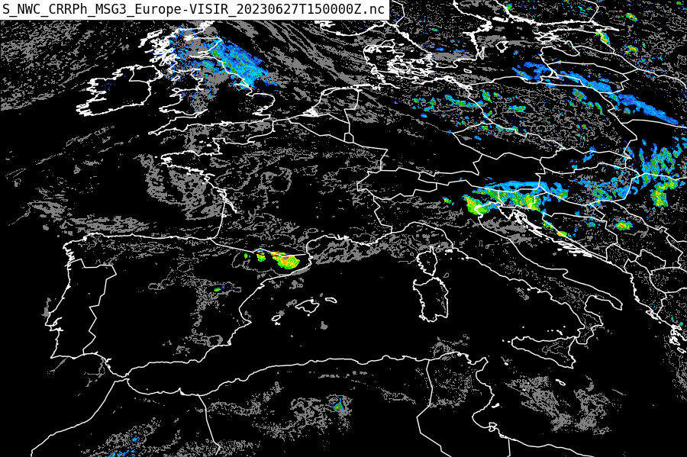
Practical Guide: iSHAI. 27.06.2023
iSHAI tpw
11:00 UTC
CRRPh
13:00 UTC
iSHAI Ki
11:00 UTC
CRRPh
15:00 UTC

Slide 17
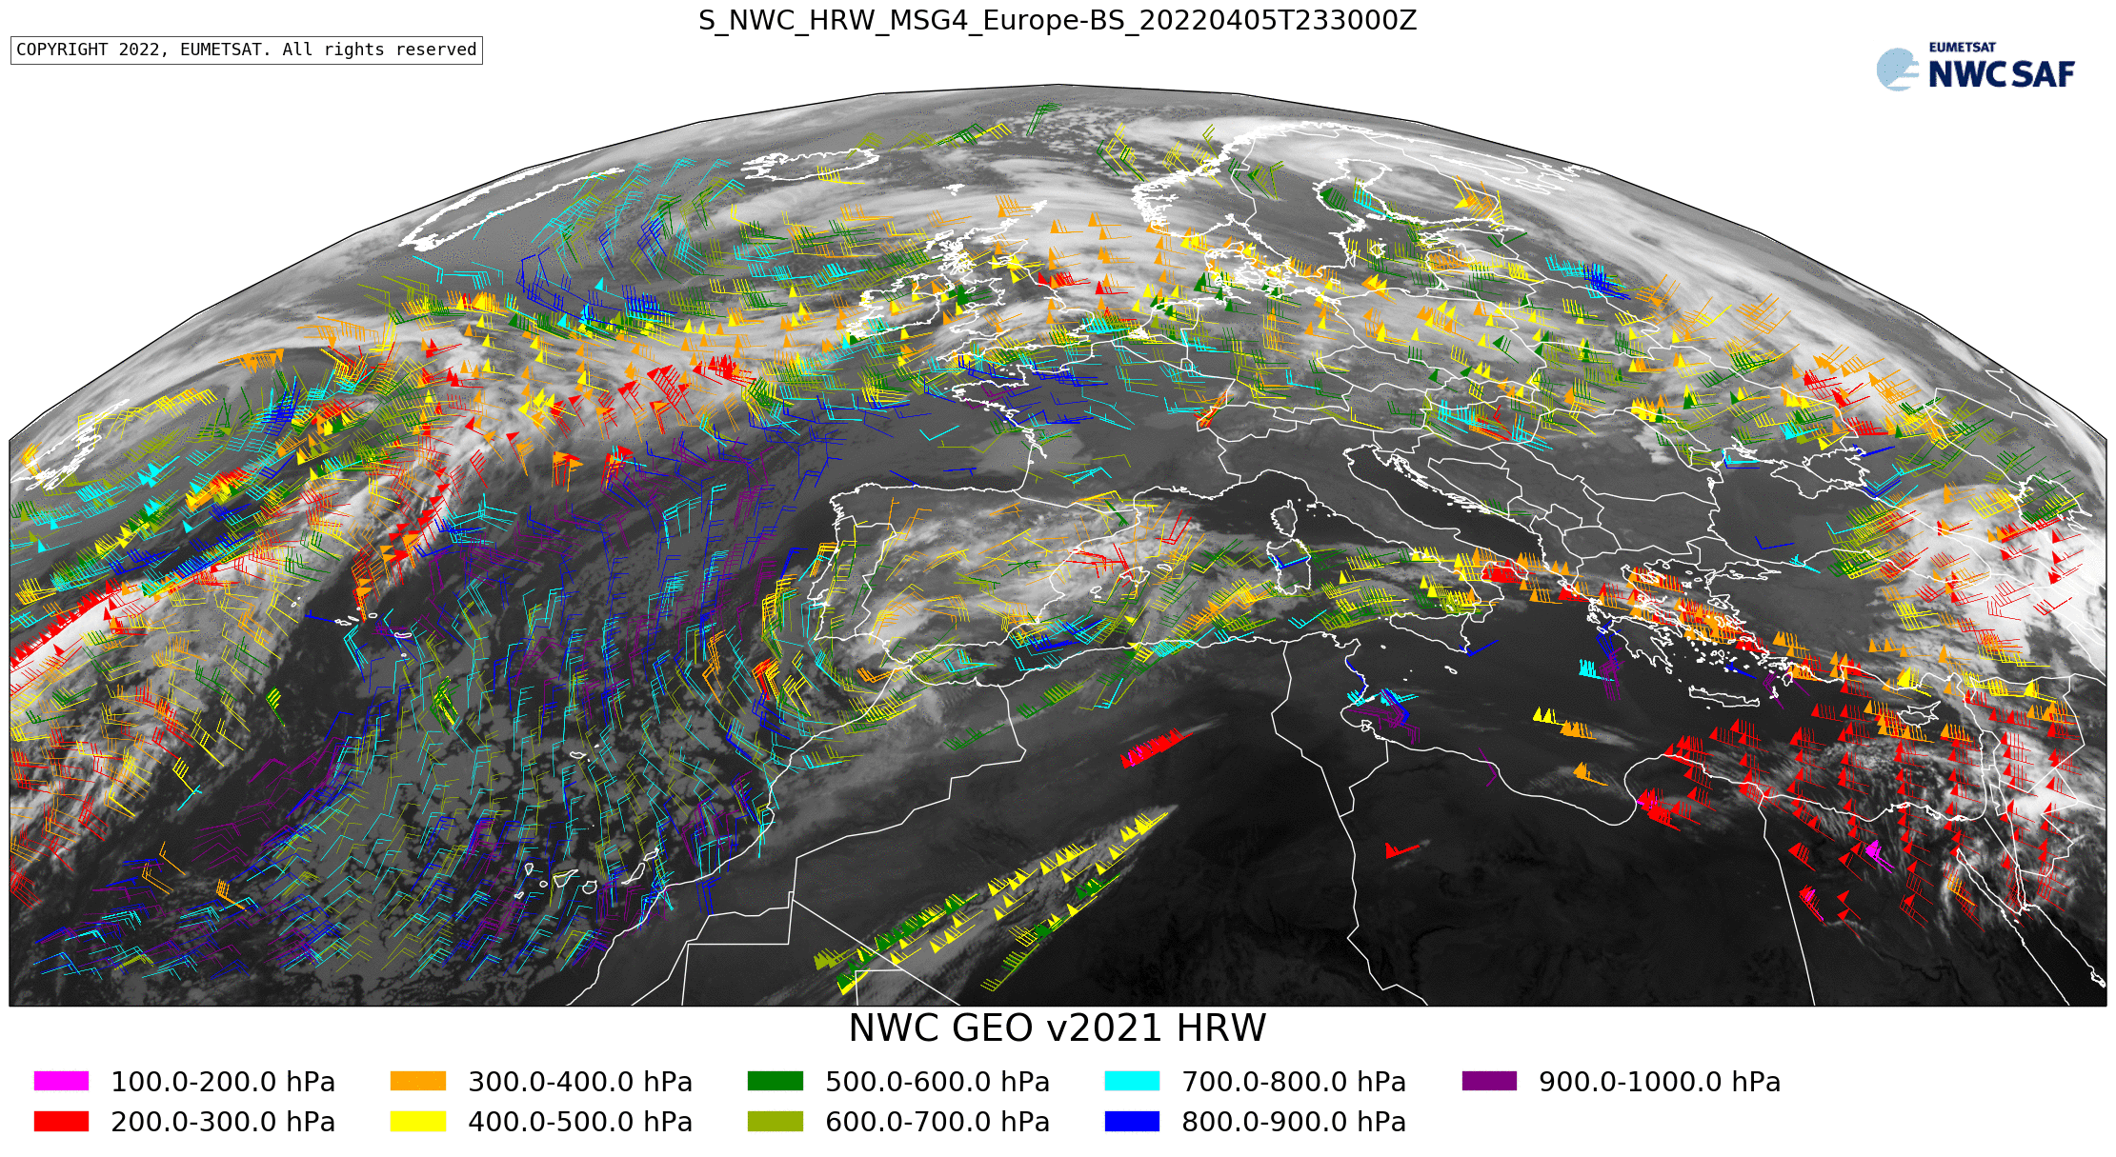
Practical Guide: HRW
HRW: High Resolution Winds
Convergence regions and strong winds at lower levels are sometimes visible
Very useful products of general purpose (any time)
Easy to interpret
HRW Winds at different levels
(low levels in blue)
Use with Confidence
Well Tested Product

Slide 18
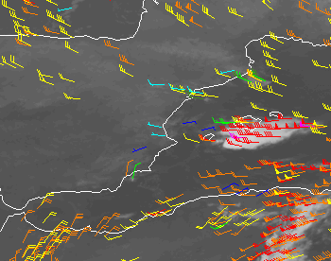
Example HRW. 19.08.2015
HRW: High Resolution Winds
HRW showing convergence in the region of interest
Very useful products of general purpose (any time)
Easy to interpret
Obtained with MSG
Data obtained at 4:00 am
RDT shows cell at 5:15 am
Intense precipitation at around 07:00 am
4:00 am HRW Winds at different levels
(low levels in blue)
Use with Confidence
Well Tested Product

Slide 19
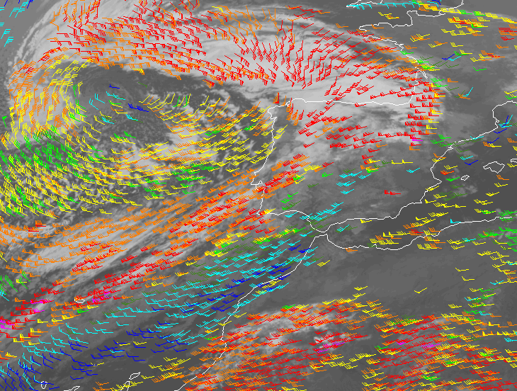
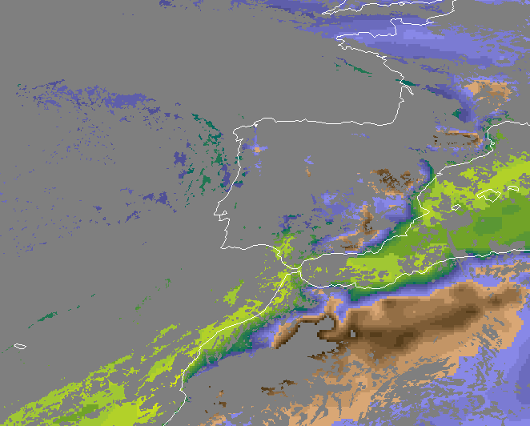
Example iSHAI + HRW. 23.10.2016
3:00 am iSHAI Boundary Layer Humidity + HRW
iSHAI: imager Satellite Humidity And Instability
HRW: High Resolution Winds
Obtained with MSG
Data obtained at 3:00 am
Moisture river confirmed with NWC SAF
Use with Confidence
Well Tested Products

Slide 20
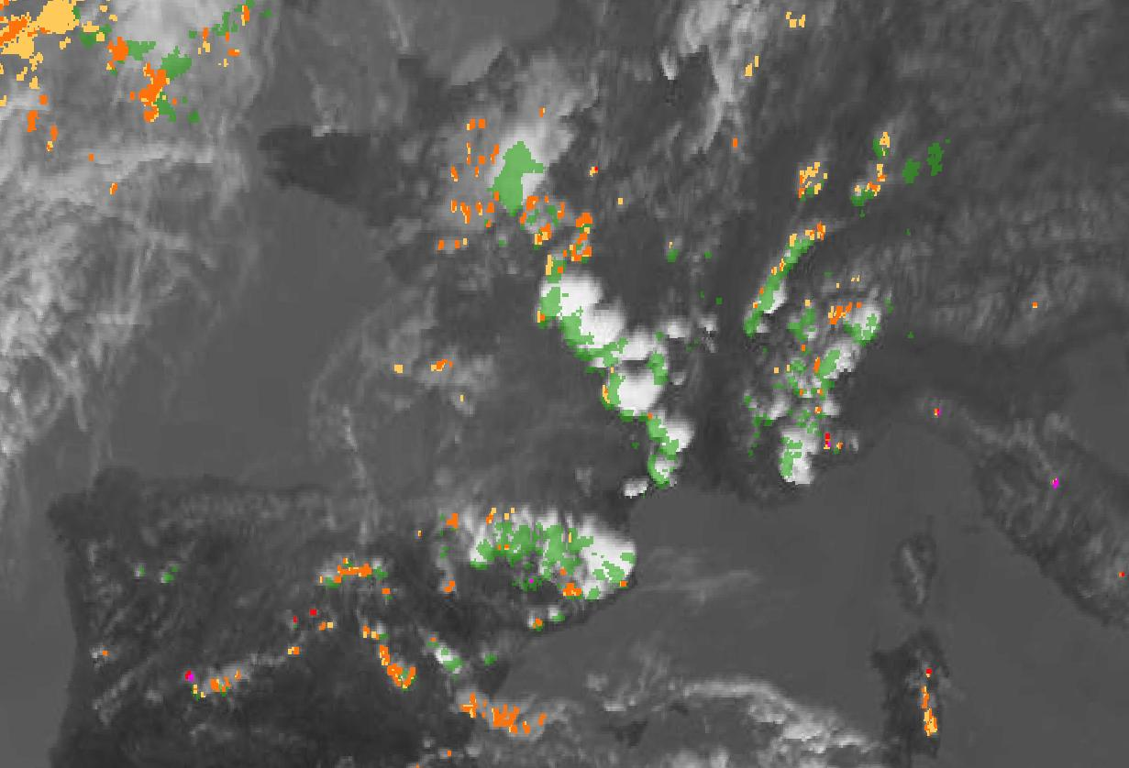
Product Guide: CI
CI
NWC SAF MétéoFrance team
CI: Convective Initiation
Detects Growing Cells which will become Storms
Detects Cells before Radar
Still under development
20100628 CI Case Study - 13h00Z IR image, superimposed with CI_prob30 and [13h00Z-13h30Z] accumulated radar > 30dBZ seen as ground truth (green shading).
Pre-operational
Under Development,
but Promising
The color code for visualization of CI is as follow:
yellow for [0-25%] probability of Convection initiation,
orange for [25-50%] probability of Convection initiation,
red for [50-75%] probability of Convection initiation,
magenta for [75-100%] probability of Convection initiation.

Slide 21
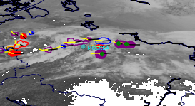
Product Guide: RDT
RDT: Rapid Developing Thunderstorm
Very useful product for Cell Tracking, Detection and Evolution
Cells are shown as polygons
Color indicate cell evolution stage (red: growing, purple: mature, blue:decaying)
Thickness of line indicate severity
Overshooting tops are shown as green circles
Yellow line: past 1 hour track
Black line: future 1 hour track
RDT
Use with Confidence
Well Tested Product

Slide 22
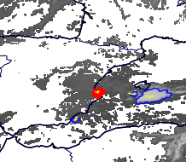
Example RDT. Date: 19.08.2015
RDT: Rapid Developing Thunderstorm
Cell Tracking, Detection and Evolution product
Fast Developing Cell shown
Cell is shown 15 min before it appears on the Radar
Obtained with MSG
Data obtained at 5:15 am
Intense precipitation at around 07:00 am
5:15 am RDT
Use with Confidence
Well Tested Product

Slide 23
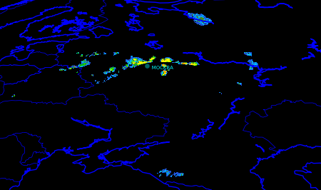
Practical Guide: Precipitation products
PC, PCPh: probability of precipitation
CRR, CRRPh: intensity of precipitation, accumulation in 1 hour
Detects Rain indirectly from Cloud Tops
Useful when Radar is Off
Radar is better when available
Radar and CRR usually do not overlap exactly
Differences between day and night products (CRRPh show less differences day/night)
CRR
Use with Confidence
Well Tested Product
Know its limitations

Slide 24
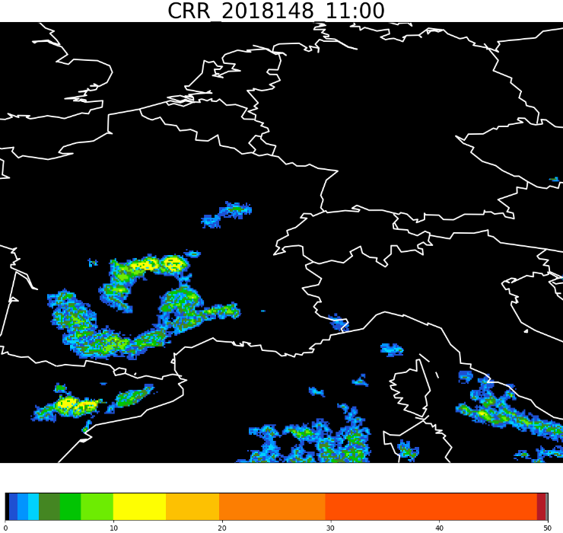
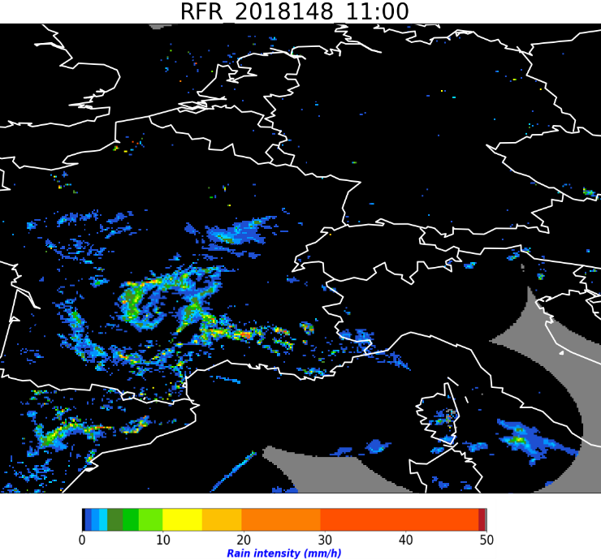
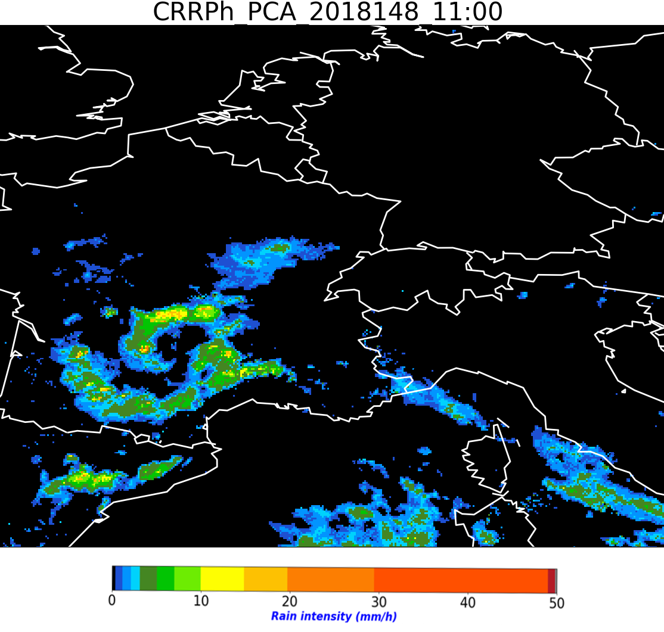
A
CRRPh and CRR
GEO v2021 CRR
EUMETNET OPERA radar composition
GEO v2021 CRRPh
28 May 2018 11:00 UTC.
J.A. Lahuerta, AEMET

Slide 25
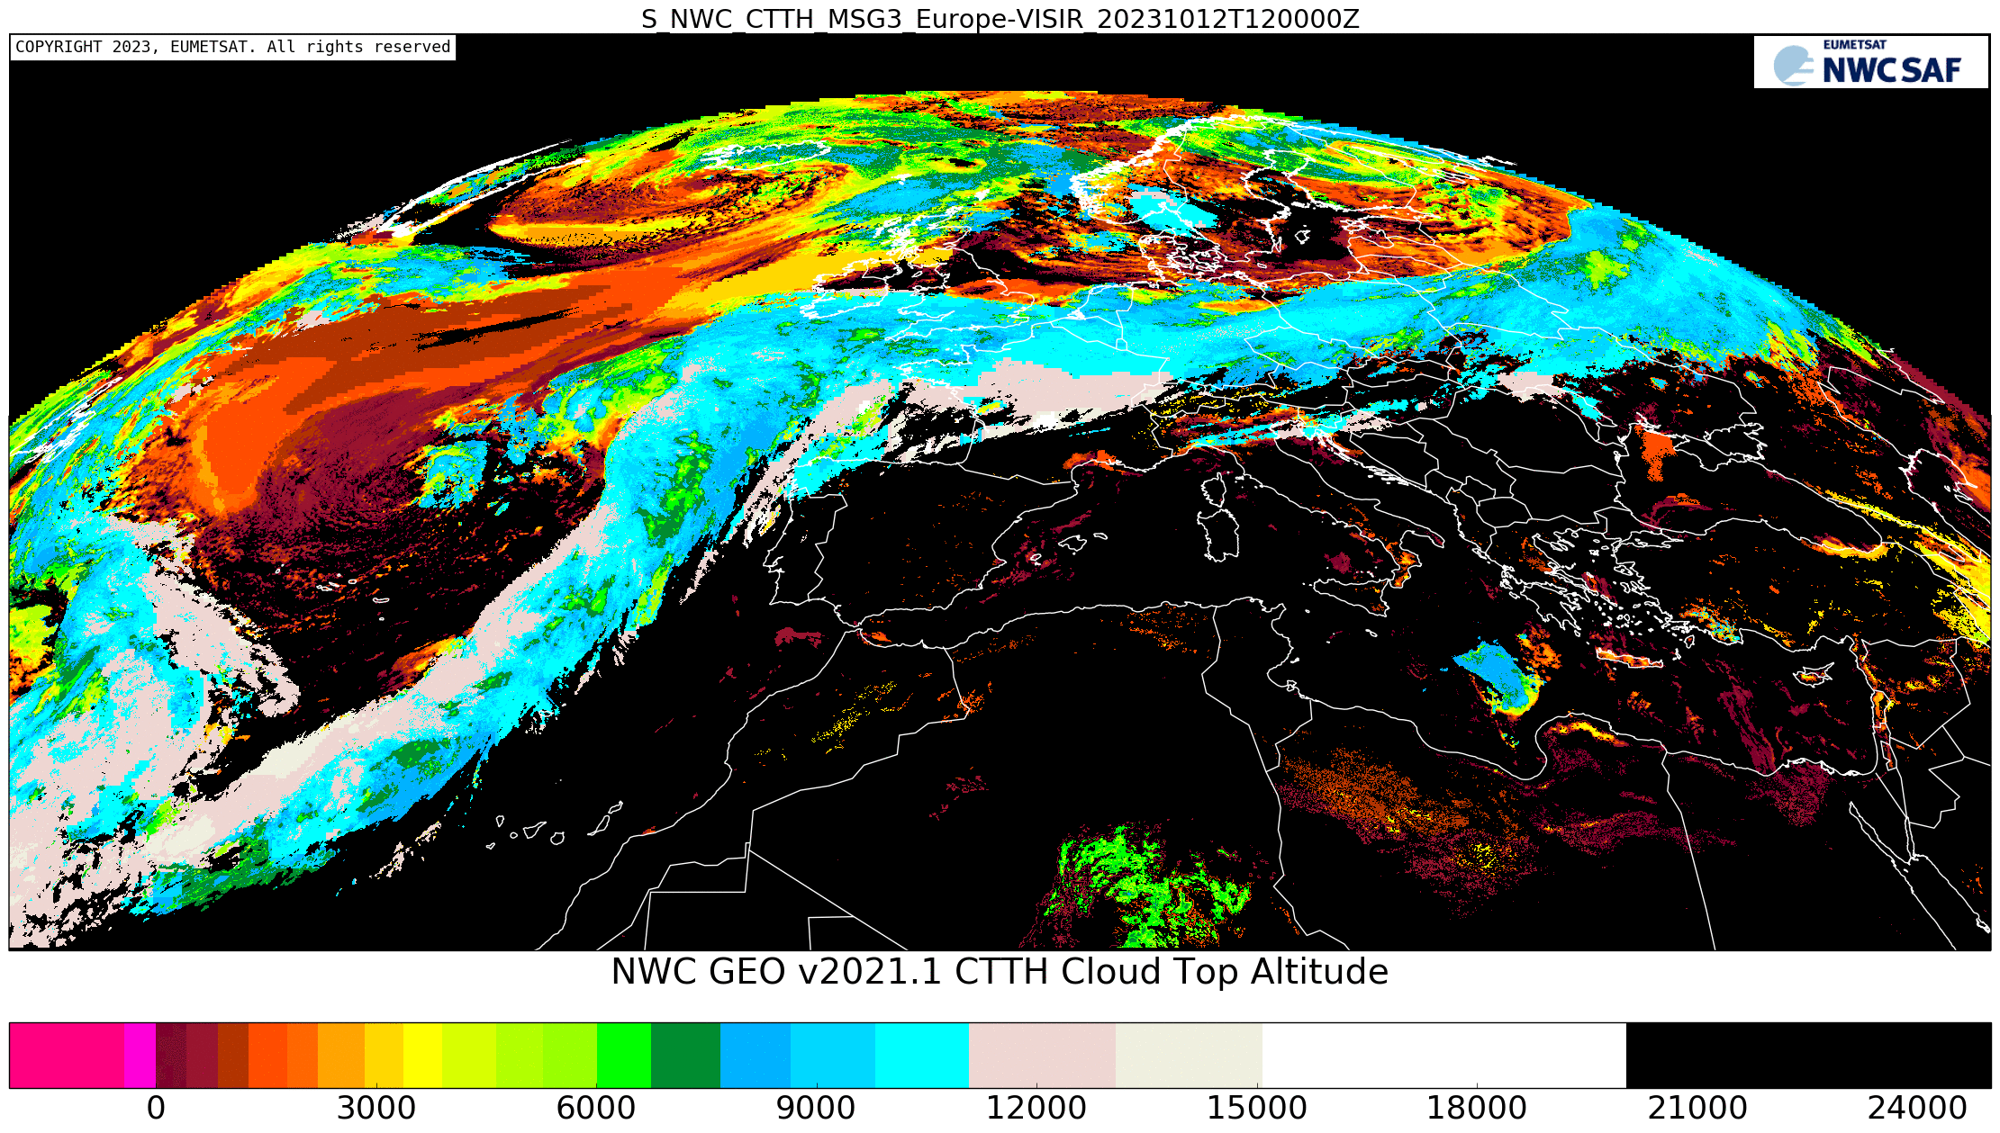
Practical Guide: Cloud Products
CMa, CT, CTTH, CMIC: Cloud Mask, Cloud Type, Cloud Top, Cloud Microphysics, dust, etc.
Very useful products of general purpose (any time)
Easy to interpret
CTTH Cloud Top Height (m)
Use with Confidence
Well Tested Product

Slide 26
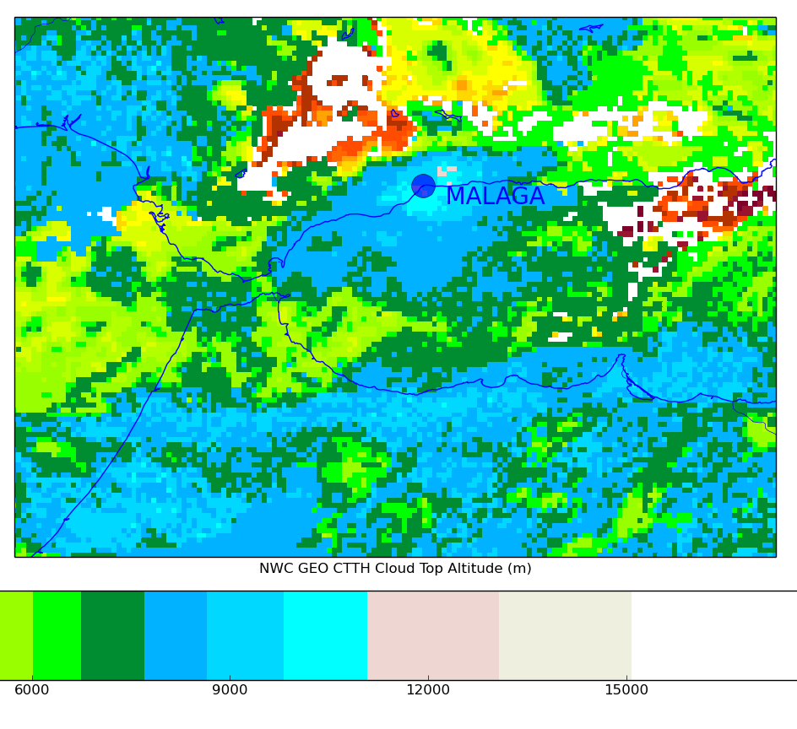
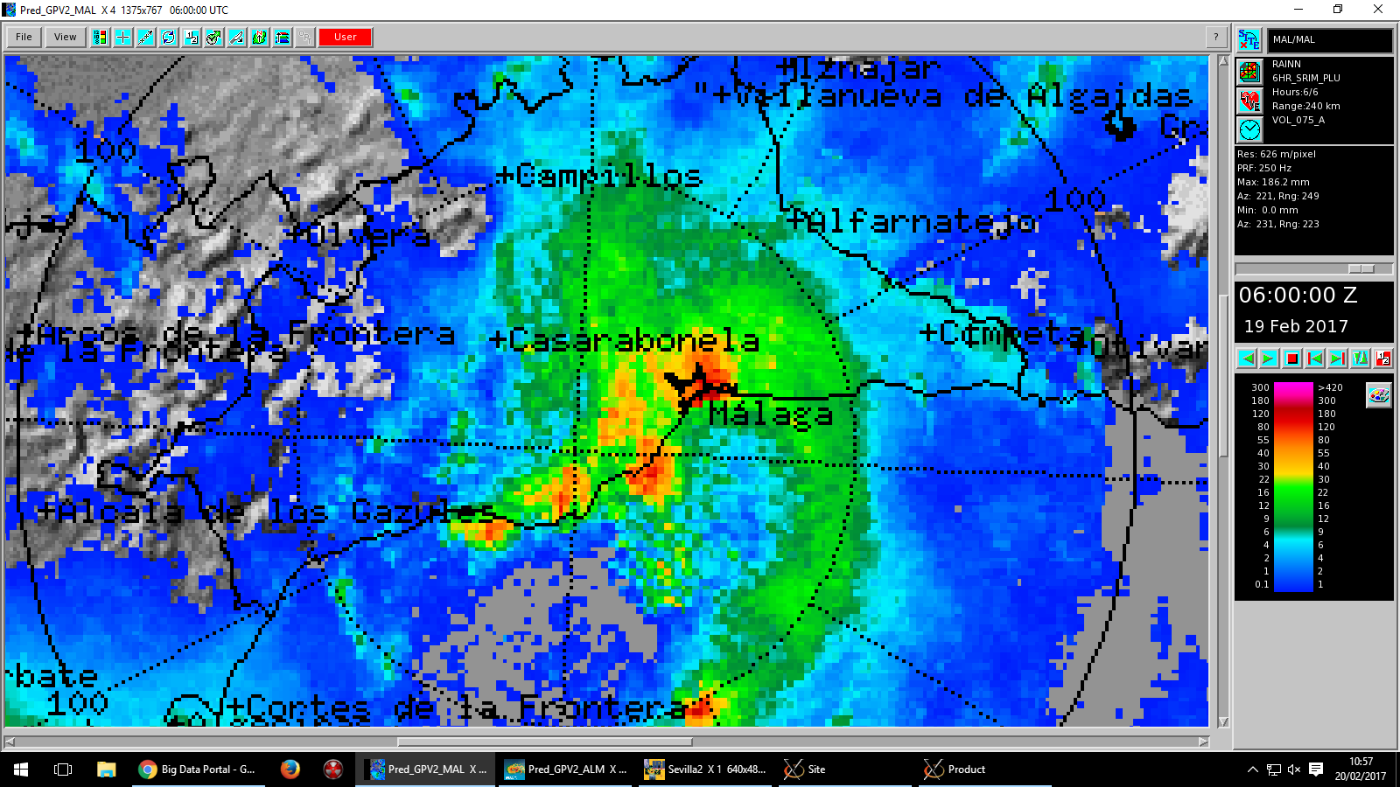
Example Cloud Products. Date: 19.02.2017
CMa, CT, CTTH, CMIC: Cloud Mask, Cloud Type, Cloud Top, Cloud Microphysics, etc.
Very useful products of general purpose (any time)
Easy to interpret
Obtained with MSG
Data obtained at 3:00 am
Torrential rain at 3:00 am
Radar had Echotops of 8.5 km giving a wrong cloud top height impression
CTTH was giving up to 12 km cloud tops
3:00 CTTH Cloud Top Height (m) and
Radar Precipitation Accumulation in 6 hr at 06:00
Use with Confidence
Well Tested Product

Slide 27
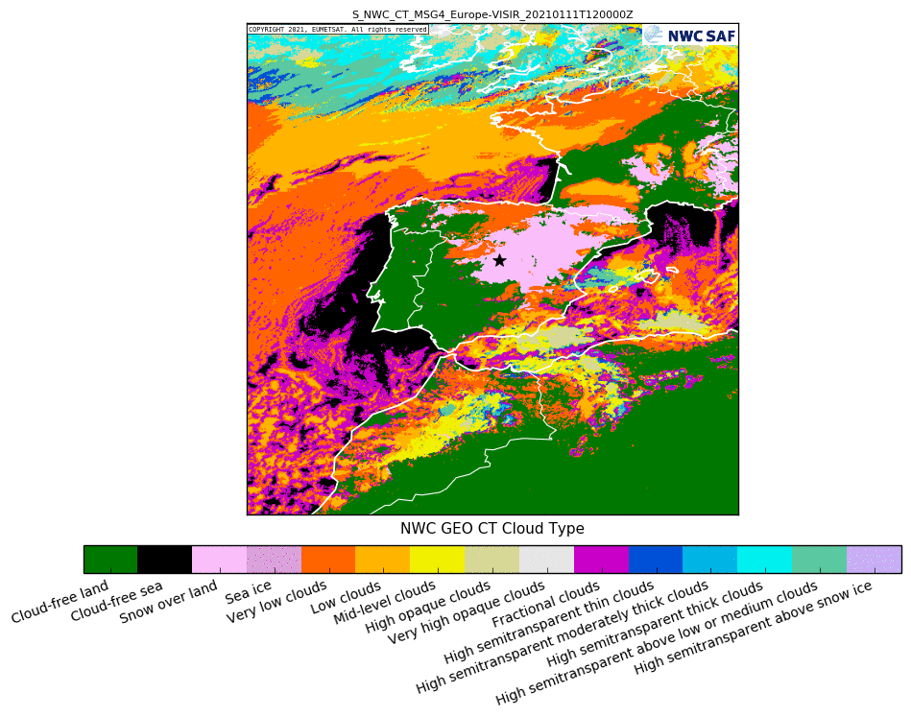
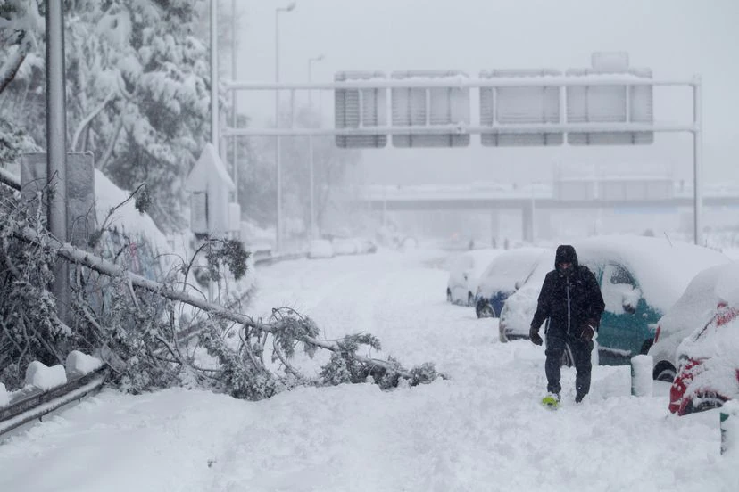
Example Cloud Type. Filomena storm. 07-18 January 2021
CT Clasifies the Clouds as they are seen from their tops
Contains information on the major cloud classes : fractional clouds, semitransparent clouds, high, medium and low clouds (including fog) for all the pixels identified as cloudy in a scene
Classes include „Cloud-free land“, „Cloud-free see“, „Snow over land“ and „Sea ice“
Use with Confidence
Well Tested Product
Know its limitations
El Pais.
M30-Madrid 9 January 2021

Slide 28
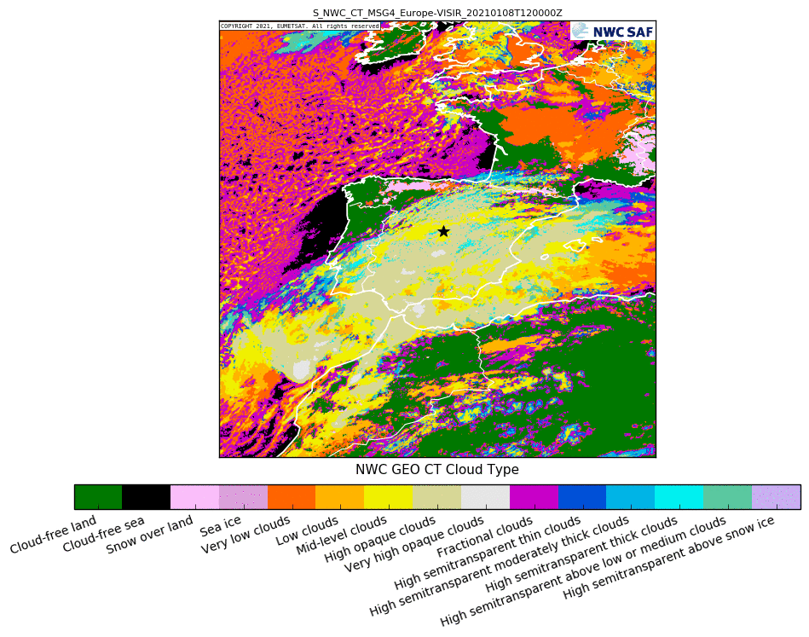
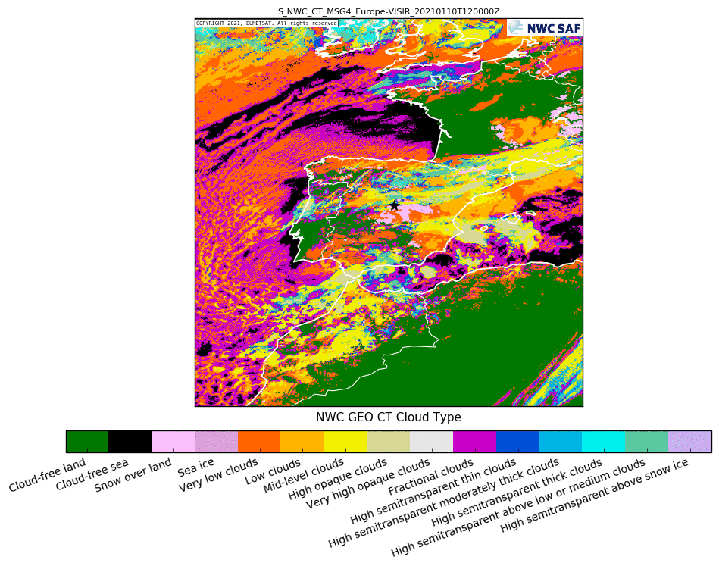
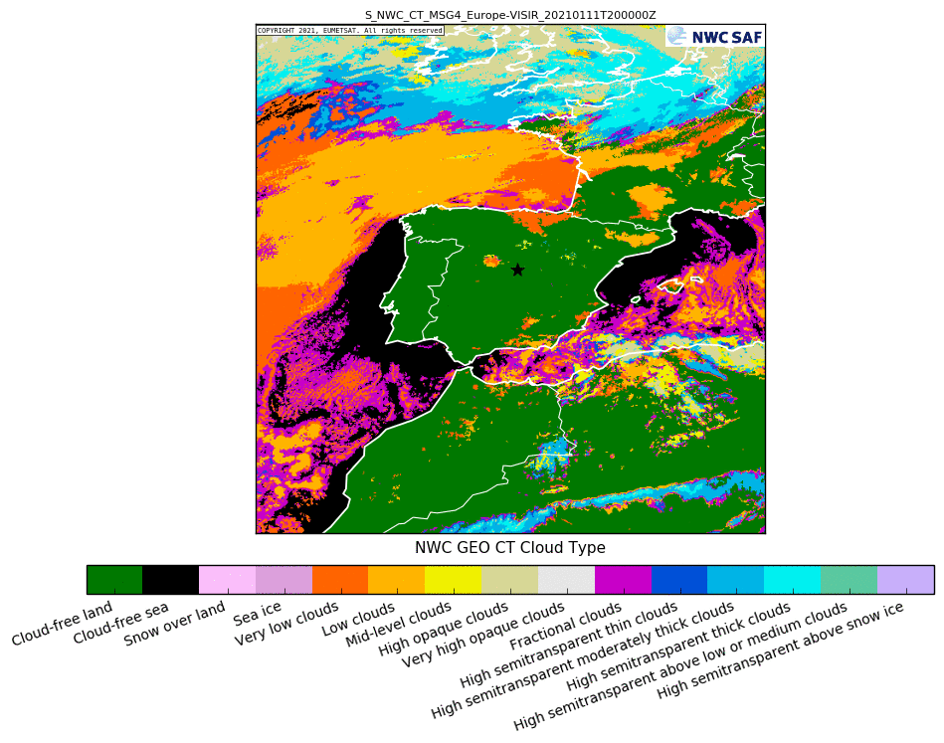
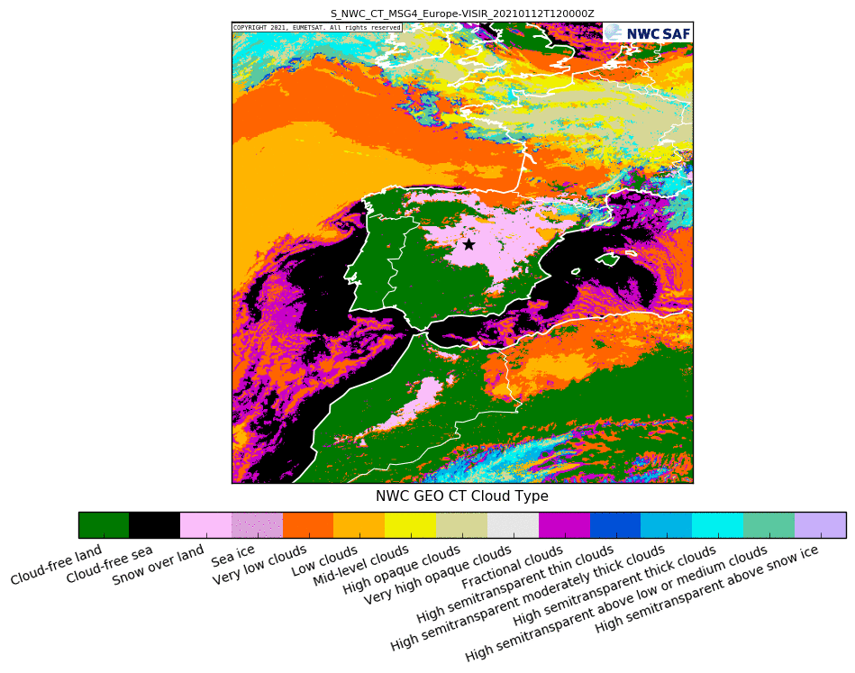
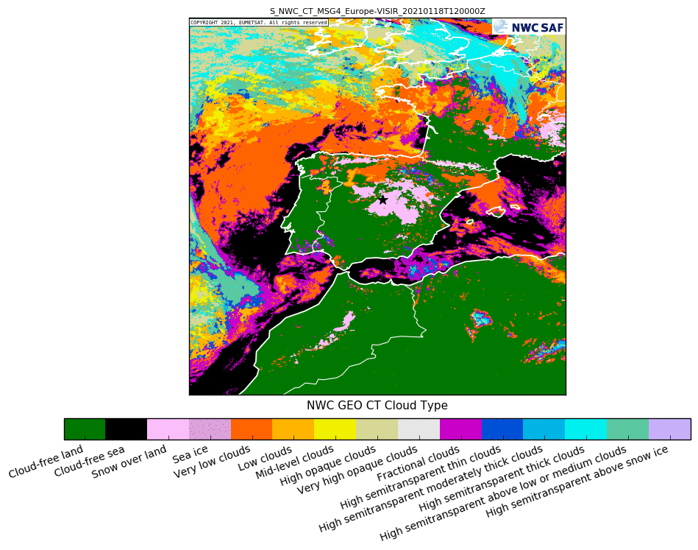
Example Cloud Type. Filomena storm. 07-18 January 2021
8 January 2021
12:00 UTC
10 January 2021
12:00 UTC
11 January 2021
12:00 UTC
11 January 2021
20:00 UTC
12 January 2021
12:00 UTC
18 January 2021
12:00 UTC

Slide 29
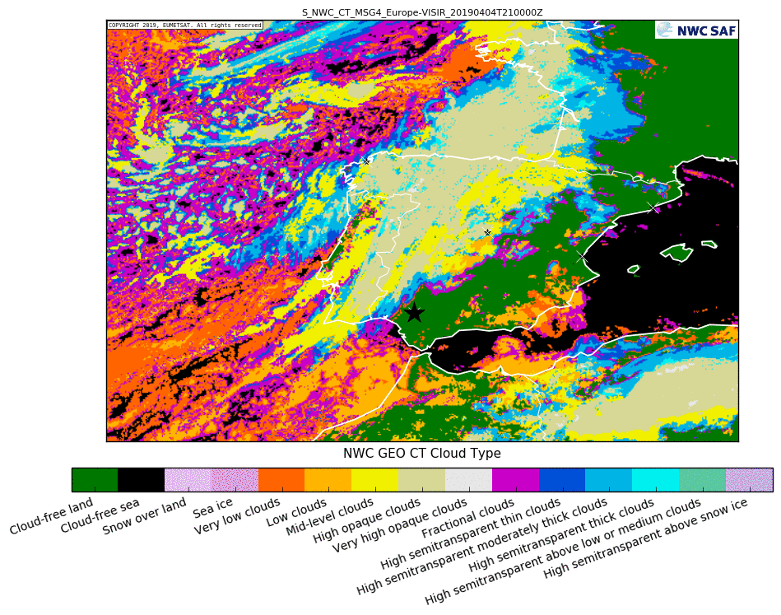
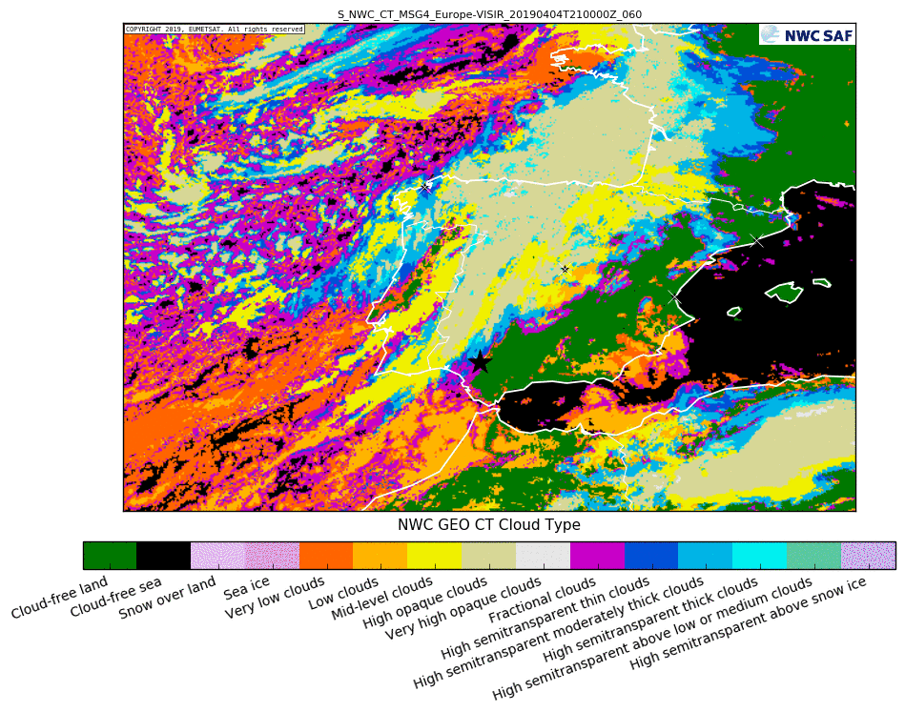
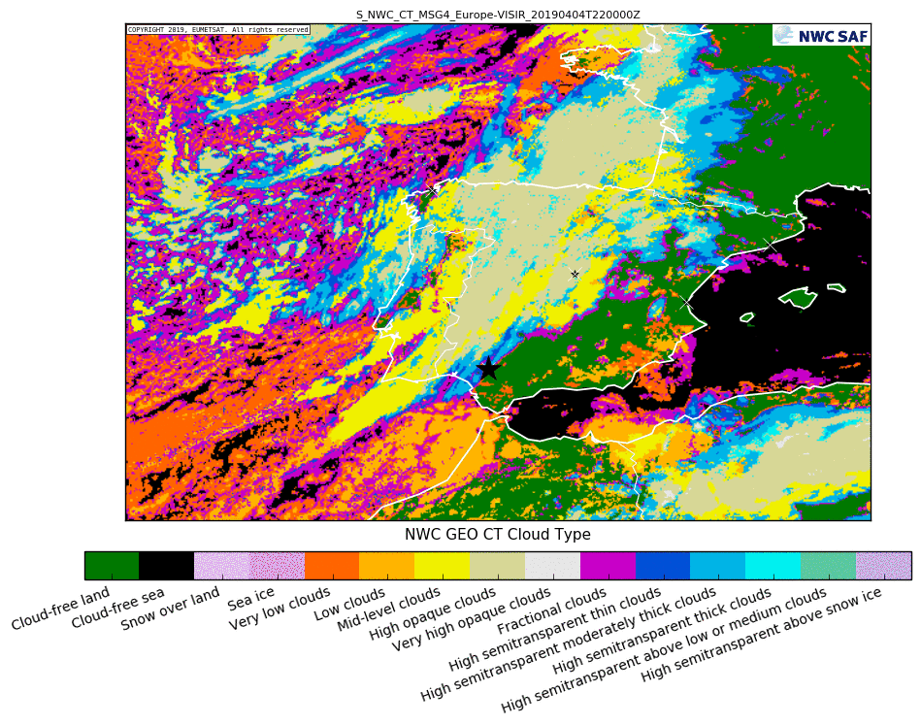
Practical Guide: EXIM
Use with Confidence
Well Tested Product
Know its limitations
EXIM: Extrapolates several NWC SAF products
Very useful products of general purpose (any time)
Easy to interpret
Extrapolate existing structures, dynamic changes in the meteorological parameters cannot be captured. the extrapolation approach
Cloud Type CT
21:00
Extrapolated Cloud Type
21:00 → 22:00
Cloud Type CT
22:00
Cloud Type
4 April 2019

Slide 30
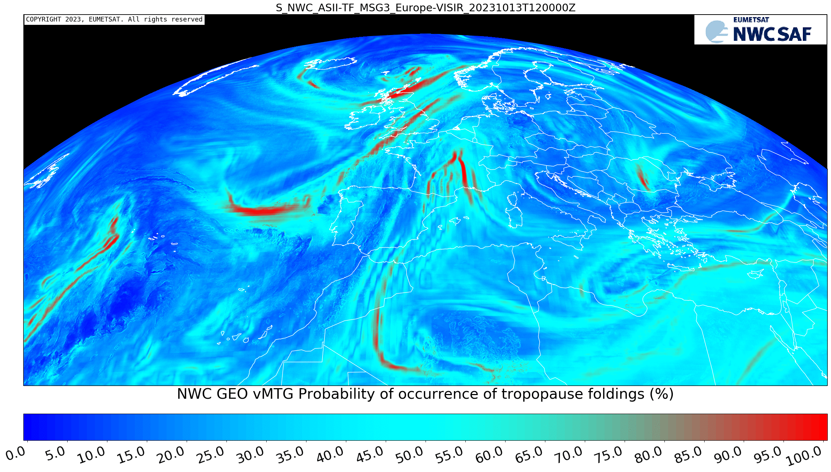
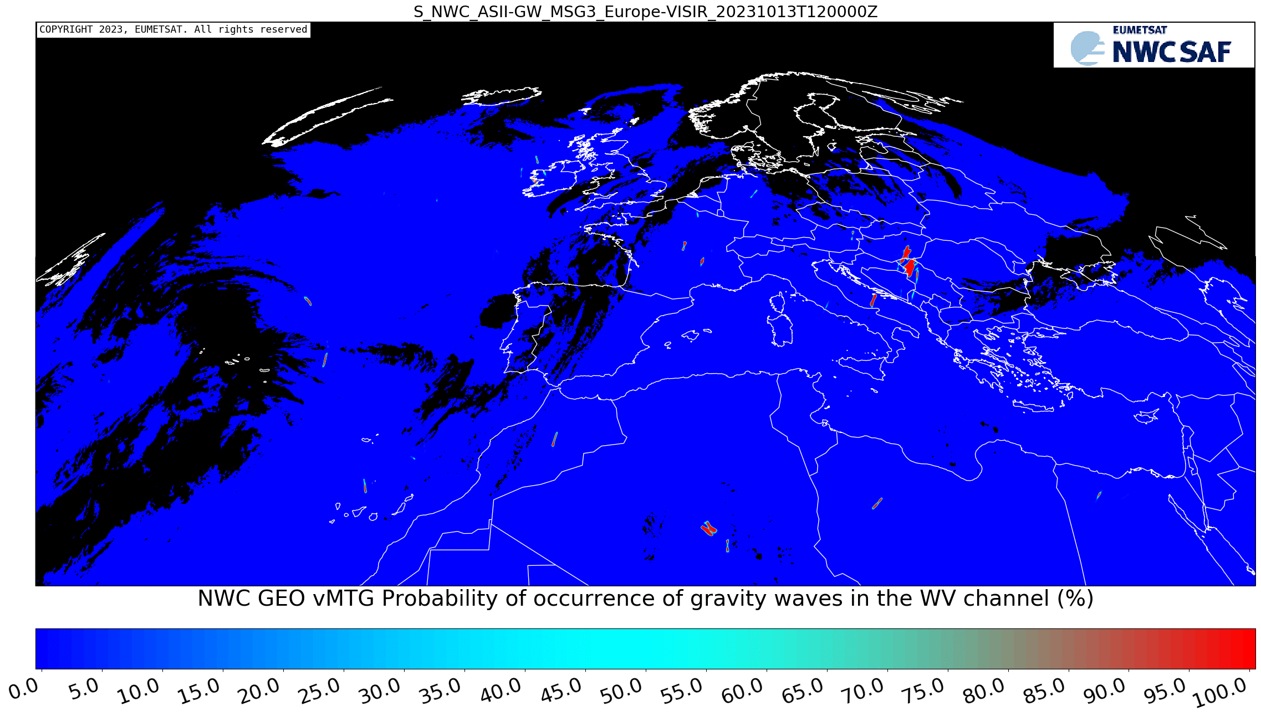
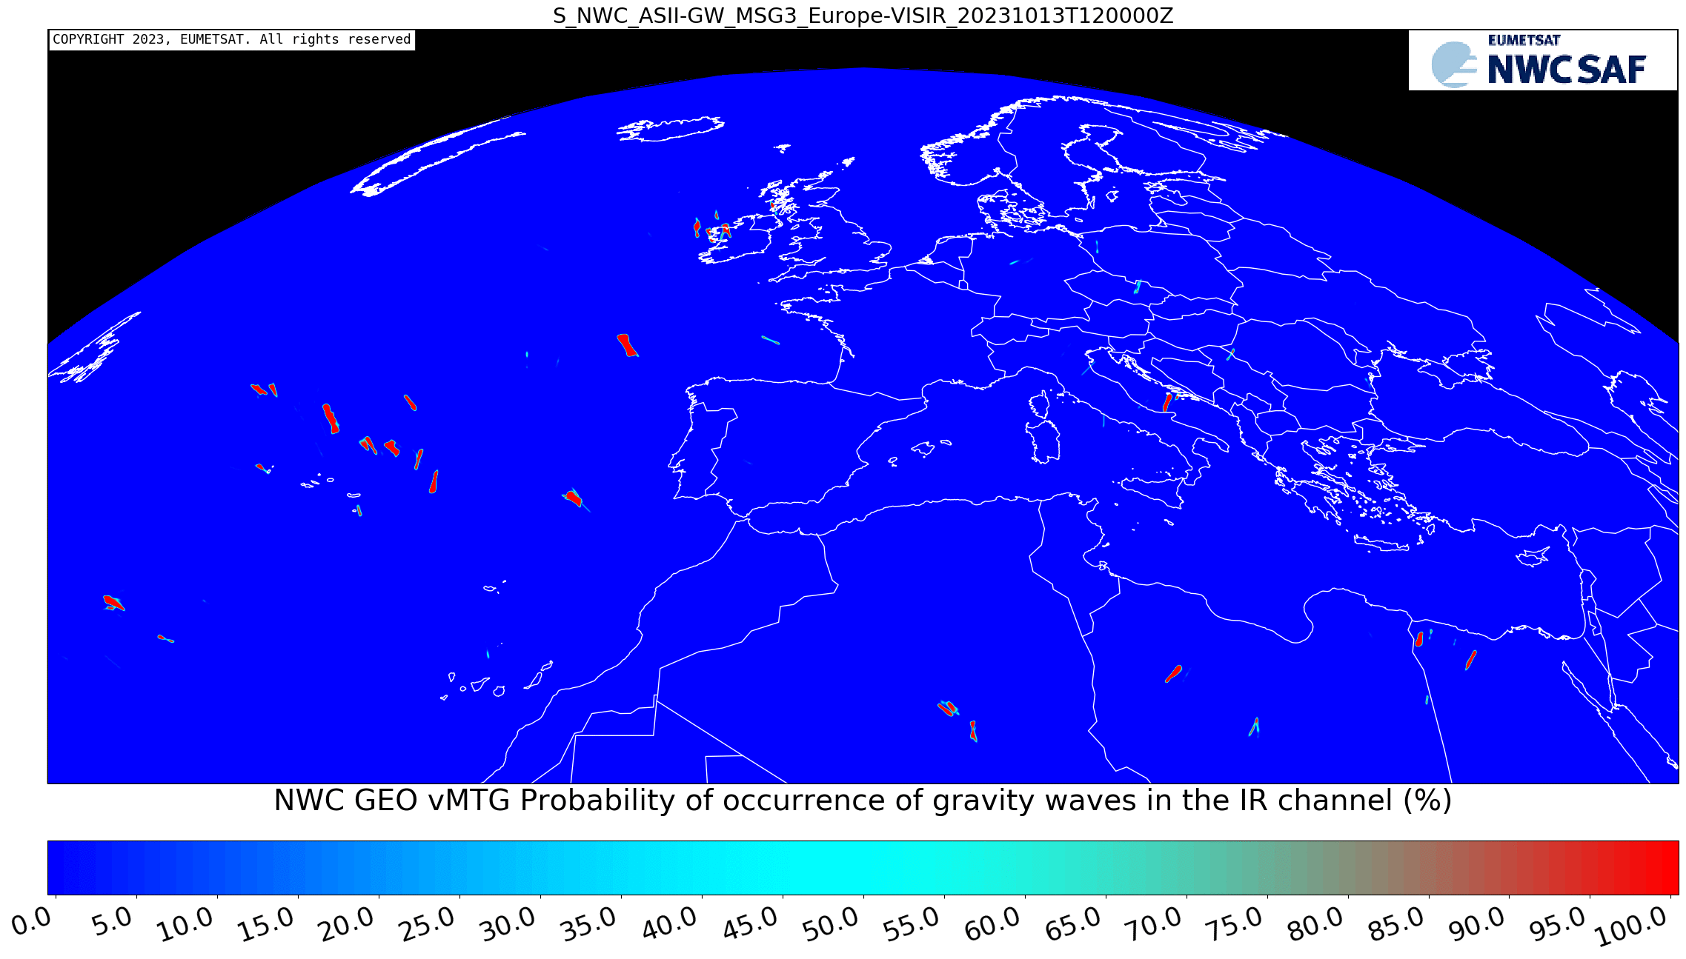
Aviation. Examples 13 October 2023 12:00 UTC
ASII-GW: Probability
of occurrance of gravity waves
From WV 7.3mµ and
IR 10.8 mµ channels
Related to turbulence. High probability in red
ASSI-TF: Probability of occurrence of tropopause folding
These are areas where turbulence close at tropopause altitudes is likely to occur
High turbulence probability regions are shown in red

Slide 31
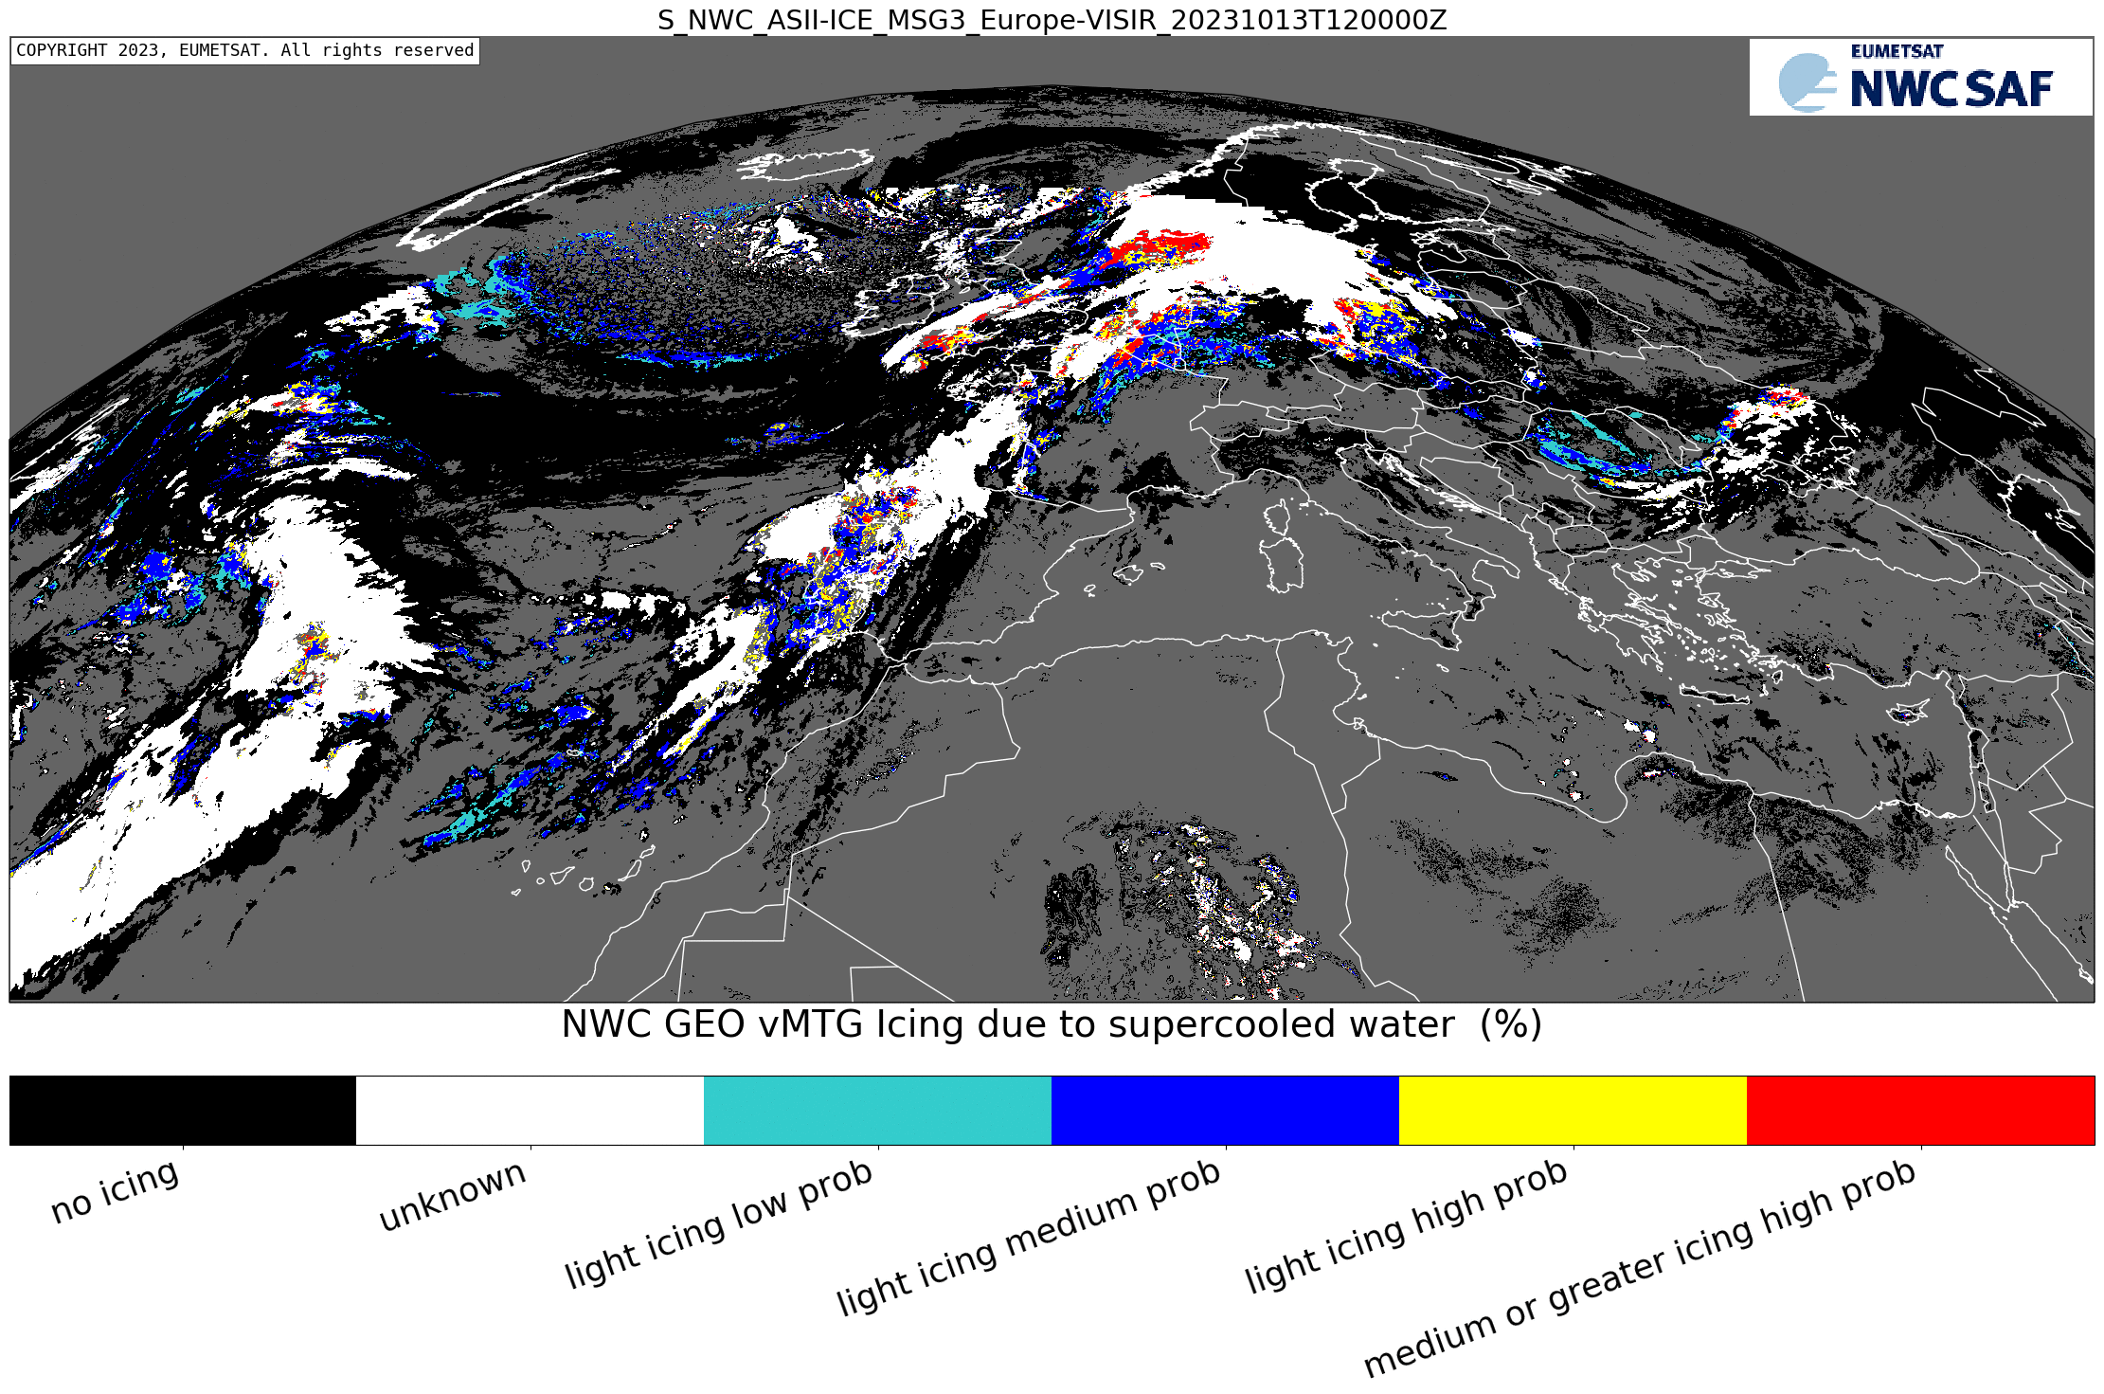
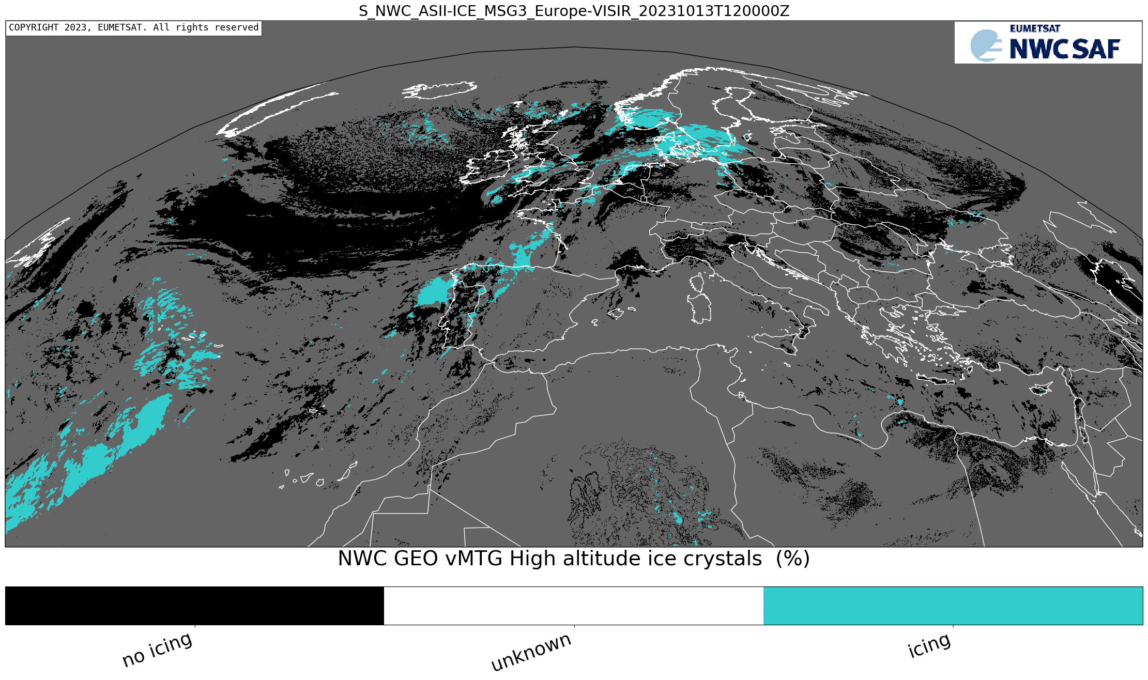
Aviation. Examples 13 October 2023 12:00 UTC. To be released in GEO-I v2024
ASII-ICE in-flight icing due to supercooled water
ASII-ICE Presence of Hight altitude ice crystals
This is day-time product. It is based on the NWC SAF CMIC product

Slide 32
Aviation
CTTH: to know the top heights to fly above them
RDT: to know the position of storms to avoid them
HRW: to localize the jet streams and other areas with high winds

Slide 33
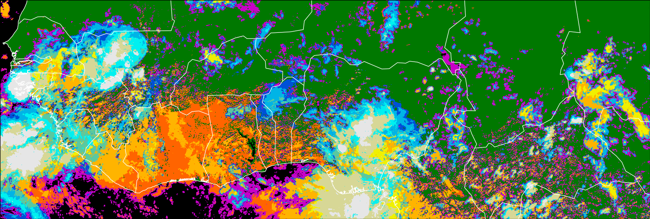
MSG3 CT 27 June 2023 13:00 – 16:45 UTC

Slide 34
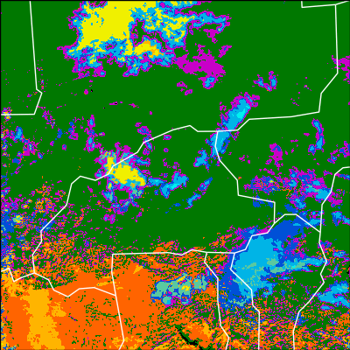
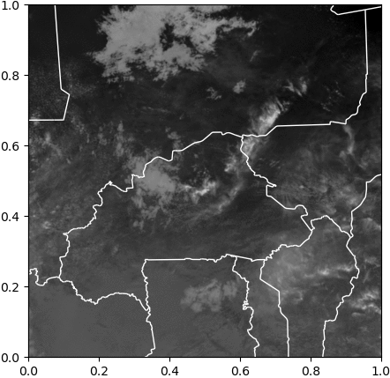
MSG3 27 June 2023 13:00 – 16:45 UTC CT (Cloud Type) CRR (Convective Rainfall Rate mm/h) RDT-CW

Slide 35
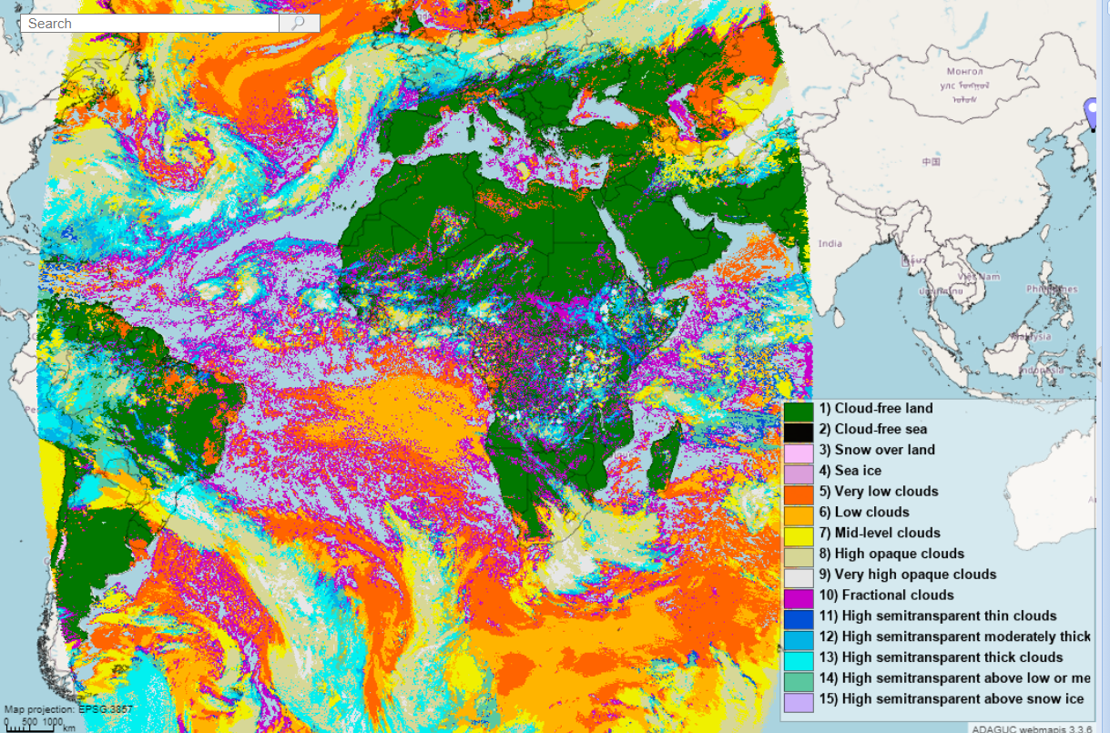
NWC SAF products in EUMETSAT EWC
The NWC SAF (NMA + AEMET teams):
has implemented the production of the NWC SAF products in the European Weather Cloud (EWC) in Near Real Time full disk (MSG, NWC SAF GEO v2021.2)
Has set up an ADAGUC server to show the
products
Products available at
https://adaguc.nwcsaf.eumetsat.ewcloud.host/

Slide 36
NWC SAF products in EUMETSAT EWC
23 October 2023
14:00 – 19:45 UTC
CRRPh + RDT-CW

Slide 37
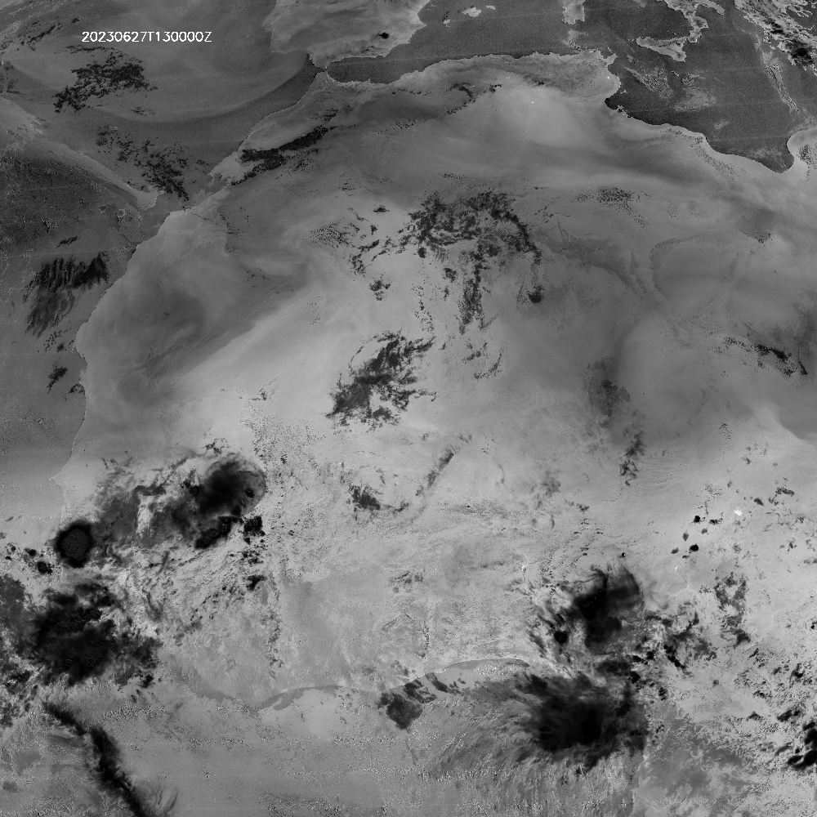
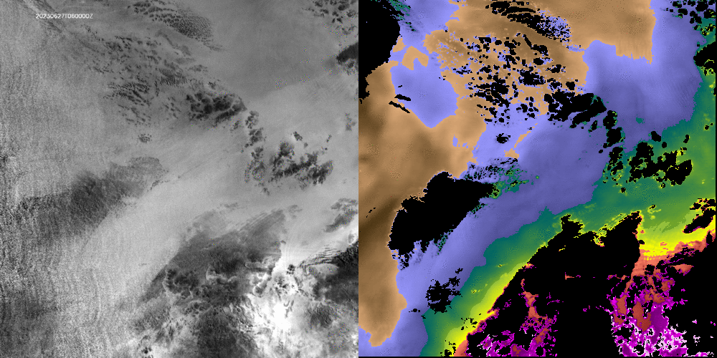
Channel 0.9 µm in MTGI1
(Provisional data MTGTD-488)
Left: Ratio of VIS09 and VIS08 proxy of TPW. Implemented through the difference of the logarithms.
Right: NWC SAF MTGI/FCI TPW iSHAI product from WV and IR channels
General pattern very similar.
Ratio of VIS09 and VIS08 can provide more detailed information (daytime).
2023-06-27 from 06:00Z 18:50Z
NWC SAF is also financing a scientific study to develop an algorithm for total water content from 0.9 and 0.8 channels.
Scientist: Jan el Kassar (FUB)
FCI (log(VIS08)-Log(VIS09)) scaled in range [0, 0.8]
iSHAI TPW (mm)
(Processed on 1x1 FOR)
Image cortesy of Miguel Ángel Martínez (AEMET)

Slide 38
New products in future software releases
New Lightning products (by NMA/Romania)
LiStack
Accumulation of EUMETSAT L2 LI gridded products in the user´s defined time period and region (with option of parallax correction).
To monitor the lightning activity.
Released around end 2024 in a dedicated release.
LiJump
Lightning jump detection (Image like product).
Released at a later stage around 2026.
Simulated MTG LI L2 AFA accumulated product
B. Viticchie, EUMETSAT

Slide 39
New software package NWC/GEO-S
NWC/GEO-S – New products from MTG-S/IRS instrument (by AEMET) First infrared hyperspectral sounder in a geostationary satellite for Europe
qIRS: Tool to manage MTG-S/IRS data: calculates radiances/BTs for channels &
combinations with physical meaning
sSHAI: Atmospheric vertical profiles retrievals (T,q,ozone) and derived stability indices. Integration of surface based measurements to the retrievals will be explored.
sSHAI_ES: Stability indices derived from EUMETSAT Secretariat L2 vertical profiles.
Delivered as Day-2 products in a dedicated NWC/GEO-S software package We aim to integrate GEO-I and GEO-S software packages for synergies of FCI,LI,IRS instruments
15 June 2015 12:00 UTC, Madrid
Comparison of protoptype retrievals with ECMWF forecast and radiosonde
N. Peinado-Galán, AEMET

Slide 40
NWCSAF Services: nwc-saf.eumetsat.int website
Access to Reference systems (GEO and PPS)
Access to NWC/GEO output product image archive.
Description of the products.
General information and documentation, including ATBDs/Validation Reports for all products.
Guides for forecasters (Guides for aviation, Case studies, Topical images gallery).
Workshops, Surveys and Training attended by the NWCSAF, with related info
Visiting Scientist Activities info and results (where external researchers can collaborate with the NWCSAF).
For registered users:
Download NWCSAF SW and other tools
User support via ticketing system
Broader information and documentation

Slide 41
Access to satellite and NWP data
Satellite NRT:
NWC SAF products: ADAGUC EWC
https://adaguc.nwcsaf.eumetsat.ewcloud.host/
RGBs and satellite channels: EUMETView
https://view.eumetsat.int/
Archived NWC SAF produtcs:
https://science.ncas.ac.uk/swift/
NWP:
eumetrain.org -> eport

Slide 42
Thank you very much for your attention!
More information in nwc-saf.eumetsat.int
You can contact us at
pripodasa@aemet.es
safnwchd@aemet.es

