Slide 1
NWCGEO a suite of softwares dedicated to nowcasting and short range forecasting for the belt of geostationnary satellites
Presentation for Central Weather Bureau of Taiwan 24th February, 2023.
E.FONTAINE, X. CALBET, J. A. LAHUERTA, S. PERE, G. KERDRAON, J-M. MOISSELIN, F. AUTONES, J. GARCIA-PEREDA, W.K. WONG, A. WIRTH, A. JANN, P. SCHMEDERER, LL. LLISO, M.A. MARTINEZ, N. PEINADO, M. CLAUDON, O. ALONSO, A. SANCHEZ & P. RIPODAS

Slide 2
INTRODUCTION (前言)
Who are we?
« Satellite Application Facility on support to nowcasting and very short range forecasting » (SAFNWC) is a partnership of 5 european national weather services who are dedicating activities to develop a software to ease the use of meteorological satellite observations (nwc-saf.eumetsat.int).
It is led by Spanish services under the supervising of Pilar Ripodas and funded by the EUMETSAT (european agency for the exploitation of meteorological satellite)
The Five agencies:
Spain (AEMET)
Sweden (SMHI)
Austrian (ZAMG)
Romanian (Meteo-Romania)
France (Météo-France)
What are we doing ?
Developping 2 suites of Softwares for the processing of meteorological satellite observations for1) geostationary orbit (NWCGEO), 2) polar orbit (NWCPPS)in order to ensure their optimum use.

Slide 3
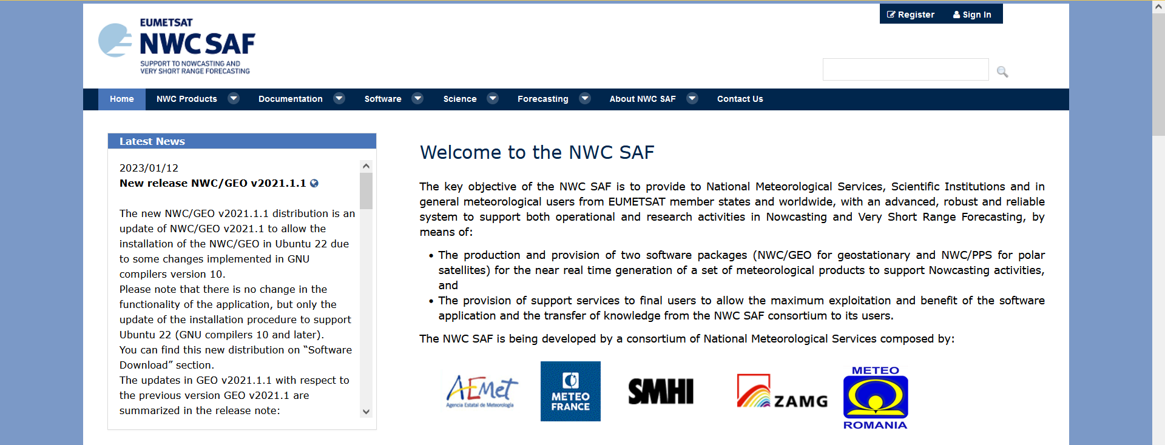
INTRODUCTION (前言)
The Website
Help Desk for assistance and questions
Register first before getting the Software
Lot of Documents to read
Guide to forecasters
GET the SOFTWARES

Slide 4
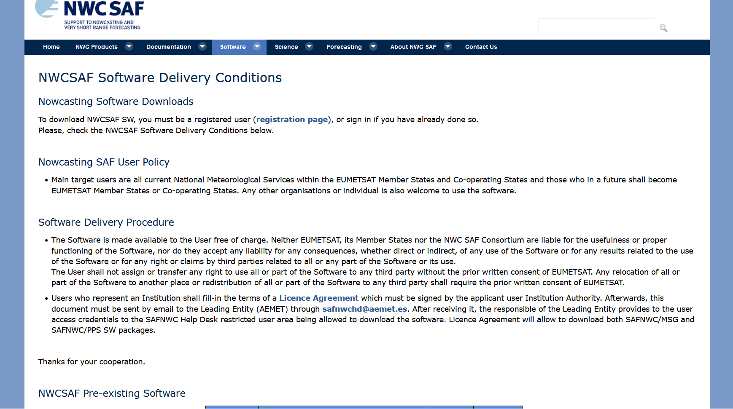
INTRODUCTION (前言)

Slide 5
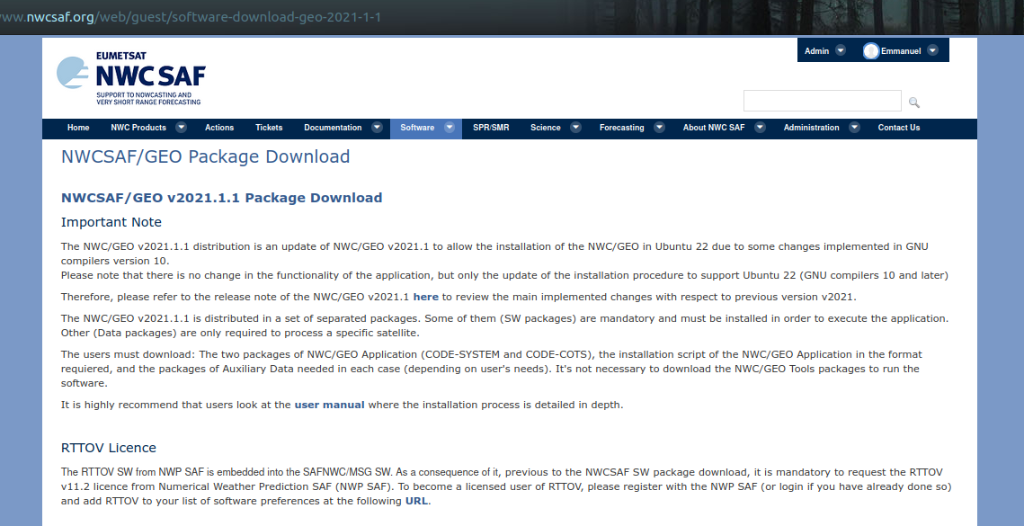
INTRODUCTION (前言)

Slide 6
INTRODUCTION (前言)

Slide 7
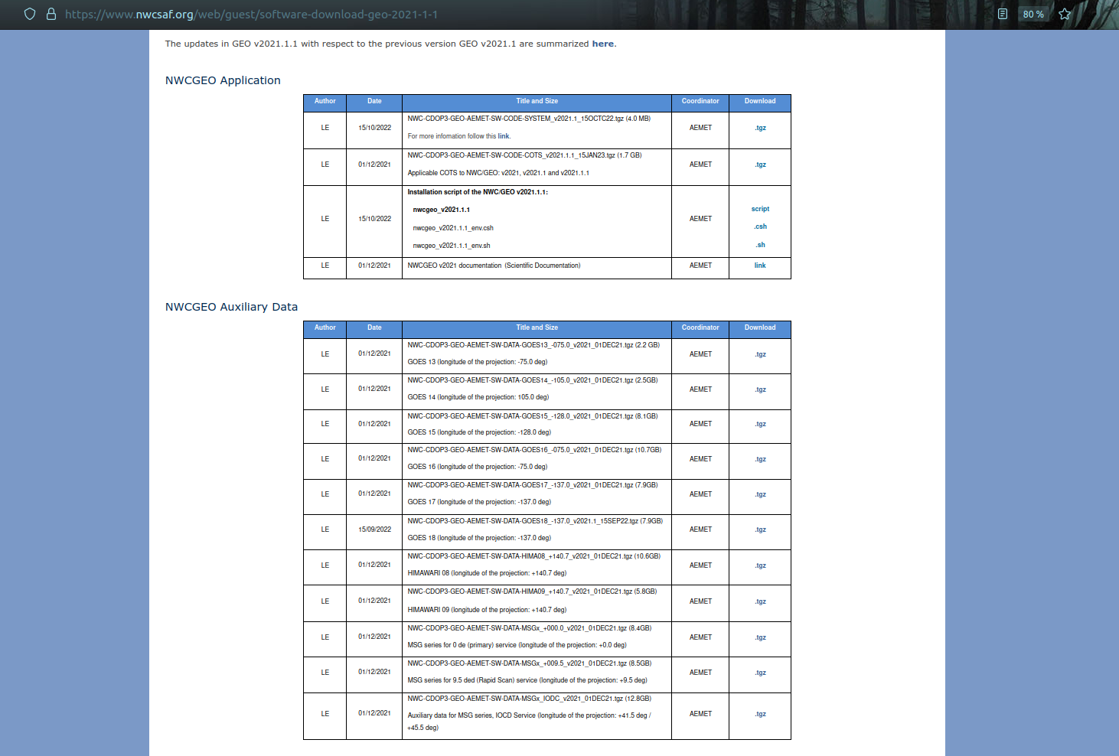
The software (軟體)
The installation takes then only 2 steps, which need less than ONE HOUR to be ready:
+ Download and decompress the software files
(2 different software tar files + 1 Auxiliary dataset for each satellite used).
+ Run the installation script.
Nothing else is needed. All software/libraries/additional elements to run and visualize
NWCSAF NWC/GEO software package are installed and ready to run with this!
Notes:
Accessing the data can be more complicated (satellite, forecast, OSTIA)

Slide 8
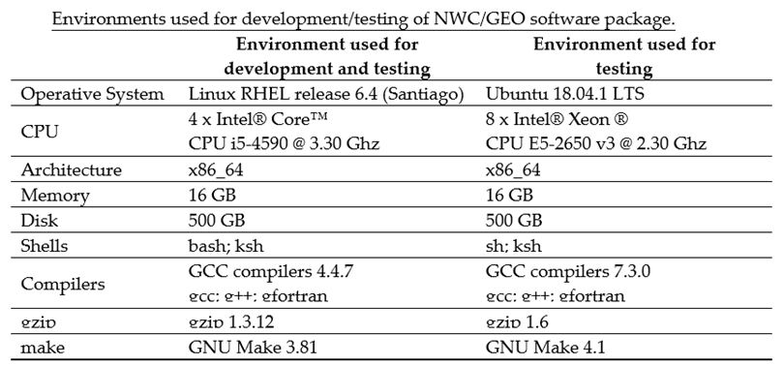
The software (軟體)
Hardware resources needed to run NWC/GEO Software package are relatively small:
Other environments like SUSE and Debian are not officially supported,
but some NWCSAF users have also tested them successfully.

Slide 9
The software (軟體)
NWCGEO officially support
MSG 1/2/3/4,
GOES 16/17/18,
HIMAWARI 8/9,
MTG I1 (commissioning phase)
NWCGEO runs with many options, main ones that must be known :
only satellite (MANDATORY)
Satellite + forecast (GFS, ECMWF, ARPEGE)
Satellite + forecast + SST (OSTIA)
Most of the algorithms are using differences between satellite channels and regards to atmosphere conditions with no clouds
Tresholds tables help to settle the properties of the clouds, precipitation, etc…
When only satellite are the only input, Climatology in the channels’ spectrum satellite are used (less accurate): not all products can be generated without forecast
Forecast allows to calculate radiative conditions of the predicted atmosphere with no clouds (Clear Sky)
SST (from the day before and day before-1) help the radiative transfert simulation and calculating the simulations error (estimation in clear sky over ocean during the night)
Becarefull to the settings you choose, if you provide the satellite observations, the program will not stop if he cannot use the Forecast and SST, it is important to check the log files to make sure they were used during the processing if you were willing to !

Slide 10
The software (軟體)
WE DO NOT PROVIDE THE DATA BUT THE SOFTWARE, USERS ARE FREE TO USE THE CONFIGURATION THEY PREFER
NWCGEO what is it exactly ?
A suite of Software than can be operated automatically and with a period shorter than the geostationary satellite
(all MTG disc tested in operational environment)
NWCGEO SOFTWARES (Products)
CLOUDS | PRECIPITATION | CONVECTION | HUMIDITY & INSTABILITY | WINDS | CONCEPTUAL MODEL | EXTRAPOLATED
Mask (CMA) | Precipitating clouds (PC ) | Rapid developing thunderstorms (RDT) | iSHAI: Total precipitable water | HRW: High resolution winds AMV levels | ASII: Automatic Satellite Interpretation | EXIM: cloud mask
Classification (CT) | Convective Rate (CRR) |  | iSHAI: Layer precipitable water | HRW: High resolution winds AMV speed | ASII-TF: Tropoause Folding detection | EXIM: Cloud Type
Height (P, T, z) (CTTH) | Precipitating clouds* (PCPh) | Convective Initiation (CI) | iSHAI: Stability analysis Imagery | HRW: High resolution winds trajectories 1H | ASII-GW: Gravity Wave pattern detection | EXIM: Cloud top height
Microphysic (I/LWP,COT, REFF) (CMIC) | Convective Rate* (CRRPh) |  |  | HRW: High resolution winds trajectories 3H |  | EXIM: Cloud Phase
Acronym | Processing time |  | Acronym | Processing time
CMA | 62s |  | ISHAI | 615s
CT | 14s |  | HRW
CTTH | 35s |  | EXIM
CMIC | 61s |  | ASII-TF | 41s
PC | 6s |  | ASII-GW | 749s
CRR | 19s |  | ASII-ICE | 6s
PCPh | 11s |  | CI | 59s
CRRPh | 11s |  | RDT-CW | 56s
Only with weather forecast
* Based on Clouds Products

Slide 11
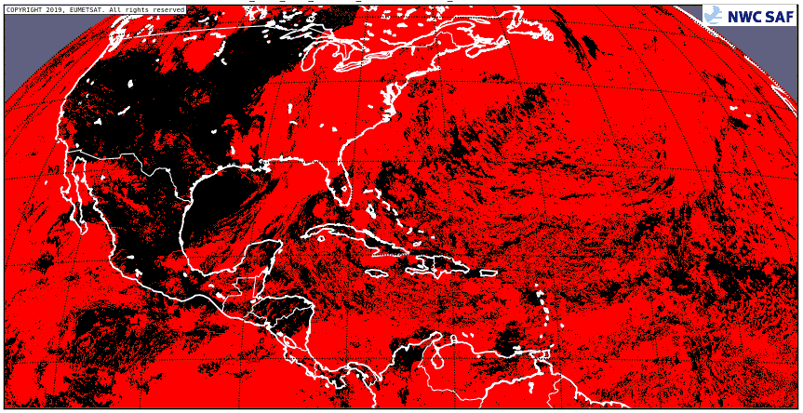
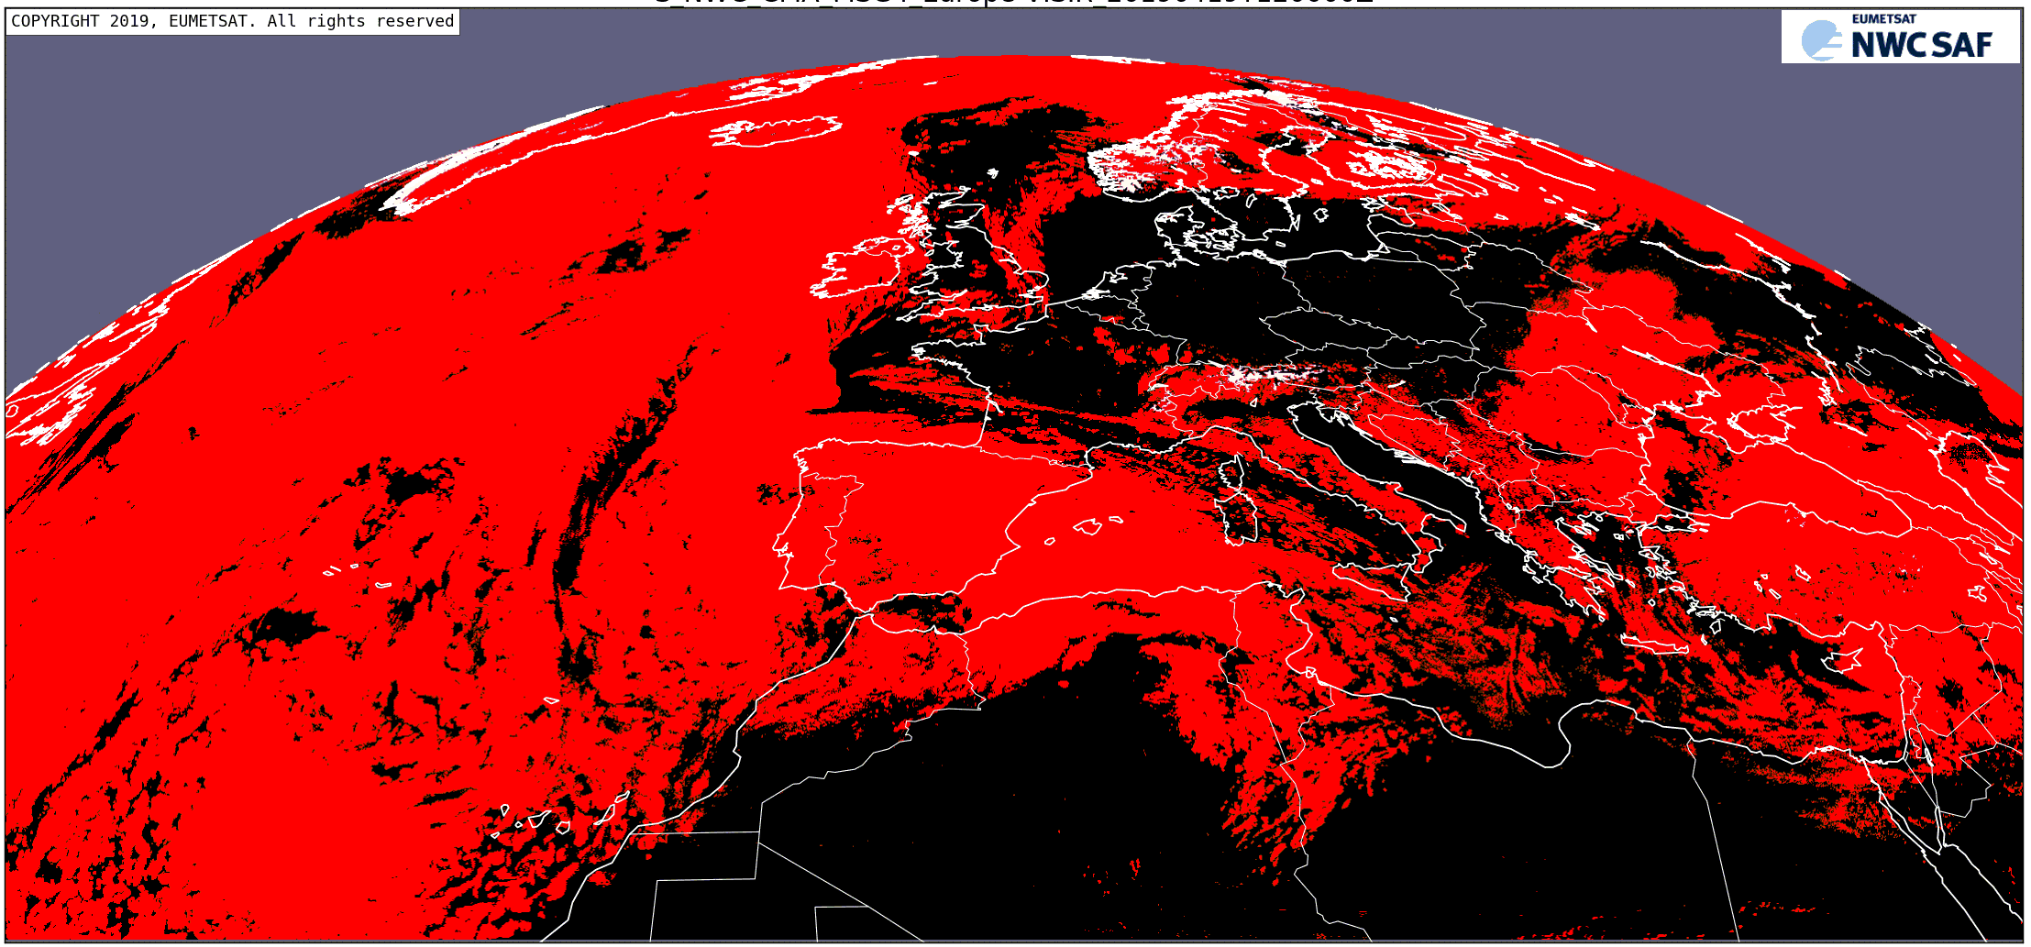
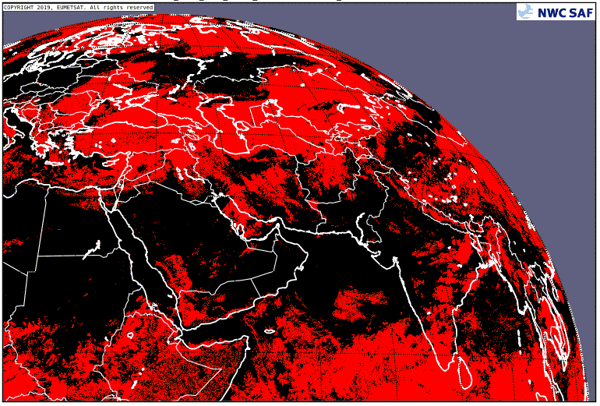
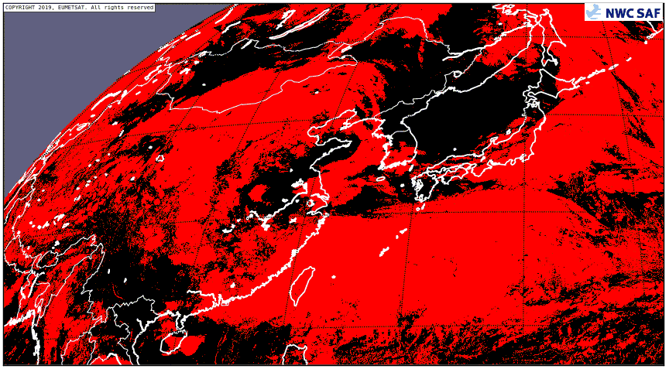
The satellite products (衛星生產)
GOES 16
MSG4
MSG I (IO)
HIMAWARI 8
CMa – Cloud Mask: cloud detection, and snow detection during daytime.
- Used as a complement to visible images during the day.
- More useful during the night, due to difficulties to identify some low cloud types in IR images.
* Based on Clouds Products

Slide 12
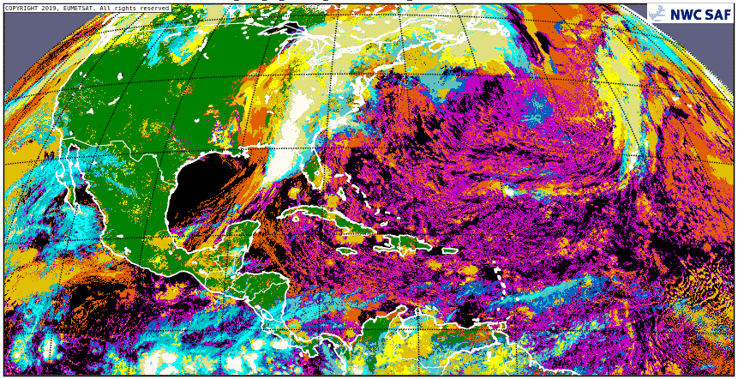
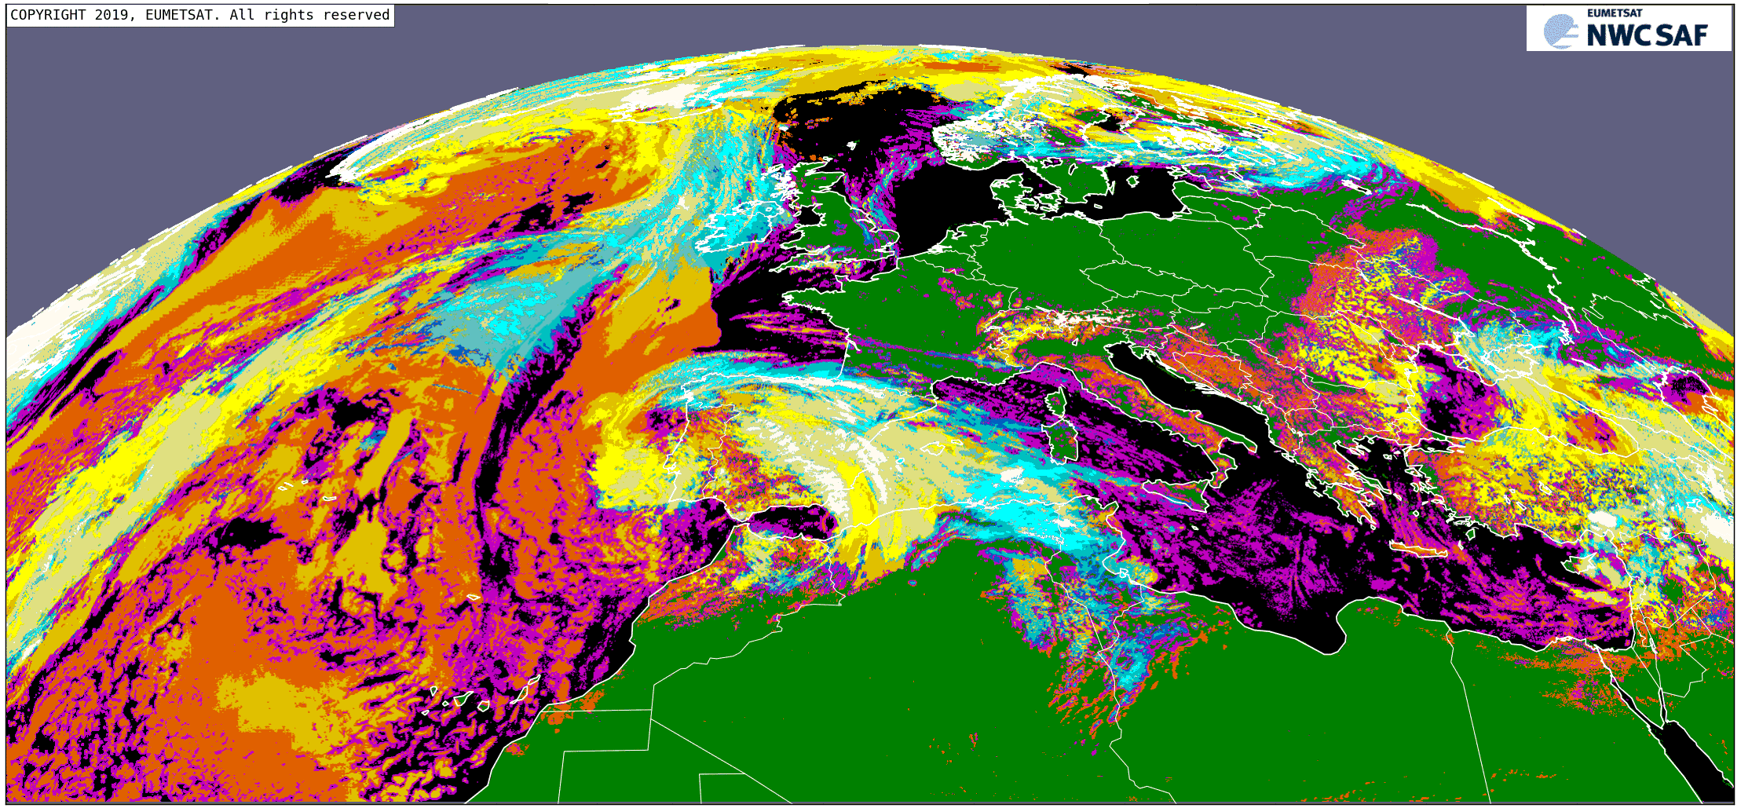
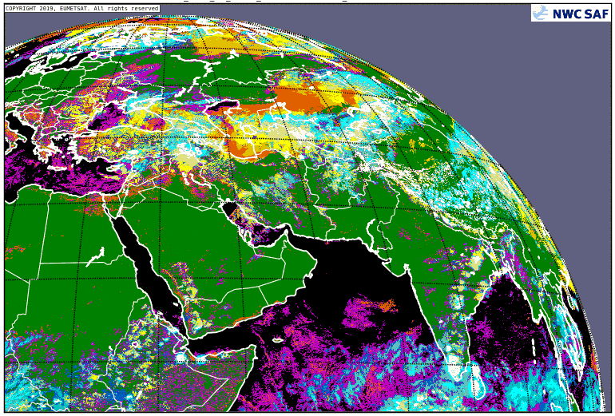
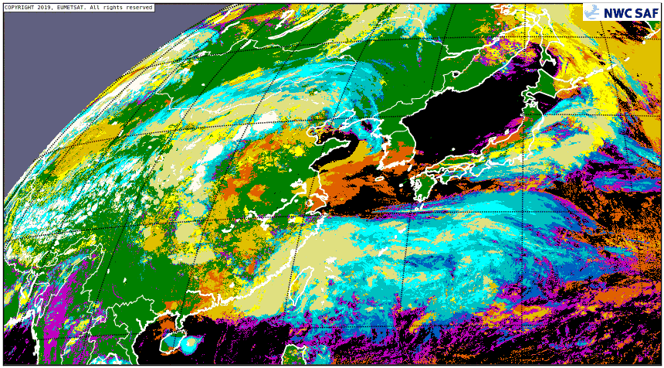
The satellite products (衛星生產)
GOES 16
MSG4
MSG I (IO)
HIMAWARI 8
CT – Cloud type
- Cloud classification based on the “opacity/transparency” and “level of the cloud top”.
(Ex: “Cb” classified as “high opaque cloud”).

Slide 13
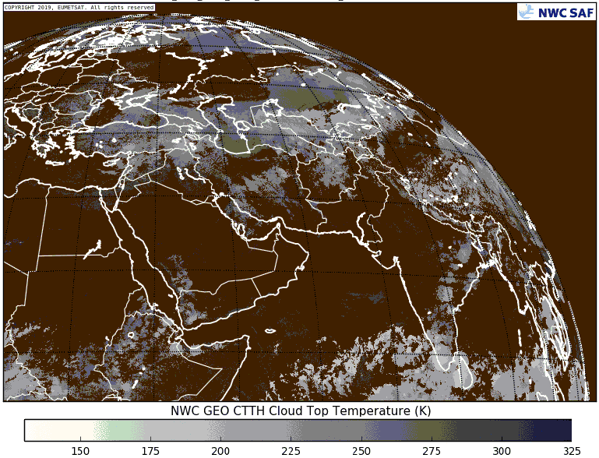
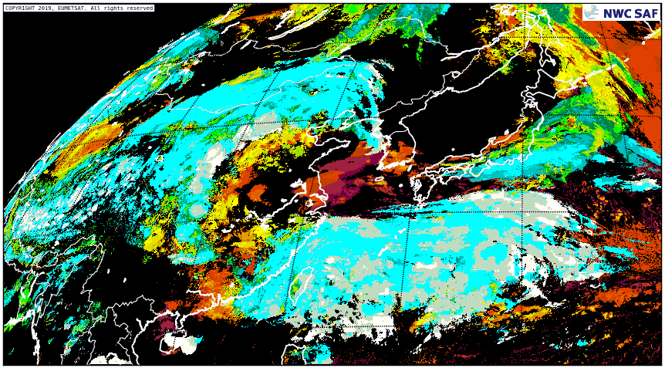
The satellite products (衛星生產)
GOES 16
MSG4
MSG I (IO)
HIMAWARI 8
CTTH: Cloud top pressure (up), cloud top temperature (down left), cloud top height (down right).
- “Fractional clouds” not having CTTH outputs.

Slide 14
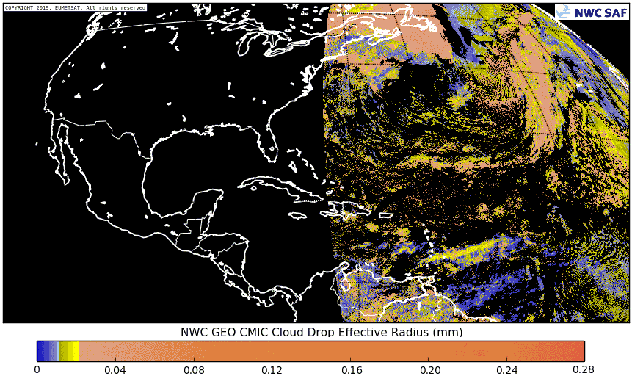
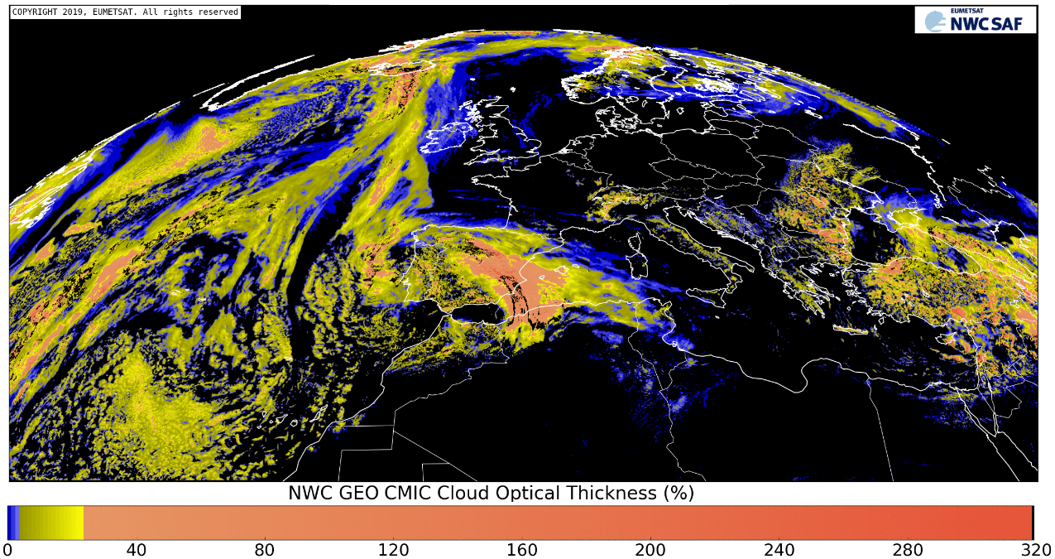
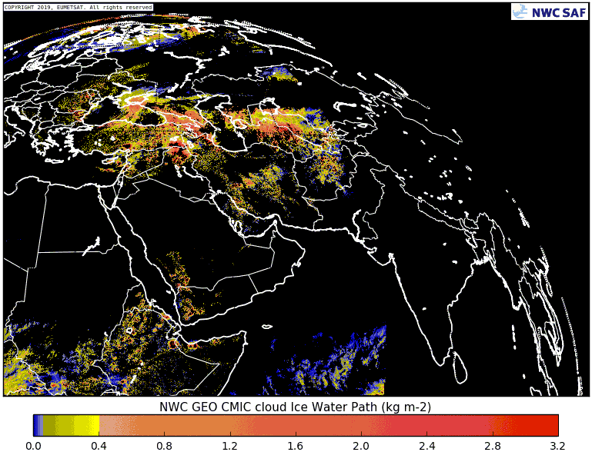
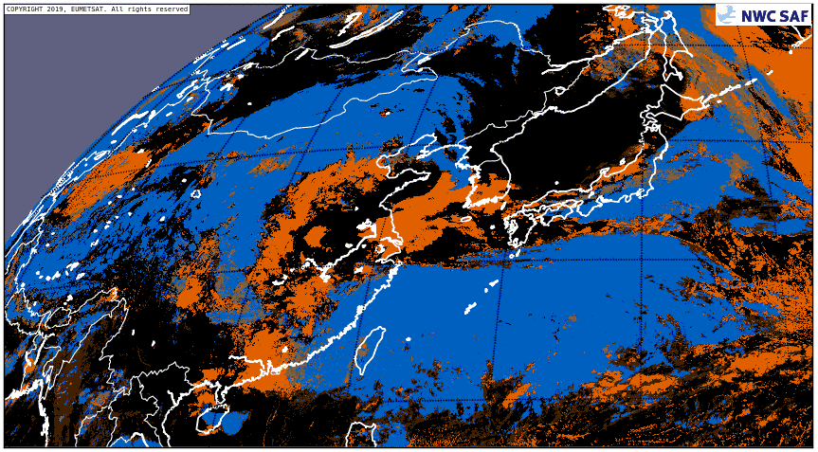
The satellite products (衛星生產)
GOES 16
MSG4
MSG I (IO)
HIMAWARI 8
CMIC: Cloud drop effective radius (up left), Cloud optical thickness (up right),
Liquid/Ice water path (down left), Cloud top phase (down right).
- Only “Cloud top phase” parameter available for night, twilight, mixed/undefined phase.

Slide 15
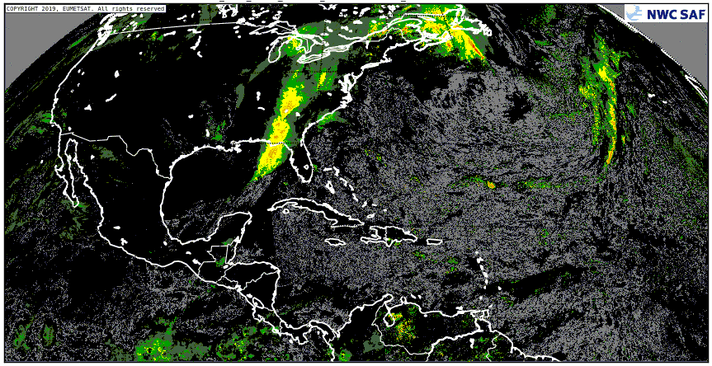
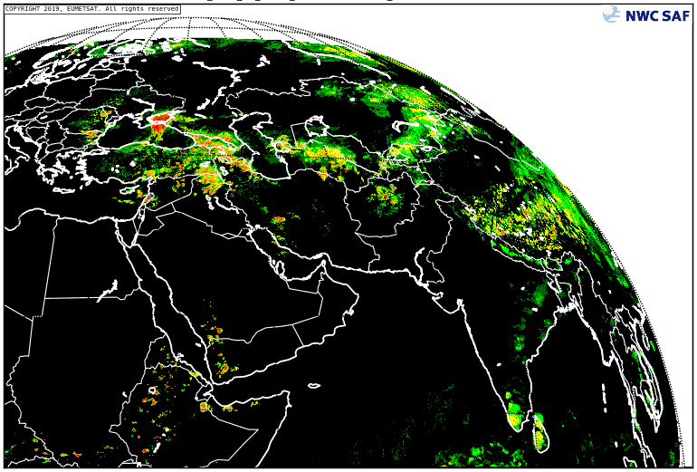
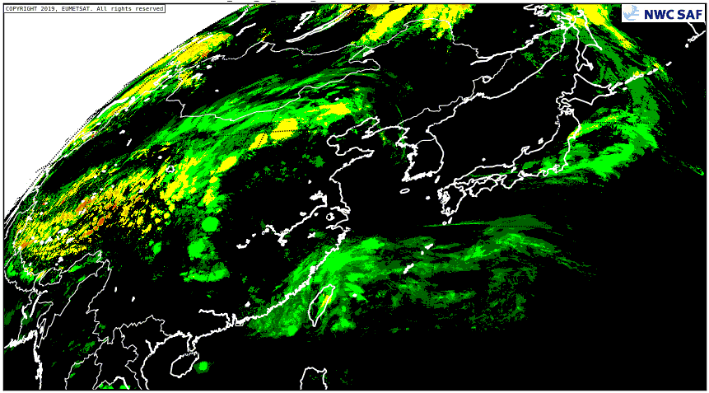
The satellite products (衛星生產)
GOES 16
MSG4
MSG I (IO)
HIMAWARI 8
PC – Precipitating Clouds (down) and
PCPh – Precipitating Clouds based on Cloud Microphysics (up)
- Probability of precipitation for all precipitation, but working better for convective precipitation.
- Useful when radar not available, with preference for PCPh product.

Slide 16
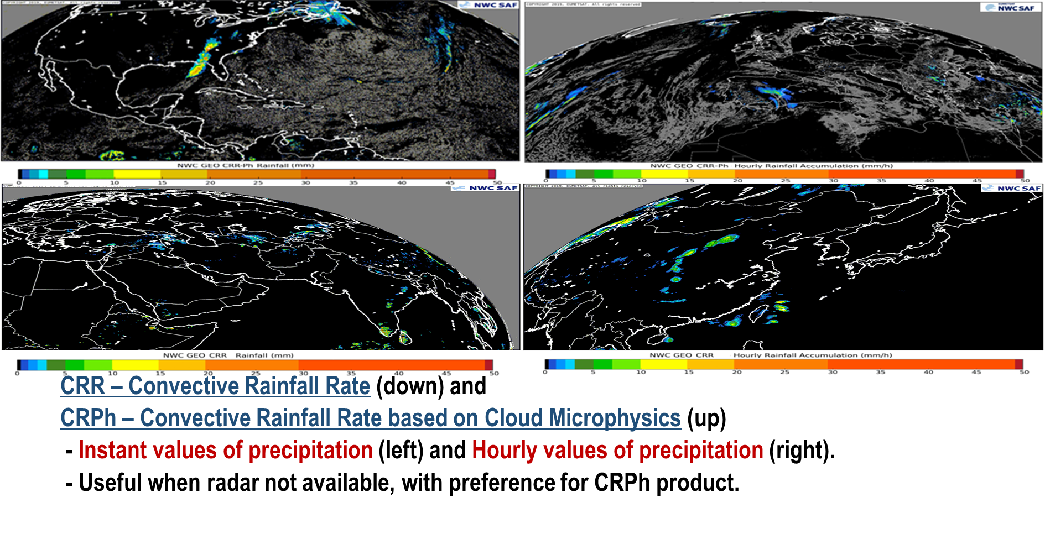
The satellite products (衛星生產)
GOES 16
MSG4
MSG I (IO)
HIMAWARI 8

Slide 17
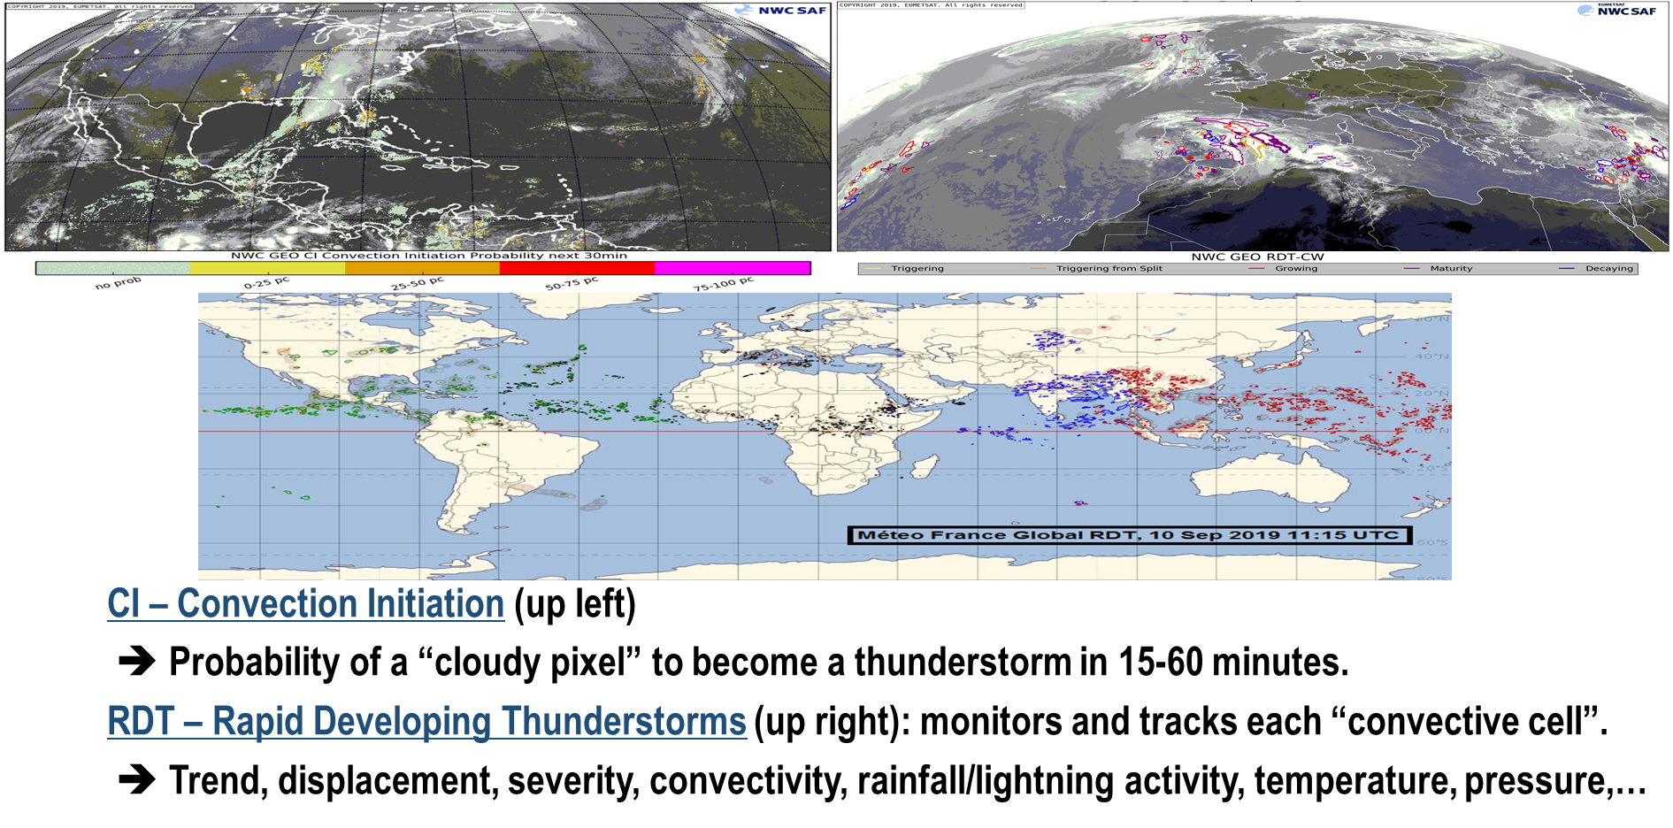
The satellite products (衛星生產)
GOES 16
MSG4

Slide 18
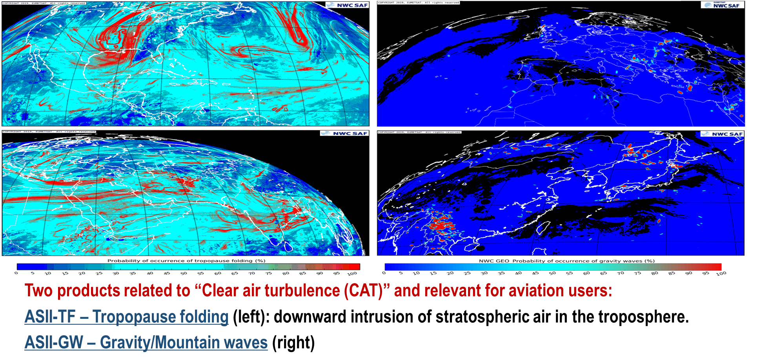
The satellite products (衛星生產)
GOES 16
MSG4
MSG I (IO)
HIMAWARI 8

Slide 19
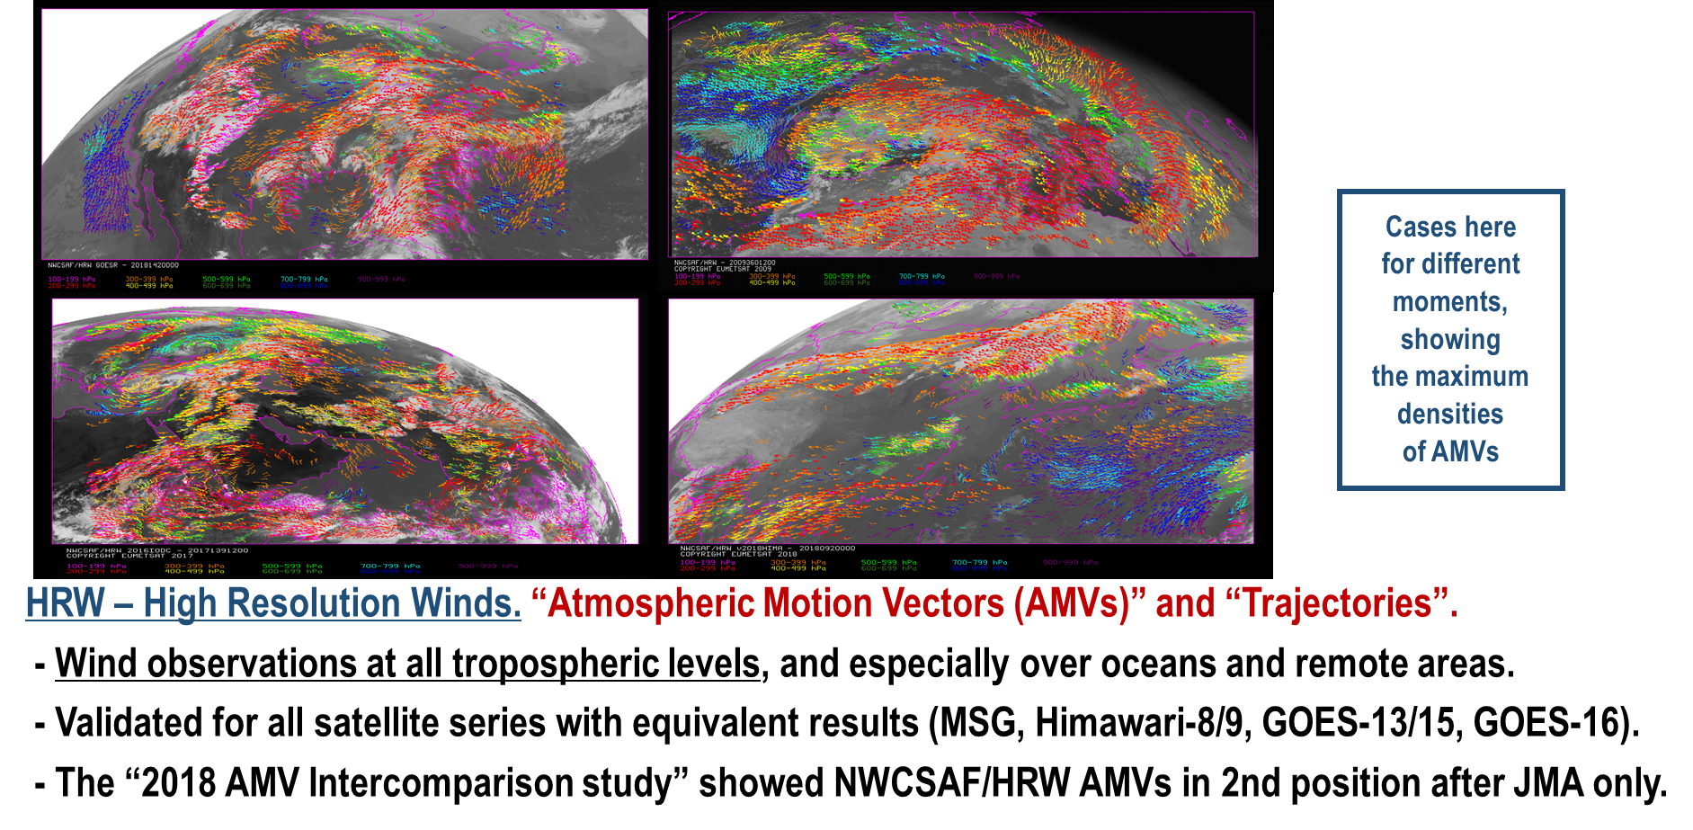
The satellite products (衛星生產)
GOES 16
MSG4
MSG I (IO)
HIMAWARI 8

Slide 20
The satellite products (衛星生產)

Slide 21
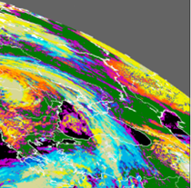
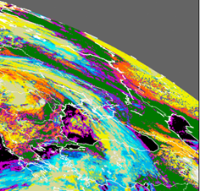
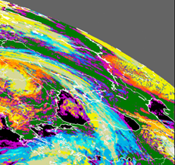
The satellite products (衛星生產)
EXIM – Extrapolated Imagery
- Kinematic extrapolation up to 1 hour of
satellite images and NWCSAF Cloud & Precipitation products.
- Possible for all satellites;
an example of NWC/GEO Cloudy Type EXIM output with MSG-4 satellite shown here:
Observation 21/May/2019 10:00Z
Observation 21/May/2019 09:00Z
Predicted 21/May/2019 10:00Z

Slide 22
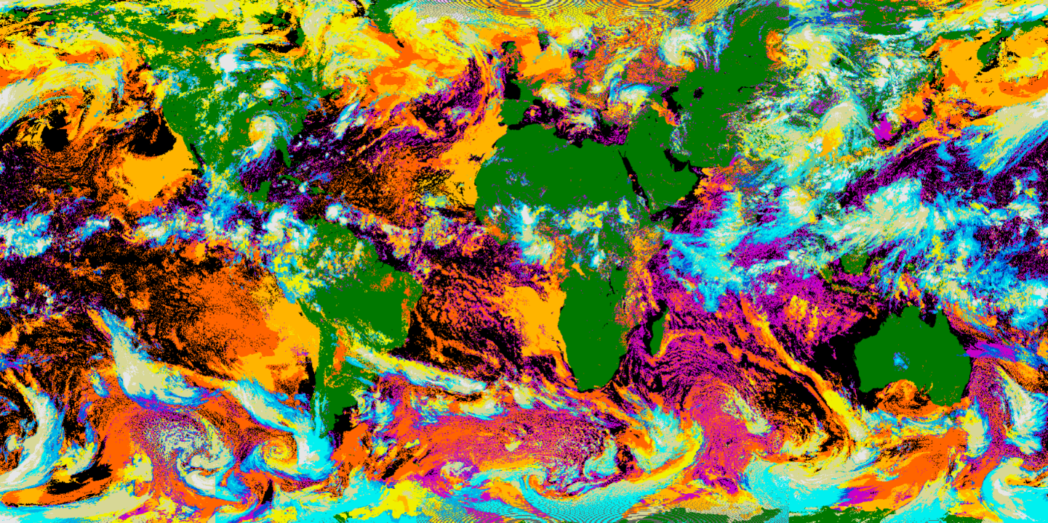
The satellite products (衛星生產)
(MSG 2)
Cloud products on a world map
Example with cloud classification

Slide 23
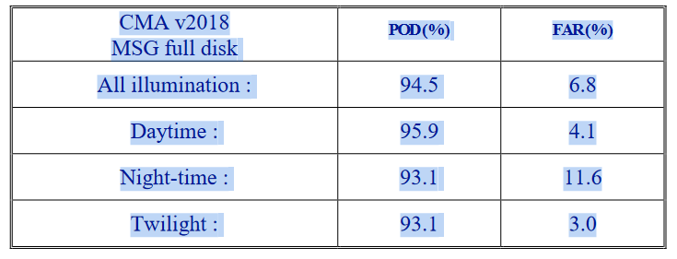
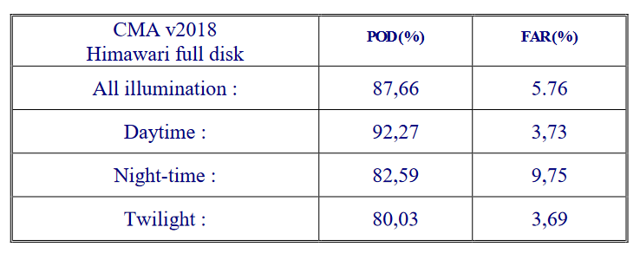
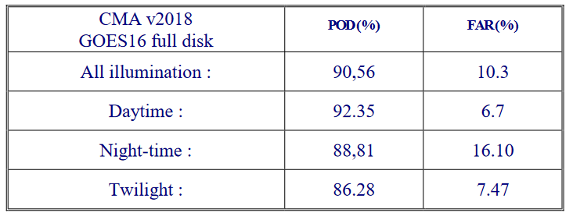
SOME COMPARISON (比較)
Comparison of Cloud Mask with SYNOP observations and ship observations
Treshold accuracy : POD>85% and FAR<20%
Target accuracy : POD > 90% and FAR<15%

Slide 24
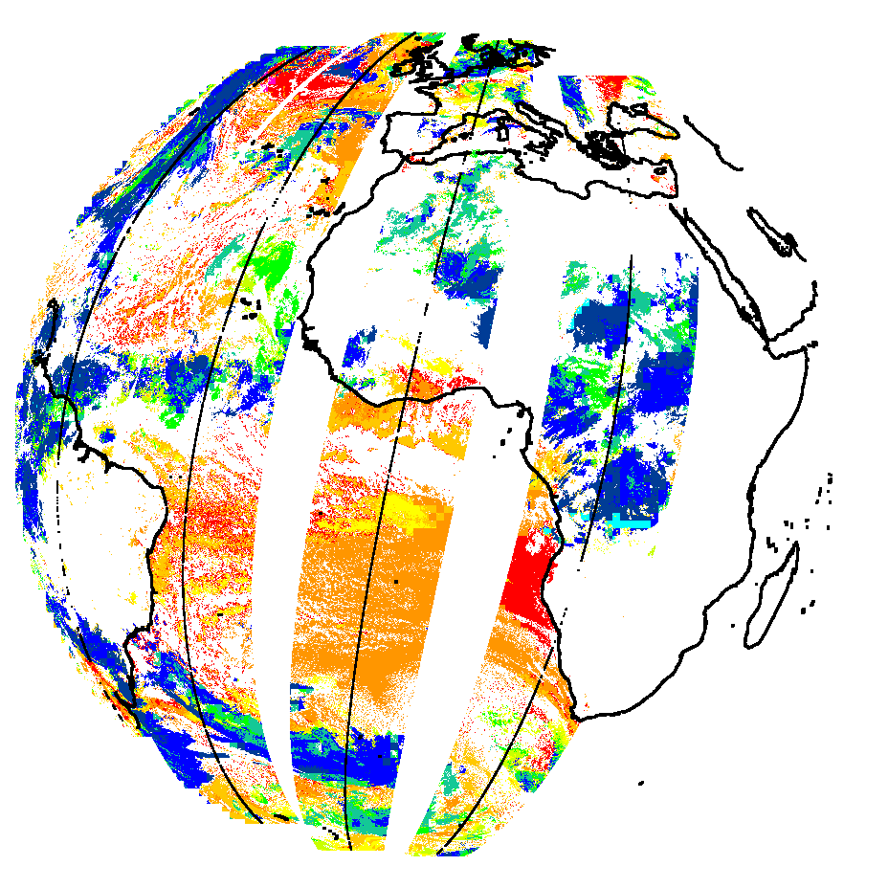
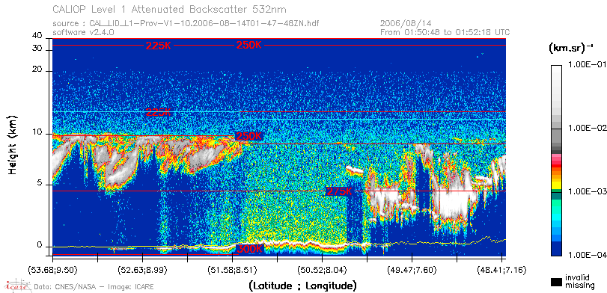
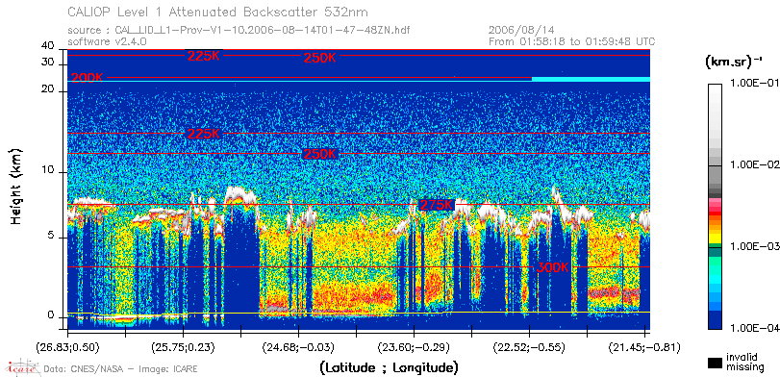
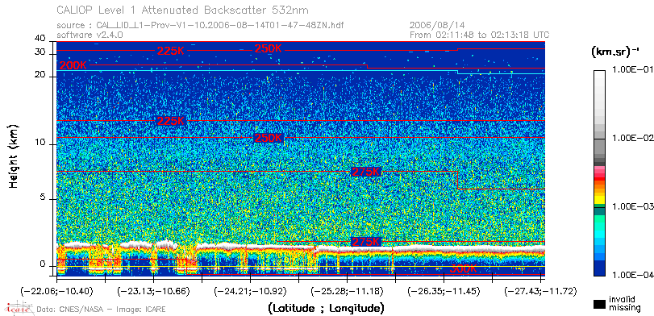
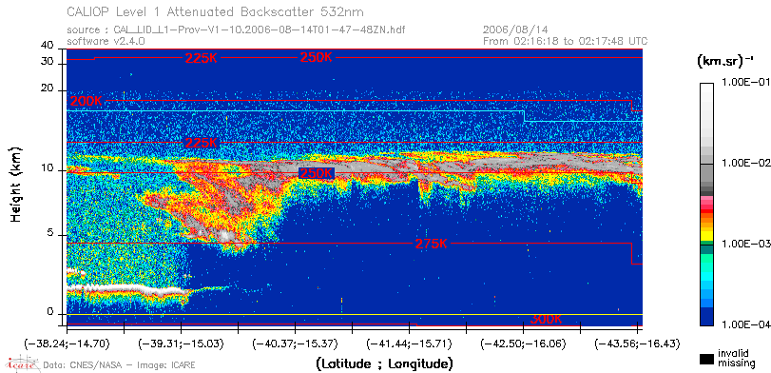
SOME COMPARISON (比較)
Comparison of CT and CTTH with RADAR and lidar observation (DARDAR Delanoë et al.,2010)
CTTH from MSG4
Obs. Lidar
100hPa
500hPa
1000hPa

Slide 25
SOME COMPARISON (比較)
Comparison of CT with lidar observation (DARDAR Delanoë et al.,2010)
CTTH from MSG4
Obs. Lidar
OPTIMAL ACCURACY | 90%
TARGET ACCURACY | 70%
TRESHOLD ACCURACY | 50%
POD for | LOW CLOUDS | SEMI-TRANSPARENT | HIGH CLOUDS
MSG 4 | 94% | 75% | 92%
GOES 16 | 91% | 75% | 83%
HIMAWARI 8 | 88% | 76% | 88%
GOES 17 | 92% | 77% | 87%

Slide 26
SOME COMPARISON (比較)
Comparison of CTTH with lidar and cloud radar observations (DARDAR Delanoë et al.,2010)
CTTH from MSG4
Obs. Lidar
Opaque clouds | Bias (km) | Std (km)
MSG | -0,46 (-0,31) | 0,93 (0,73)
Himawari 8 | -0,82 (-0,56) | 1,21 (0,96)
GOES 16 | -0,62 | 1,12
GOES17 | -0,38 | 1,08
Treshold accuracy (opaque clouds) | Bias < 1km Std<2km
Treshold accuracy for semi-tranpasrent clouds | Bias<2km Std<2,5km
Semi-Transp. | Bias (km) | Std (km)
MSG | -1,26 (0,44) | 1,97 (1,90)
HIMAWARI 8 | -1,41 (0,5) | 2,19 (2,06)
GOES 16 | -1 | -2,01
GOES17 | -0,36 | -1,9

Slide 27
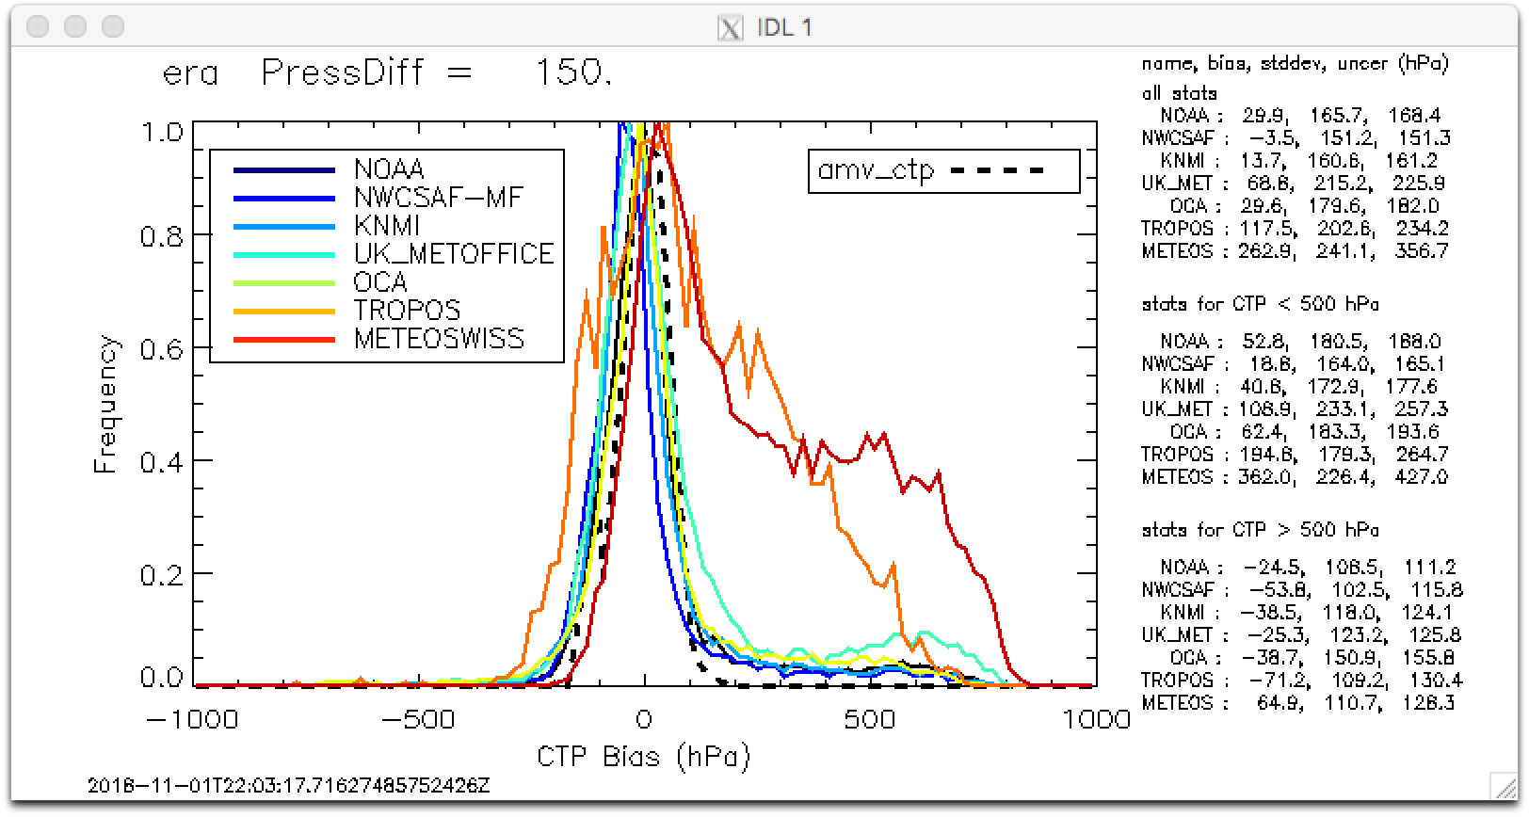
SOME COMPARISON (比較)
2nd International cloud working group 2018
MSG2 13/06/2008

Slide 28
R&D Until 2027 (研究與開發)
Research and development phase for SAFNWC are planned over a period of 5 years : we are actually in the phase 4 :
Up coming of vMTG day1 (2024): after commissioning phase of MTG (start in the mid o 2023)
Version MTG day2 (2026):
Microphysic day and night (CMIC), Product at visible resolution (1km @ nadir), Improvement of handle multi-layer clouds, Cloud top height for fractionnal clouds, Flag Stratiforme/cumuliforme clouds
Scientific studies :
Use of machine learning
Use of hyper spectral MTG launch (2025)
Visiting scientist program

Slide 29
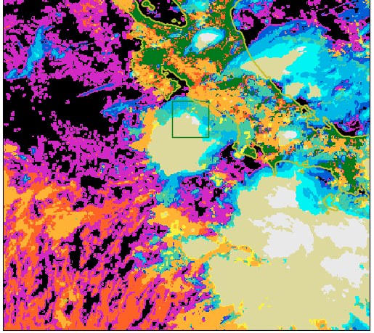
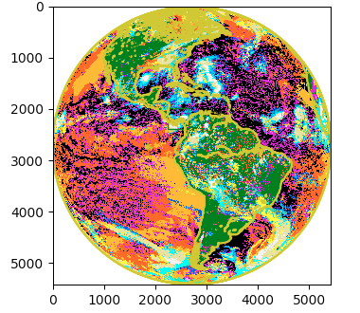
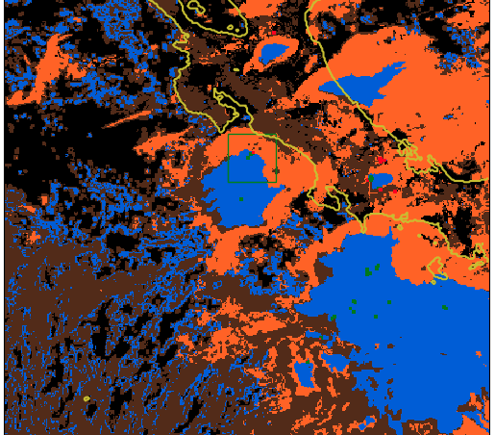
R&D Until 2027 (研究與開發)
One example: The Flag Stratiform/Cumuliforme
Cloud type Goes16
15 September 2021 17:30UTC
Flag – Stratiforme/Cumuliforme
Version MTG day 2
Cumuliforme
Stratiforme
GLM flash
unknown

Slide 30
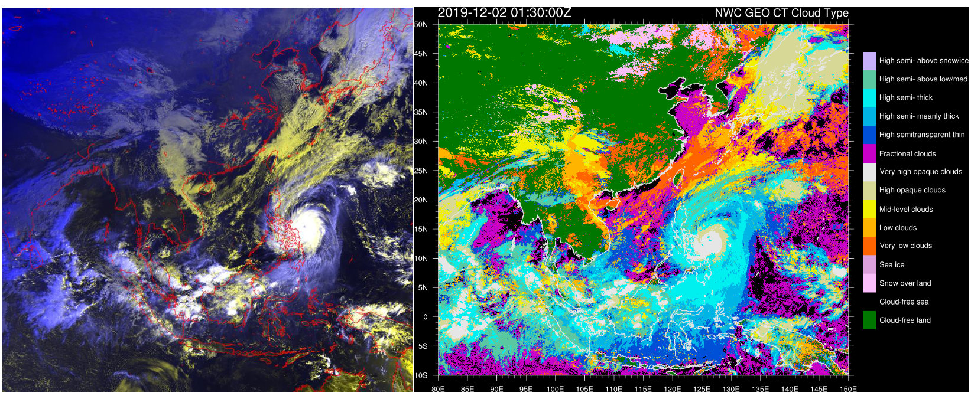
Case Study (舉例)
Example with Kammuri Typhoon december 2nd 2019

Slide 31
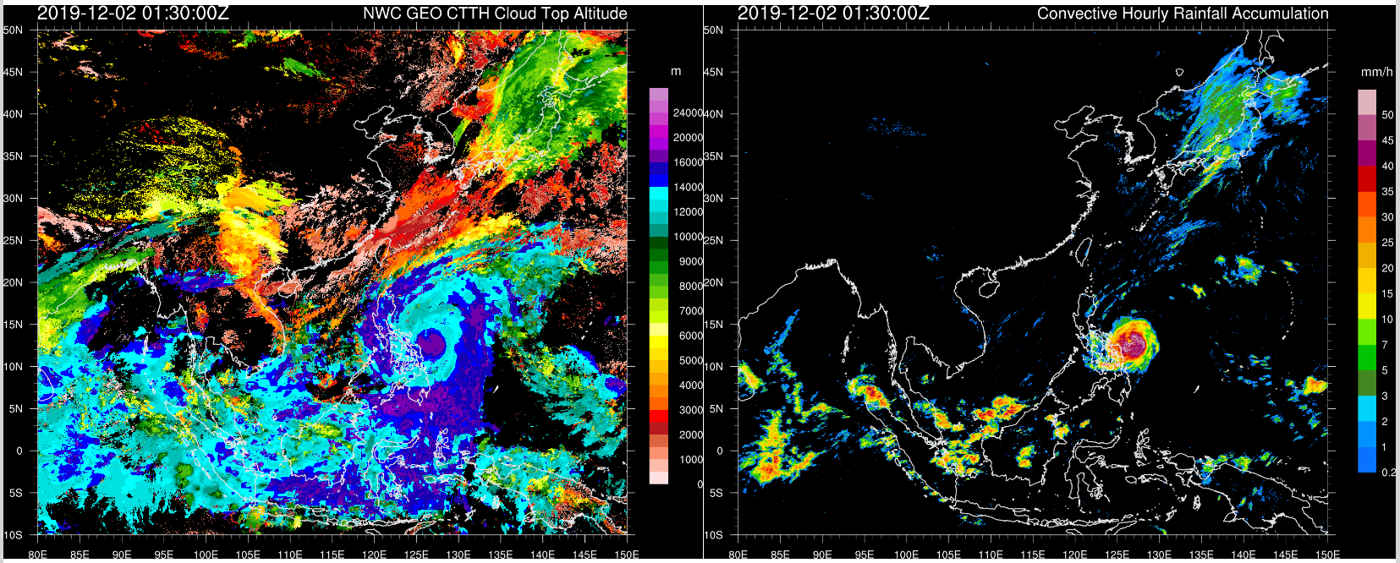
Case Study (舉例)
Example with Kammuri Typhoon december 2nd 2019

Slide 32
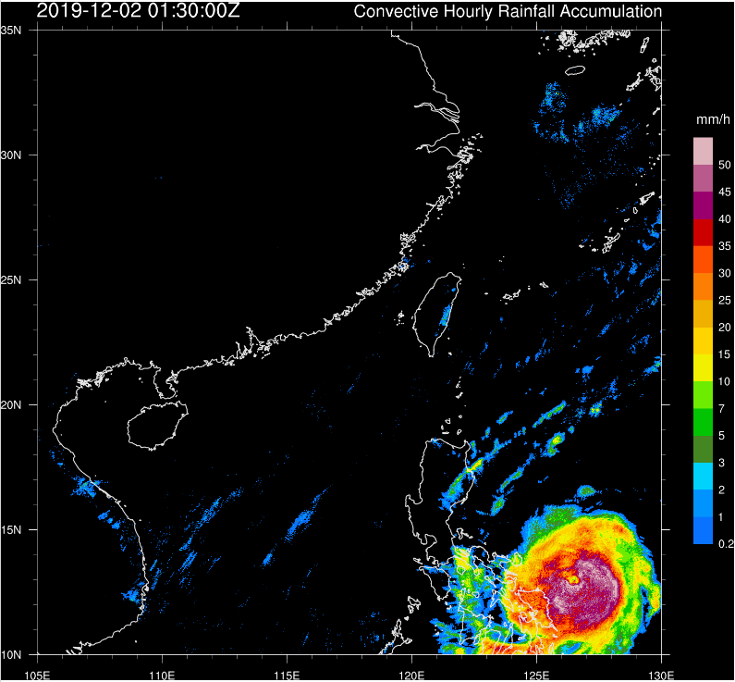
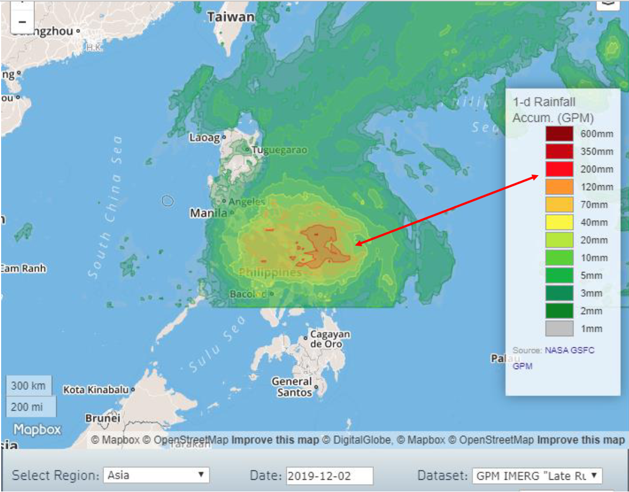
Thank you for your attention
(www.nwcsaf.org)
Case Study (舉例)
Extrapolation of CRR-Ph hourly rainfall accumulation using forecast tracks from major TC Warning Centers (e.g. HKO and JTWC above) suggested the daily rainfall on 2-3 Dec would reach a maximum of around 100 – 150 mm over the central part of the Philippines
Example with Kammuri Typhoon december 2nd 2019

Slide 34
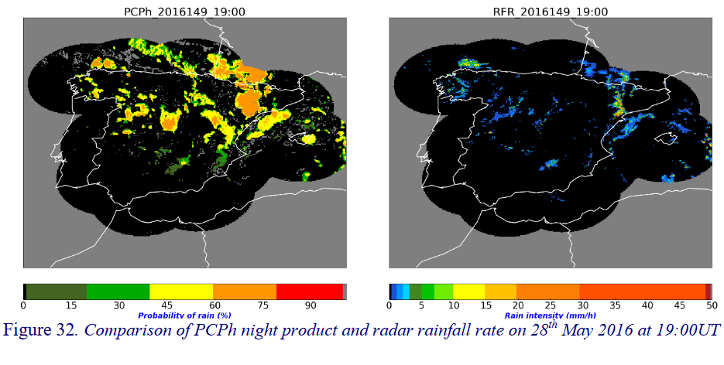
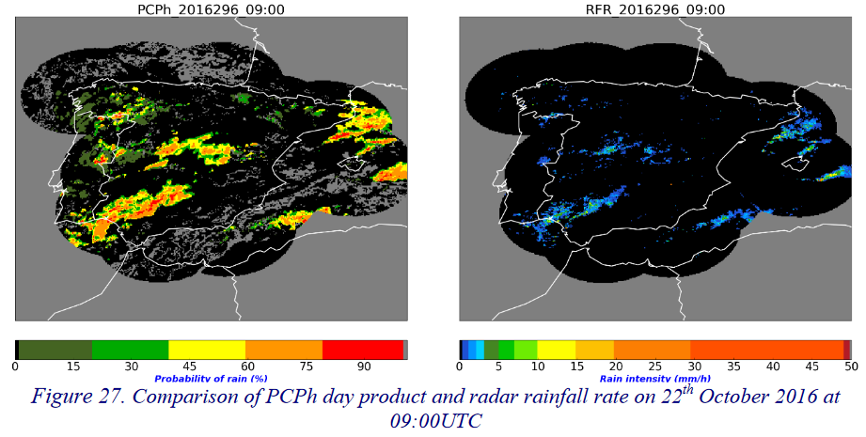
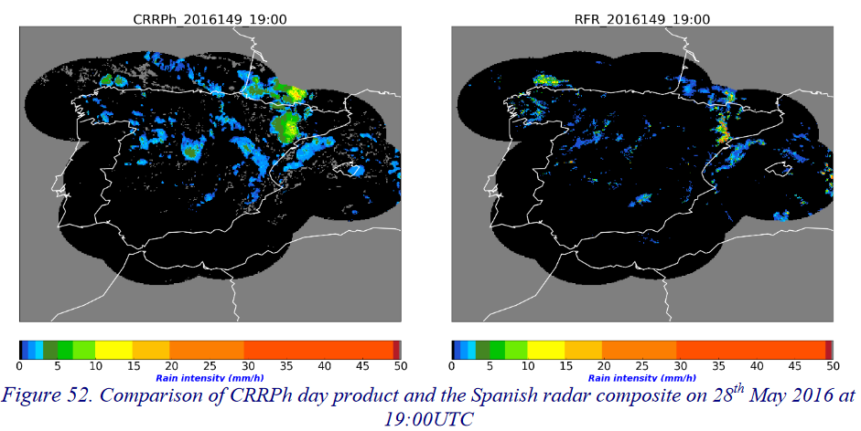
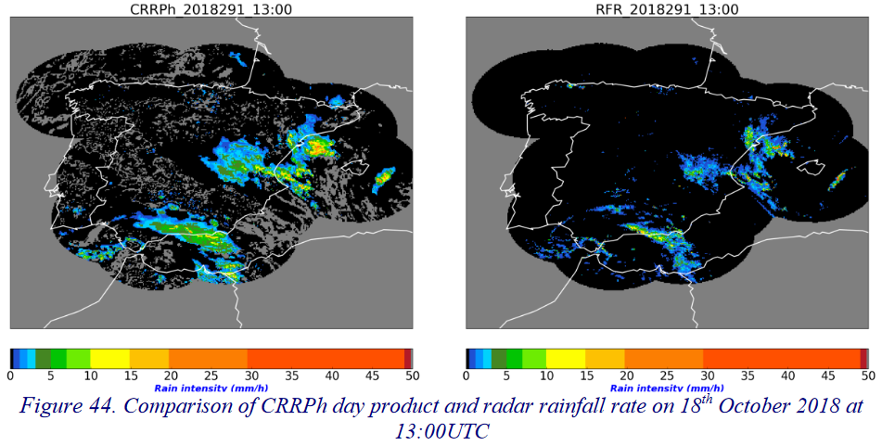
SOME COMPARISON (比較)
Comparison of PCPh and CRRPh with precipitation radar network over Spain (C Band ?)
NIGHT (晚)
DAY (天)
Notes:
PCPh day algorithm shows the product is able to detect little precipitation areas located in several regions of the Iberian Peninsula: in the mountains of León, south of the Pyrenees, the central part of the Iberian Peninsula and in between the Cape of Gata and the Cape of Palos
Figures 32 show a night scene where, overall, almost all precipitation areas depicted in the radar image are detected by PCPh. It can be noticed that PCPh night version tends to show larger precipitation areas than the radar (False alarms increases). At night time, it can also be observed that PCPh do not reach some high values of probability of precipitation compared with day time PCPh algorithm. This can be attributed to the lack of the visible channels and the cloud microphysics. Although a simulation of the VIS0.6 and the Cloud Water Path is done at night time, this simulations are not perfect. That is possibly the reason why PCPh night algorithm tends to provide lower values.
Since Microphysical Cloud Top parameters used by PCPh and CRRph have been computed only for sun zenith angles lower than 70º, this validation has been undertaken under the same condition. Both PCPh and CRRPh products assign NO DATA value to those pixels with undefined phase according to the phase output of the CMIC product, which means that no information on whether the cloud consists of water or ice is available. Those pixels have been excluded in the algorithm validation.
Figure 44 is an example of active convective nuclei with high rain rates associated to them. CRRPh detect the precipitating areas and assign high rates in the same areas the Spanish radar does.

Slide 35
SOME COMPARISON (比較)
Comparison of PCPh with precipitation radar network over Spain (C Band)
Lower are the probability higher are the POD but higher are the FAR
Day time precipitation are better detected with smaller FAR than night time
Notes:
Question for AEMET Does PCPh depend only on CMIC phase ?
What could explain thes difference between day and noght for FAR ?

Slide 36
SOME COMPARISON (比較)
Comparison of PCPh & CRRPh with precipitation radar network over Japan
[mm/h]

Slide 37
The software (軟體)
FORECAST (NWP)
SST
Satellites

Slide 38
The software (軟體)

Slide 39
And more
Comparison of Convective Initiation with echo radar
20210207 14h00Z
MSG 1 10,8µm
20210207 16h00Z (+2h00)
Convective initiation
is on a pre-operationnal stage
Radar echo > 32 dBZ
Formed Last 30 min dev.
Will Forme the next 30 min

Slide 40
And more
P = Previous product of same type
M = Mandatory
O = Optional

