Slide 1
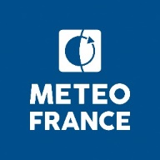
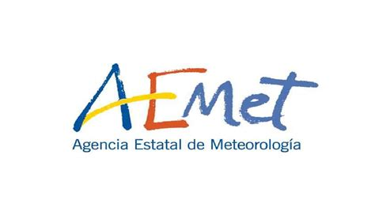
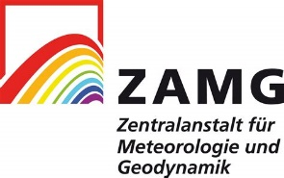
NWCGEO : SUITE of SOFTWAREs FOR nowcasting with GEOSTATIONNARY SATELLITE and research tools.
National Taiwan University 23rd February, 2023.
E.FONTAINE, X. CALBET, J. A. LAHUERTA, S. PERE, G. KERDRAON, J-M. MOISSELIN, F. AUTONES, J. GARCIA-PEREDA, A. WIRTH, A. JANN, P. SCHMEDERER, LL. LLISO, M.A. MARTINEZ, N. PEINADO, M. CLAUDON, O. ALONSO, A. SANCHEZ, A. M. HIDAYAT, K. HEGBETOWONYA, M-A. MANT & P. RIPODAS

Slide 2
PLAN
INTRODUCTION
THE SOFTWARES
THE SATELLITE PRODUCTS
SOME COMPARISON
CLOUD DISTRIBUTION IN ERA5
PROSPECTIVES

Slide 3
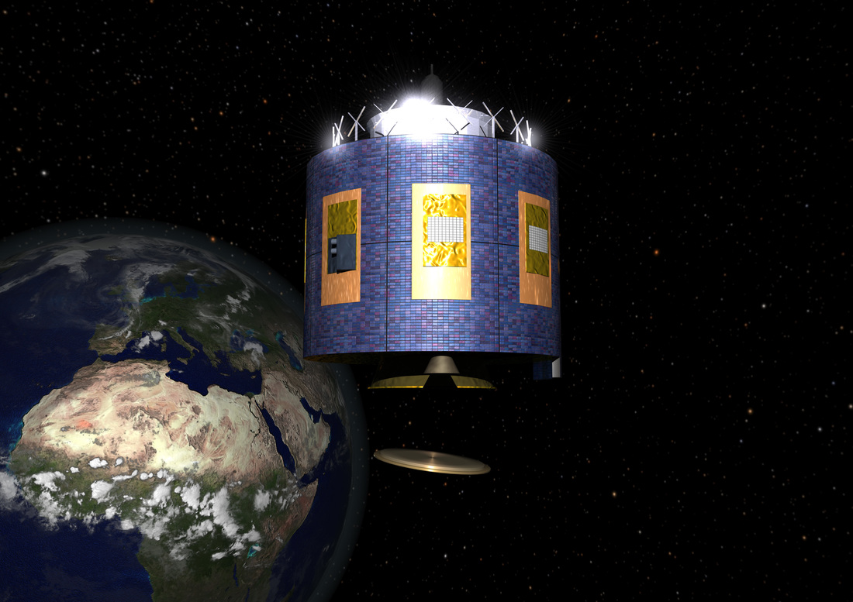
INTRODUCTION (前言)
Geostationnary satellites measure the radiance from Earth at around ~38000 km from it.
In the visible and proche infra rouge and Infra red we get the:
Reflectance: ratio Earh radiance/Sun radiance. Day only with a resolution of 500m, 1km, 2km
Brightness temperature (black body emission) Day and night with a lower resolution than visible (1km, 2km, 3km)
Since 2002 MSG types satellites are in gestationnary orbit point at 0° latitude and 0° longitude in Nadir

Slide 4
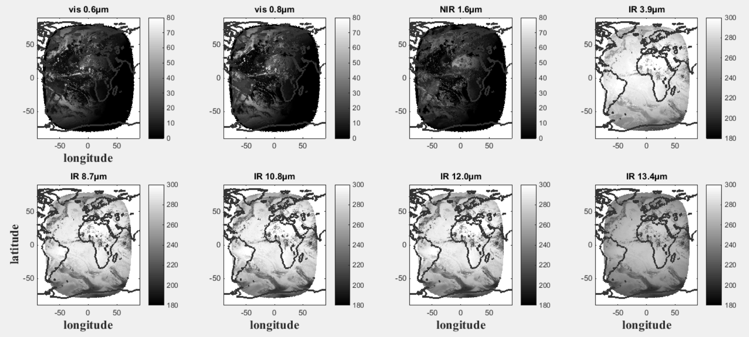
INTRODUCTION (前言)
Exemple of MSG Observations
Ref. [%]
Ref. [%]
Ref. [%]
Tb. [K]
Tb. [K]
Tb. [K]
Tb. [K]
Tb. [K]

Slide 5
INTRODUCTION (前言)
« Satellite Application Facility on support to nowcasting and very short range forecasting » (SAFNWC) is a partnership of 5 european national weather services who are dedicating activities to develop a software to ease the use of meteorological satellite observations (nwc-saf.eumetsat.int).
It is led by Spanish services under the supervising of Pilar Ripodas and funded by the EUMETSAT (european agency for the exploitation of meteorological satellite)
The Five agencies:
Spain (AEMET)
Sweden (SMHI)
Austrian (ZAMG)
Romanian (Meteo-Romania)
France (Météo-France)
Developping 2 suites of Softwares for the processing of meteorological satellite observations for1) geostationary orbit (NWCGEO), 2) polar orbit (NWCPPS) in order to ensure their optimum use.

Slide 6
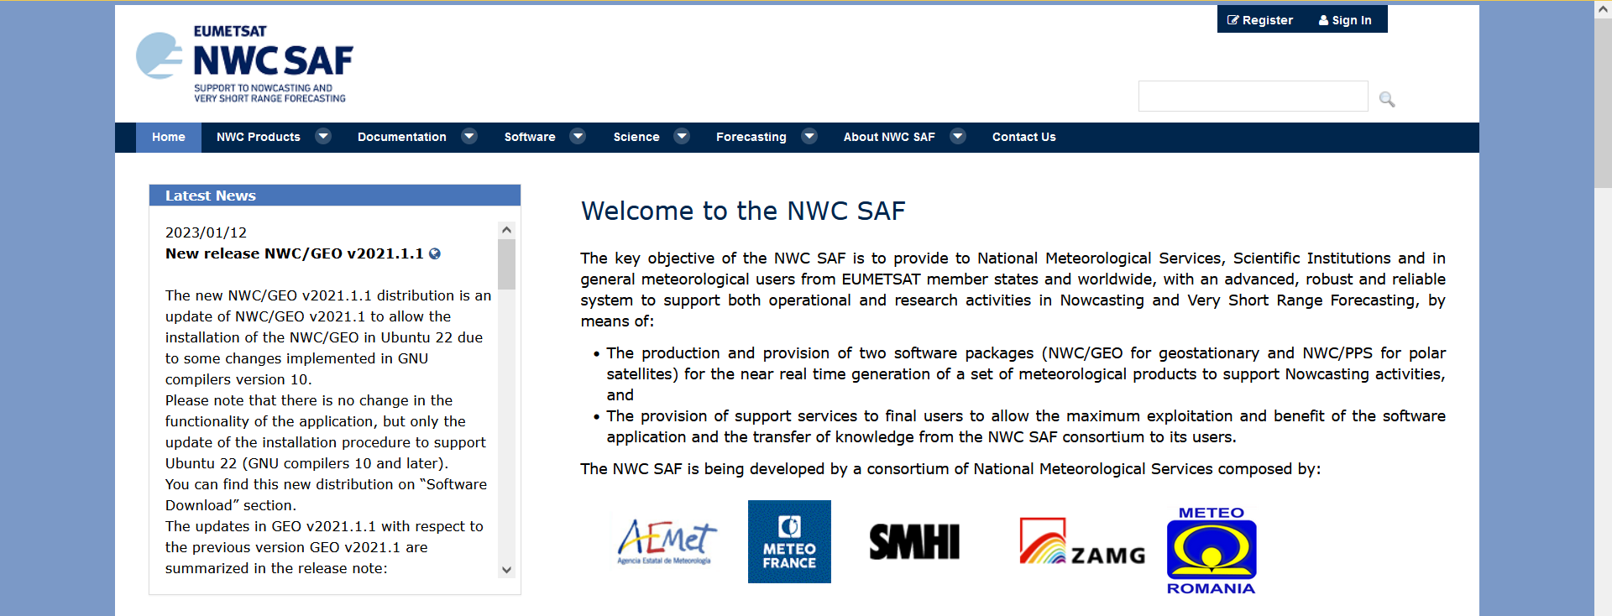
INTRODUCTION (前言)
The software (軟體)
The Website
Help Desk for assistance and questions
Register first before getting the Software
Lot of Documents to read
Guide to forecasters
GET the SOFTWARES

Slide 7
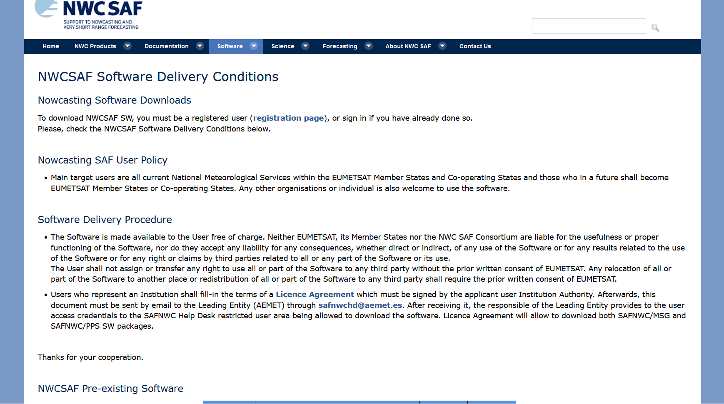
INTRODUCTION (前言)
The software (軟體)

Slide 8
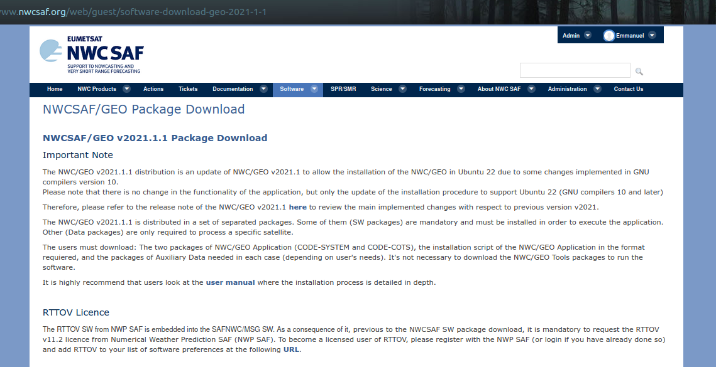
INTRODUCTION (前言)
The software (軟體)

Slide 9
The software (軟體)

Slide 10
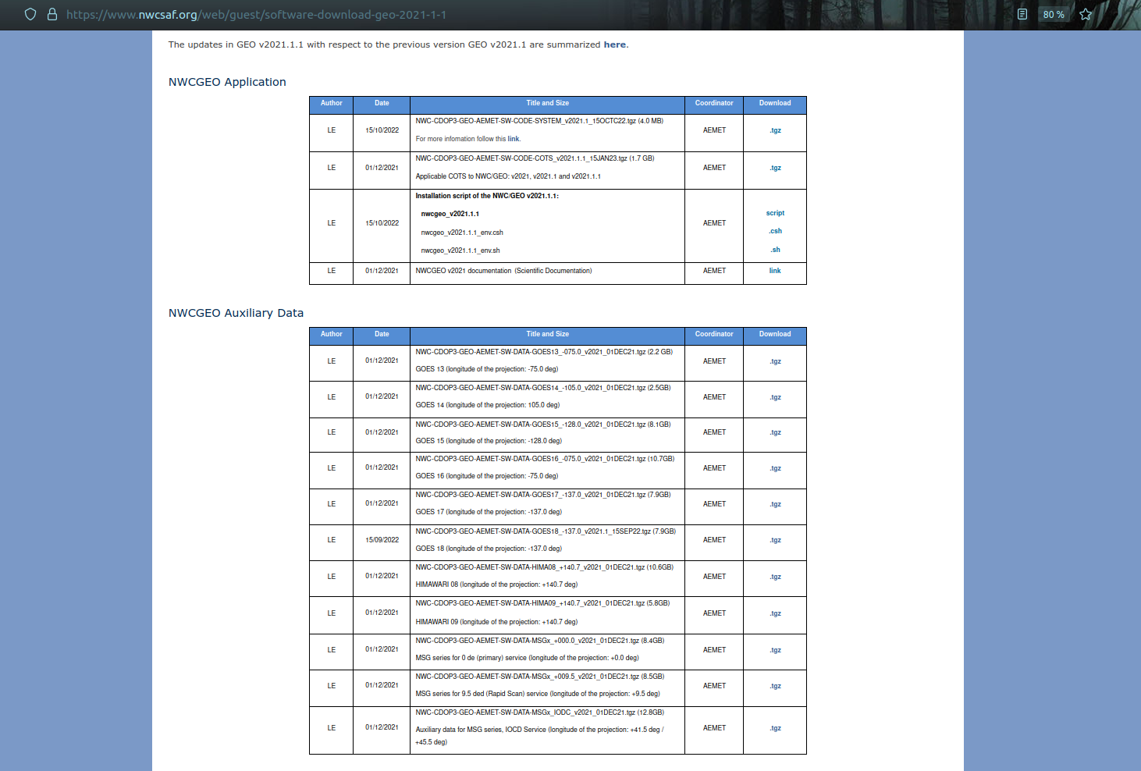
The software (軟體)
The installation takes then only 2 steps, which need less than ONE HOUR to be ready:
+ Download and decompress the software files
(2 different software tar files + 1 Auxiliary dataset for each satellite used).
+ Run the installation script.
Nothing else is needed. All software/libraries/additional elements to run and visualize
NWCSAF NWC/GEO software package are installed and ready to run with this!
Satellite, weather forecast and complementary observations are nor provided.
Notes:
Accessing the data can be more complicated (satellite, forecast, OSTIA)

Slide 11
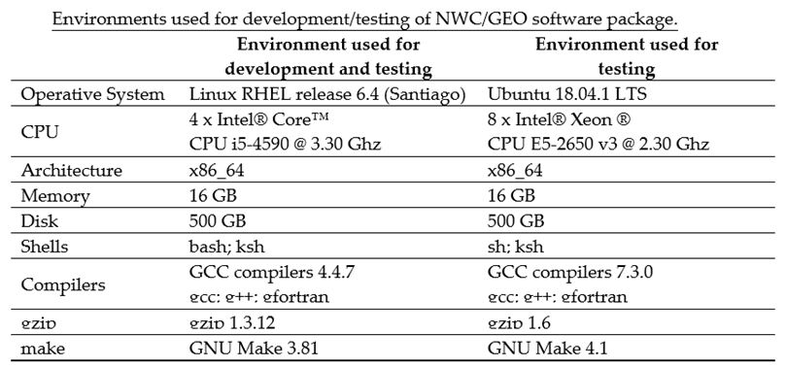
The software (軟體)
Hardware resources needed to run NWC/GEO Software package are relatively small:
Other environments like SUSE and Debian are not officially supported,
but some NWCSAF users have also tested them successfully.

Slide 12
The software (軟體)
NWCGEO officially support
MSG 1/2/3/4,
GOES 16/17/18,
HIMAWARI 8/9,
MTG I1 (commissioning phase)
NWCGEO runs with many options, main ones that must be known :
only satellite (MANDATORY)
Satellite + forecast (GFS, ECMWF, ARPEGE)
Satellite + forecast + SST (OSTIA)
Most of the algorithms are using differences between satellite channels and regards to atmosphere conditions with no clouds
Tresholds tables help to settle the properties of the clouds, precipitation, etc…
When satellite are the only input, Climatology in the channels’ spectrum satellite are used (less accurate): not all products can be generated without forecast
Forecast allows to calculate radiative conditions of the predicted atmosphere with no clouds (Clear Sky)
SST (from the day before and day before-1) help the radiative transfert simulation and calculating the simulations error (estimation in clear sky over ocean during the night)
Becarefull of the settings you choose, if you provide the satellite observations, the program will not stop, if he cannot use the Forecast and SST, it is important to check the log files to make sure they were used during the processing if you were willing to !

Slide 13
The software (軟體)
NWCGEO what is it exactly ?
A suite of Software than can be operated automatically and with a period shorter than the geostationary satellite
NWCGEO SOFTWARES (Products)
CLOUDS | PRECIPITATION | CONVECTION | HUMIDITY & INSTABILITY | WINDS | CONCEPTUAL MODEL | EXTRAPOLATED
Mask (CMA) | Precipitating clouds (PC ) | Rapid developing thunderstorms (RDT) | iSHAI: Total precipitable water | HRW: High resolution winds AMV levels | ASII: Automatic Satellite Interpretation | EXIM: cloud mask
Classification (CT) | Convective Rate (CRR) |  | iSHAI: Layer precipitable water | HRW: High resolution winds AMV speed | ASII-TF: Tropoause Folding detection | EXIM: Cloud Type
Height (P, T, z) (CTTH) | Precipitating clouds* (PCPh) | Convective Initiation (CI) | iSHAI: Stability analysis Imagery | HRW: High resolution winds trajectories 1H | ASII-GW: Gravity Wave pattern detection | EXIM: Cloud top height
Microphysic (I/LWP,COT, REFF) (CMIC) | Convective Rate* (CRRPh) |  |  | HRW: High resolution winds trajectories 3H |  | EXIM: Cloud Phase
Only with weather forecast
* Based on Clouds Products

Slide 14
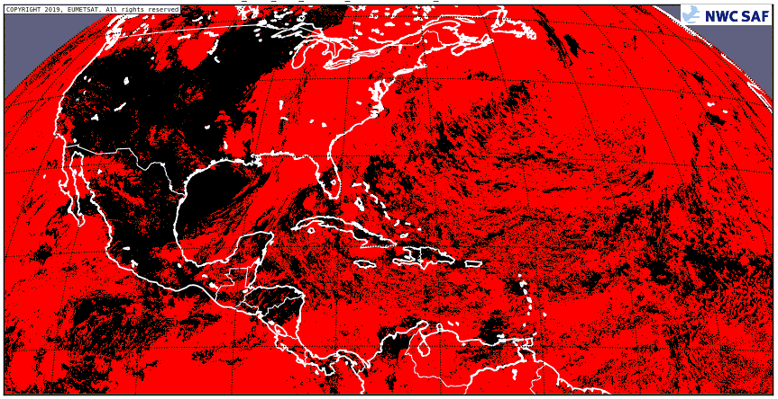
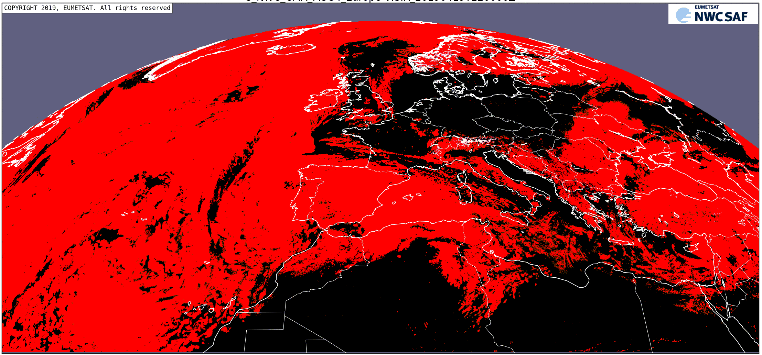
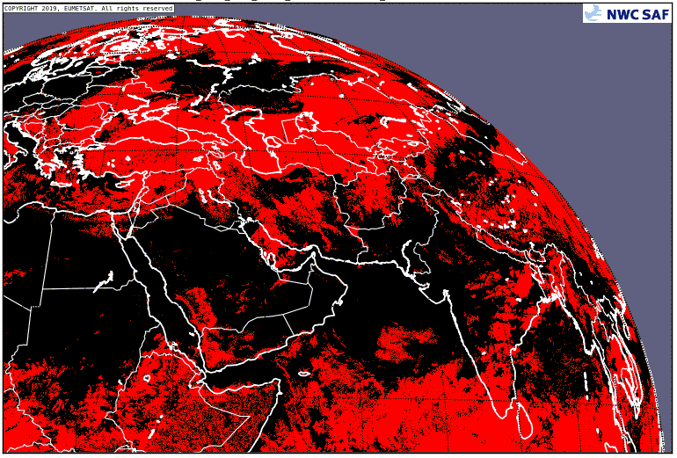
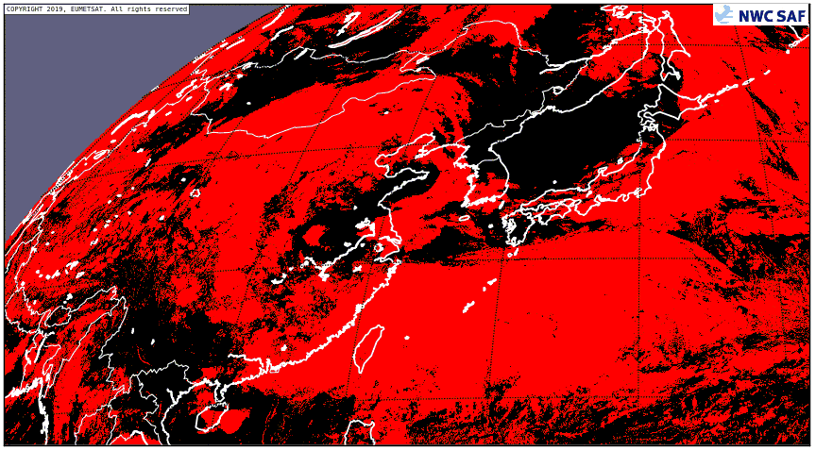
The satellite products (衛星生產)
GOES 16
MSG4
MSG I (IO)
HIMAWARI 8
CMa – Cloud Mask: cloud detection, and snow detection during daytime.
- Used as a complement to visible images during the day.
- More useful during the night, due to difficulties to identify some low cloud types in IR images.
* Based on Clouds Products

Slide 15
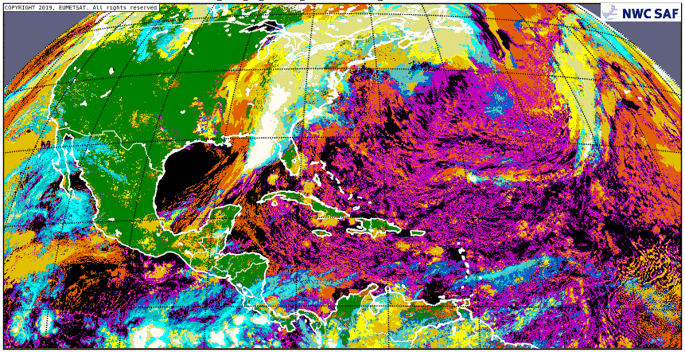
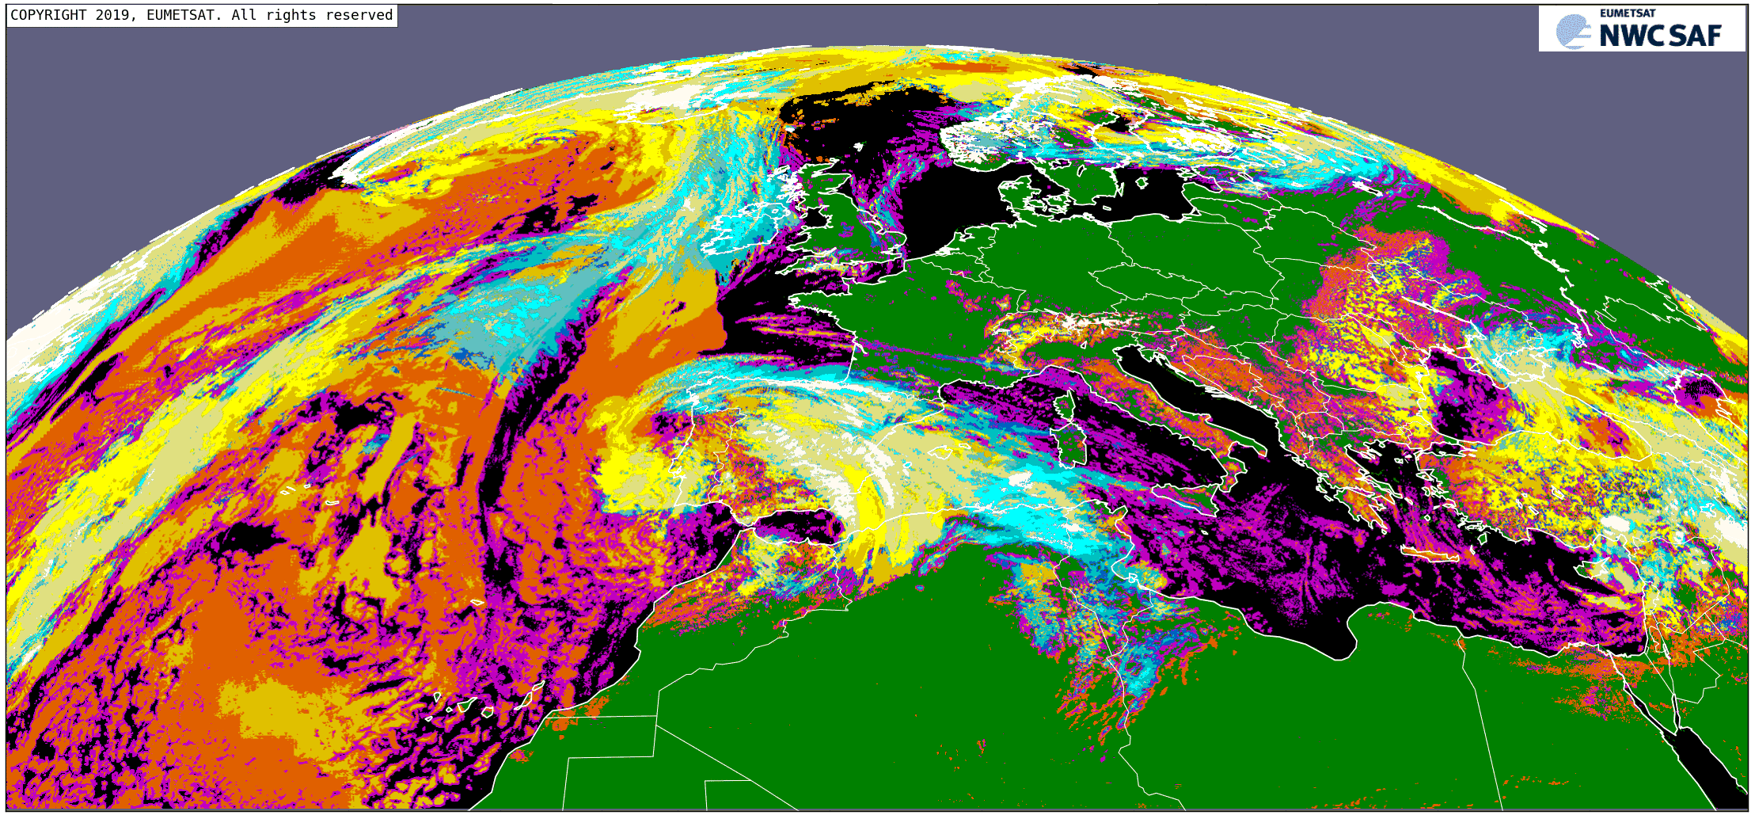
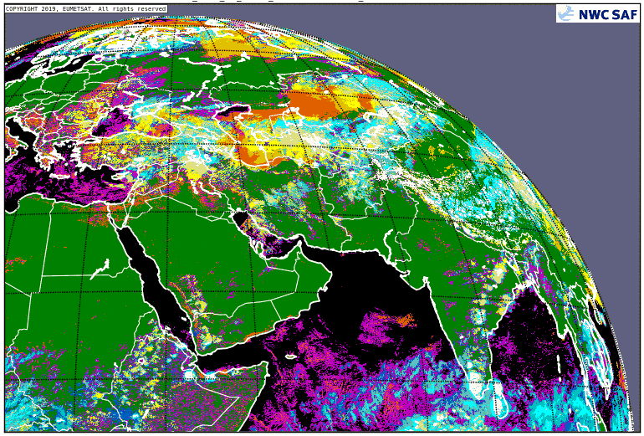
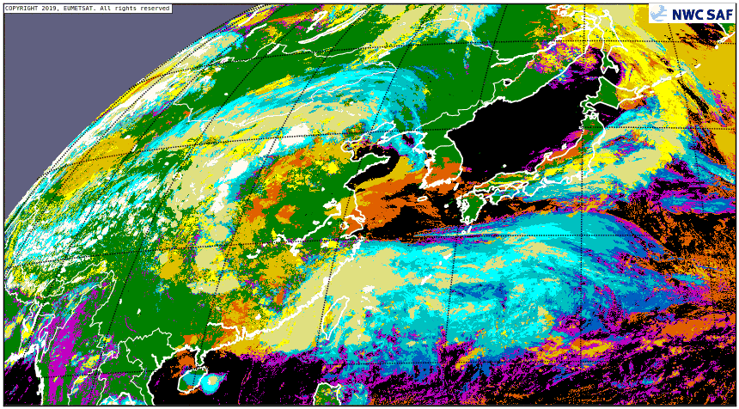
The satellite products (衛星生產)
GOES 16
MSG4
MSG I (IO)
HIMAWARI 8
CT – Cloud type
- Cloud classification based on the “opacity/transparency” and “level of the cloud top”.
(Ex: “Cb” classified as “high opaque cloud”).

Slide 16
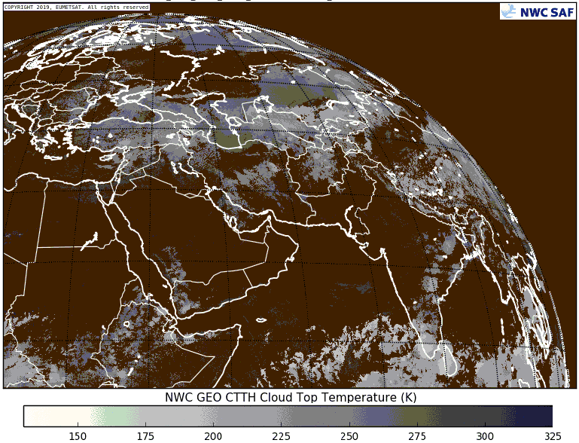
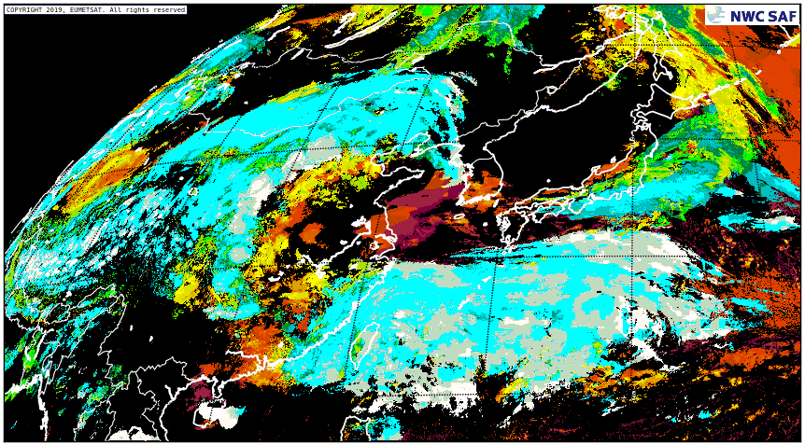
The satellite products (衛星生產)
GOES 16
MSG4
MSG I (IO)
HIMAWARI 8
CTTH: Cloud top pressure (up), cloud top temperature (down left), cloud top height (down right).
- “Fractional clouds” not having CTTH outputs.

Slide 17
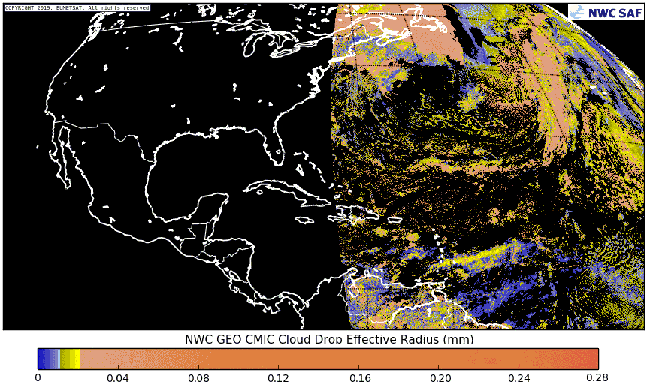
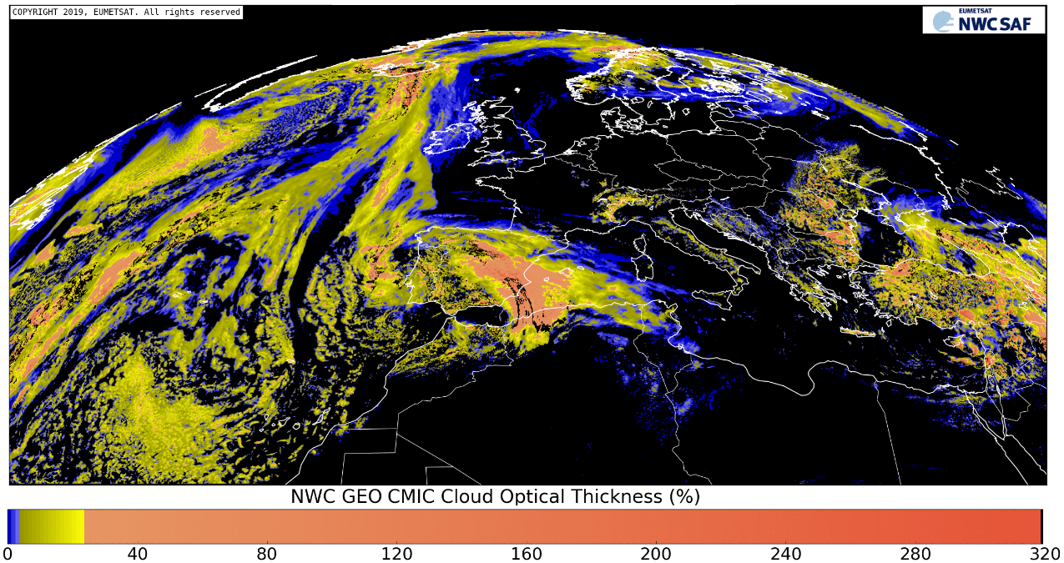
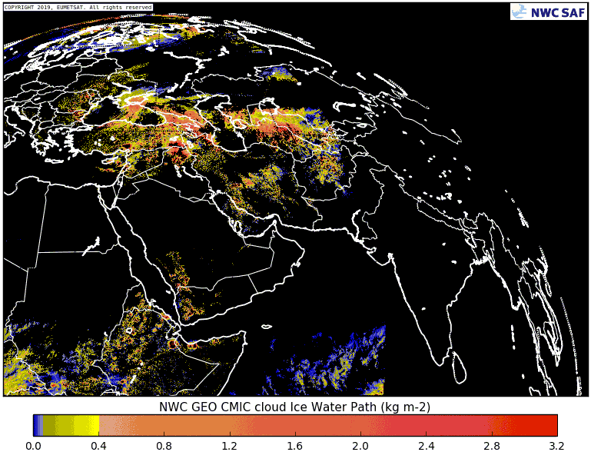
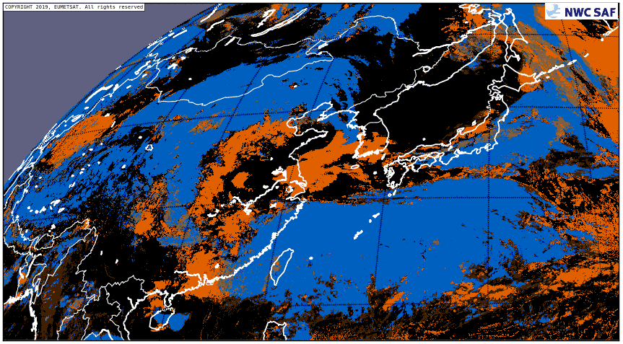
The satellite products (衛星生產)
GOES 16
MSG4
MSG I (IO)
HIMAWARI 8
CMIC: Cloud drop effective radius (up left), Cloud optical thickness (up right),
Liquid/Ice water path (down left), Cloud top phase (down right).
- Only “Cloud top phase” parameter available for night, twilight, mixed/undefined phase.

Slide 18
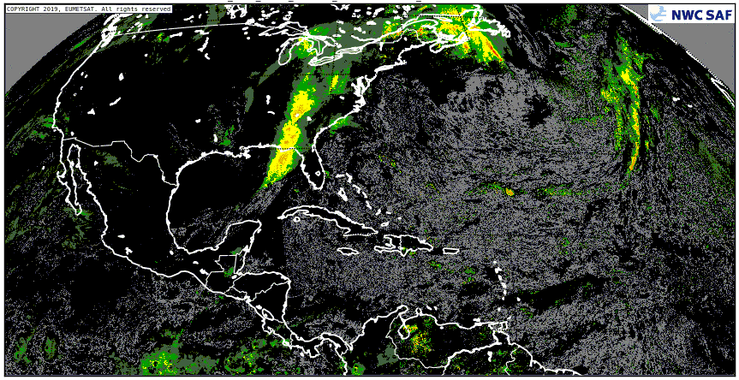
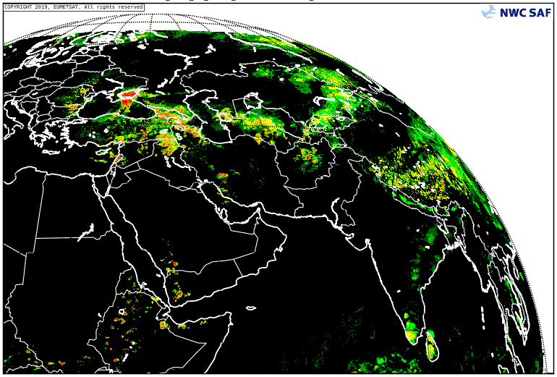
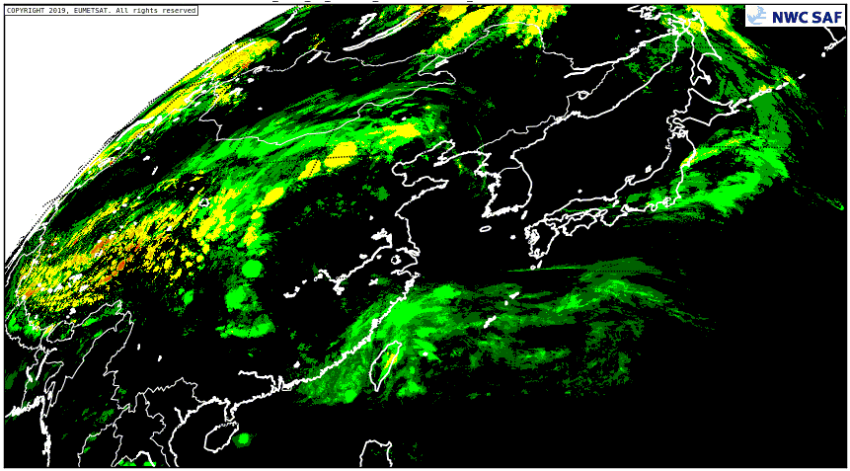
The satellite products (衛星生產)
GOES 16
MSG4
MSG I (IO)
HIMAWARI 8
PC – Precipitating Clouds (down) and
PCPh – Precipitating Clouds based on Cloud Microphysics (up)
- Probability of precipitation for all precipitation, but working better for convective precipitation.
- Useful when radar not available, with preference for PCPh product.

Slide 19
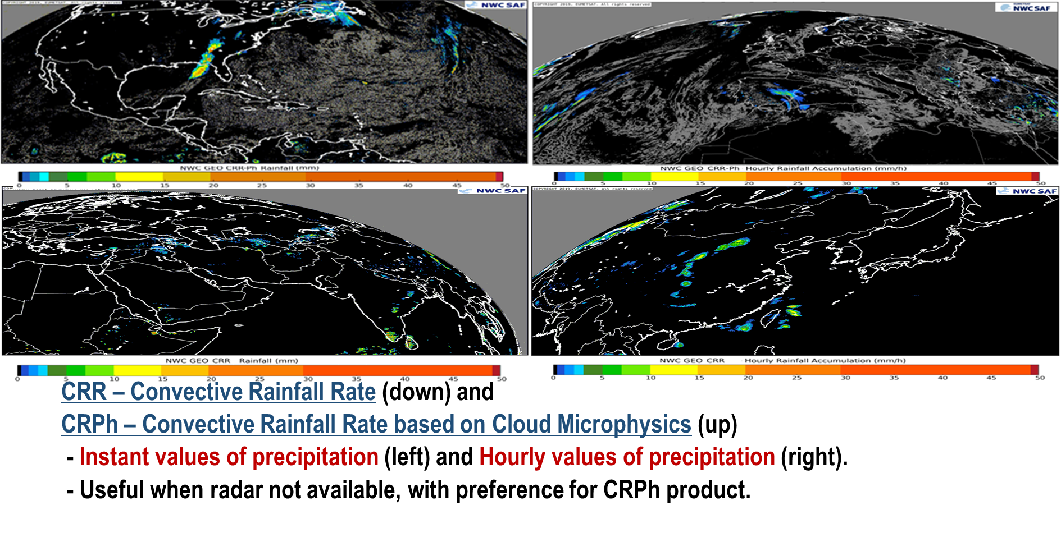
The satellite products (衛星生產)
GOES 16
MSG4
MSG I (IO)
HIMAWARI 8

Slide 20
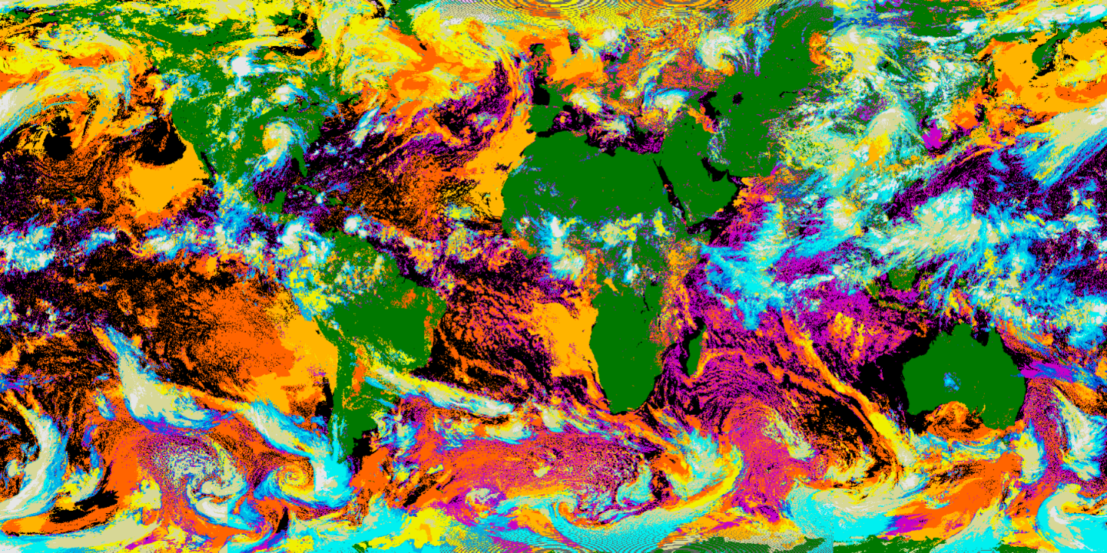
The satellite products (衛星生產)
Cloud products on a world map
Example with cloud classification

Slide 21
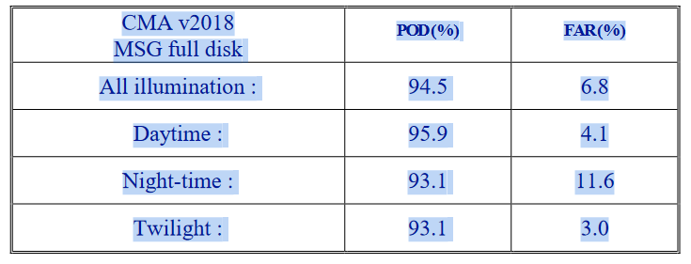
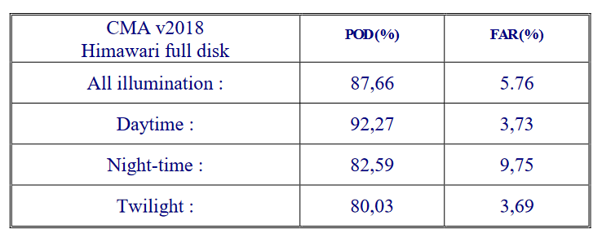
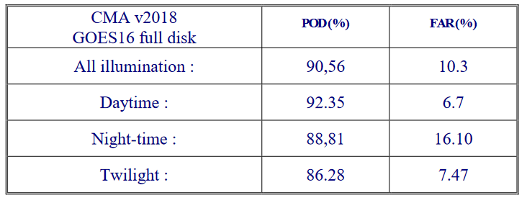
SOME COMPARISON (比較)
Comparison of Cloud Mask with SYNOP observations and ship observations
Treshold accuracy : POD>85% and FAR<20% for operationnal
POD : Probability of detection
FAR : False Alarm
Notes:
In order that the CMA can be used in operationnal way it has to satisfy the treshold accuracy which is true for all satellite when looking at al illumination.

Slide 22
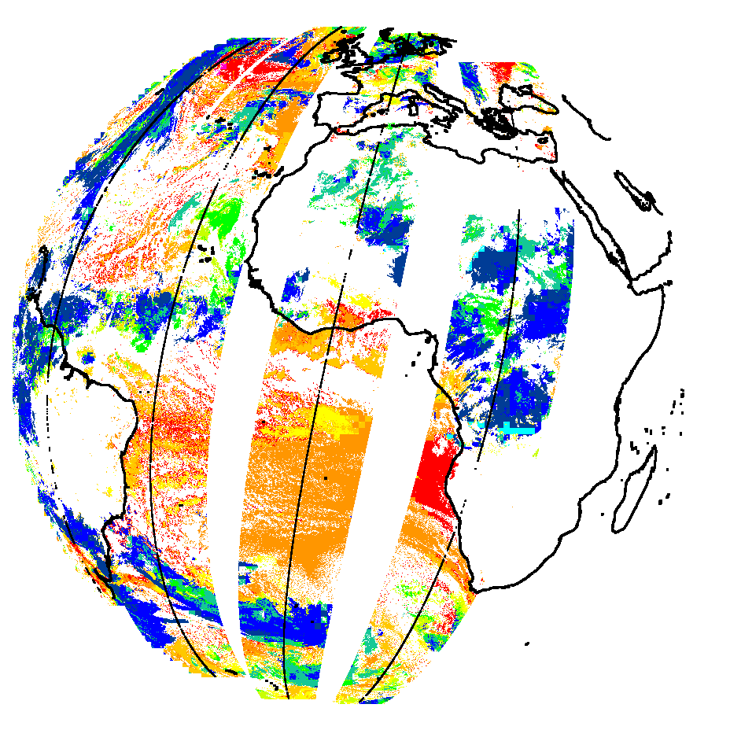
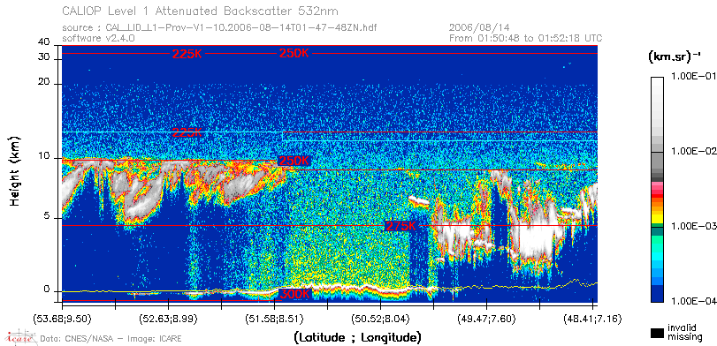
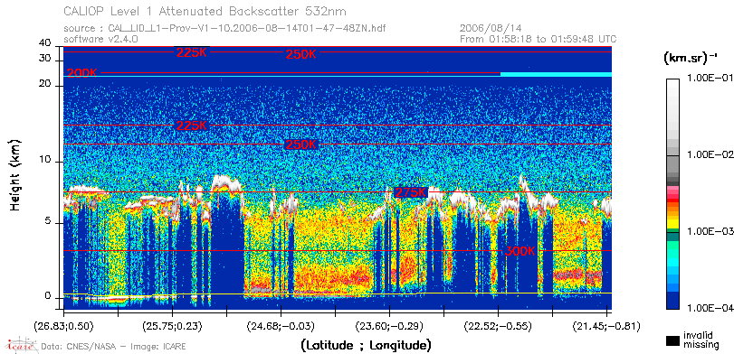
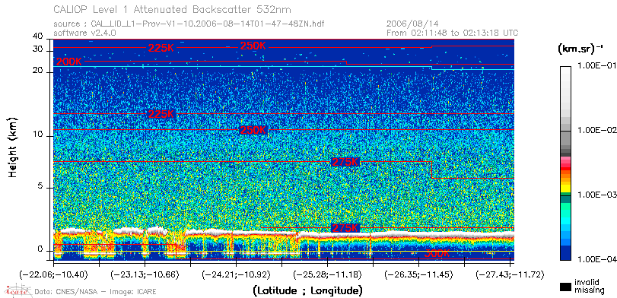
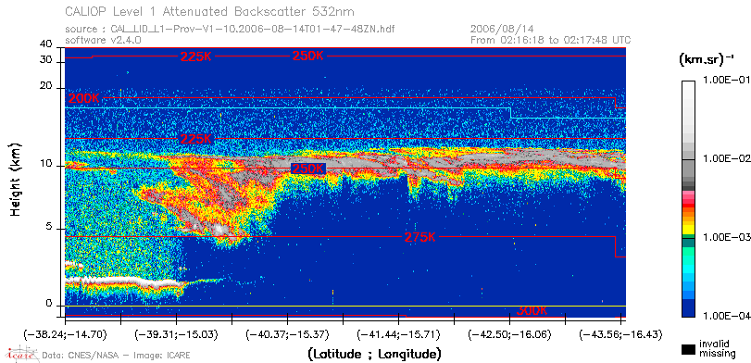
SOME COMPARISON (比較)
Comparison of CT and CTTH with RADAR and lidar observation (DARDAR Delanoë et al.,2010)
CTTH from MSG4
Obs. Lidar
100hPa
500hPa
1000hPa

Slide 23
SOME COMPARISON (比較)
Comparison of CT with lidar observation (DARDAR Delanoë et al.,2010)
CTTH from MSG4
Obs. Lidar
OPTIMAL ACCURACY | 90%
TARGET ACCURACY | 70%
TRESHOLD ACCURACY | 50%
POD for | LOW CLOUDS | SEMI-TRANSPARENT | HIGH CLOUDS
MSG 4 | 94% | 75% | 92%
GOES 16 | 91% | 75% | 83%
HIMAWARI 8 | 88% | 76% | 88%
GOES 17 | 92% | 77% | 87%

Slide 24
SOME COMPARISON (比較)
Comparison of CTTH with lidar and cloud radar observations (DARDAR Delanoë et al.,2010)
CTTH from MSG4
Obs. Lidar
Opaque clouds | Bias (km) | Std (km)
MSG | -0,46 (-0,31) | 0,93 (0,73)
Himawari 8 | -0,82 (-0,56) | 1,21 (0,96)
GOES 16 | -0,62 | 1,12
GOES17 | -0,38 | 1,08
Treshold accuracy (opaque clouds) | Bias < 1km Std<2km
Treshold accuracy for semi-tranpasrent clouds | Bias<2km Std<2,5km
Semi-Transp. | Bias (km) | Std (km)
MSG | -1,26 (0,44) | 1,97 (1,90)
HIMAWARI 8 | -1,41 (0,5) | 2,19 (2,06)
GOES 16 | -1 | -2,01
GOES17 | -0,36 | -1,9

Slide 25
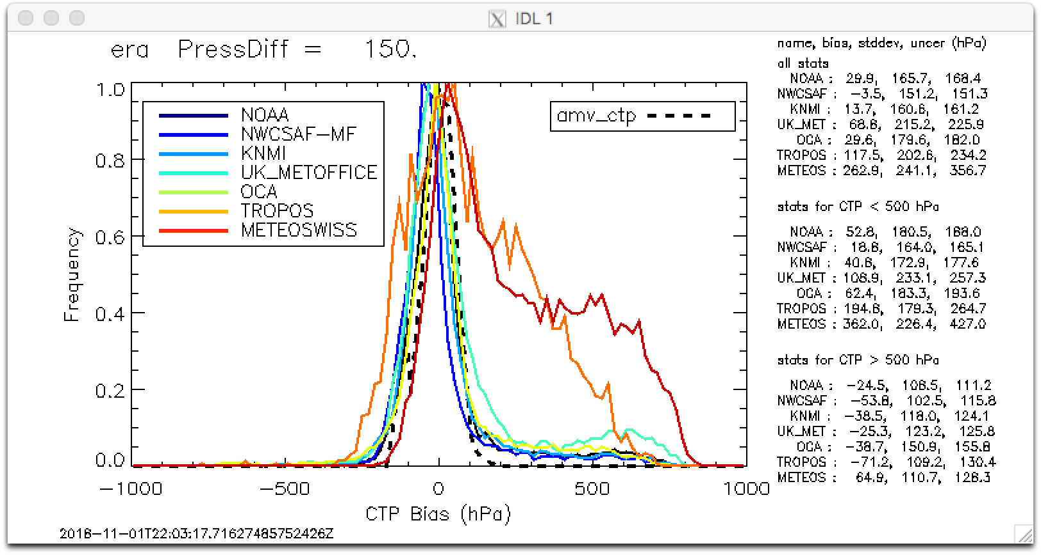
SOME COMPARISON (比較)
2nd International cloud working group 2018
MSG2 13/06/2008
Truth given by CALIPSO-CloudSat

Slide 26
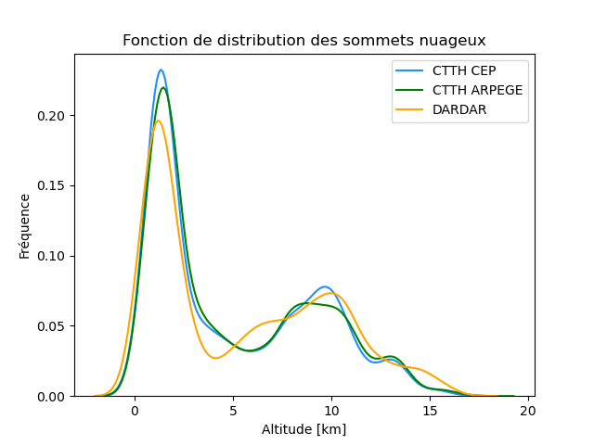
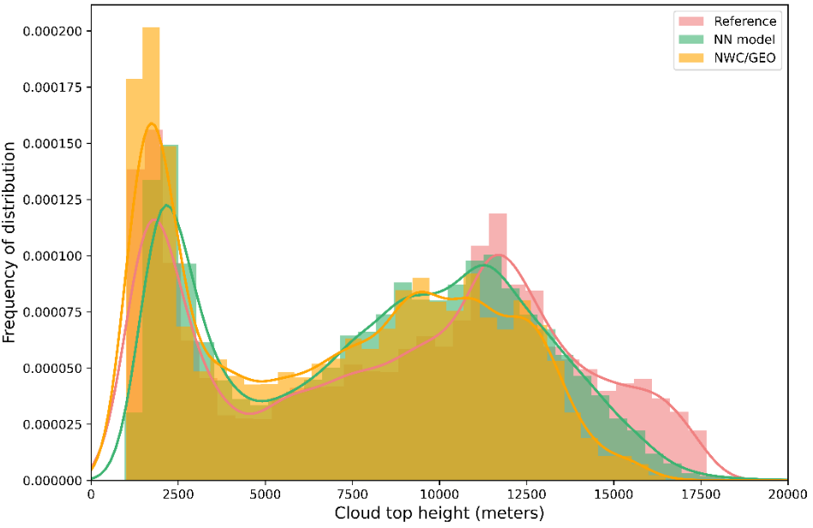
SOME COMPARISON (比較)
Comparison of CTTH with lidar observation (DARDAR Delanoë et al.,2010)
Cloud Top height distribution using different weather Forecast
Comparison of Cloud top height between actual CTTH software and a version with neural network
improvement are expected with the third generation of satellite with higher resolution and more visible and NIR channels.
We still miss the very high thin cirrus =>

Slide 27
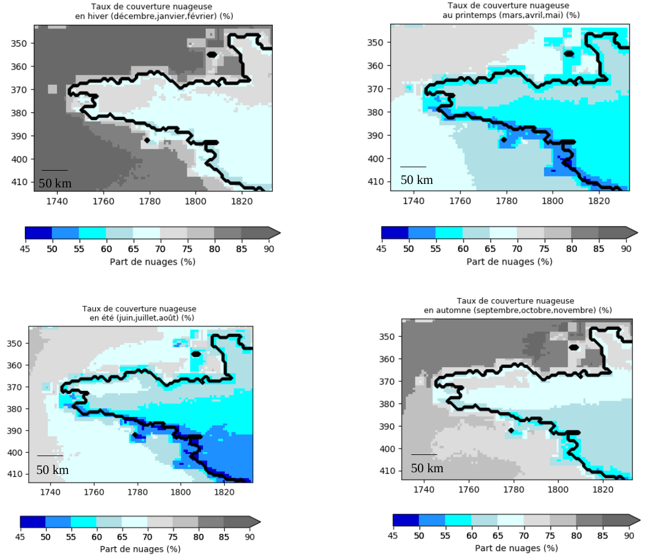
Cloud Distribution in ERA5
Cloud Frequencies with Cloud Mask over Brittany (France)
Cloud Mask (and other NWCGEO product) is available on the same frequence as Satellite observations i.e 10min (GOES, Himawari) or 15 min (MSG)
It offers the possibility to evaluate model at different stage of the day
vs
polar orbiting satellite that offer few observation /day (CALIPSO, CloudSat, coming EarthCare)

Slide 28
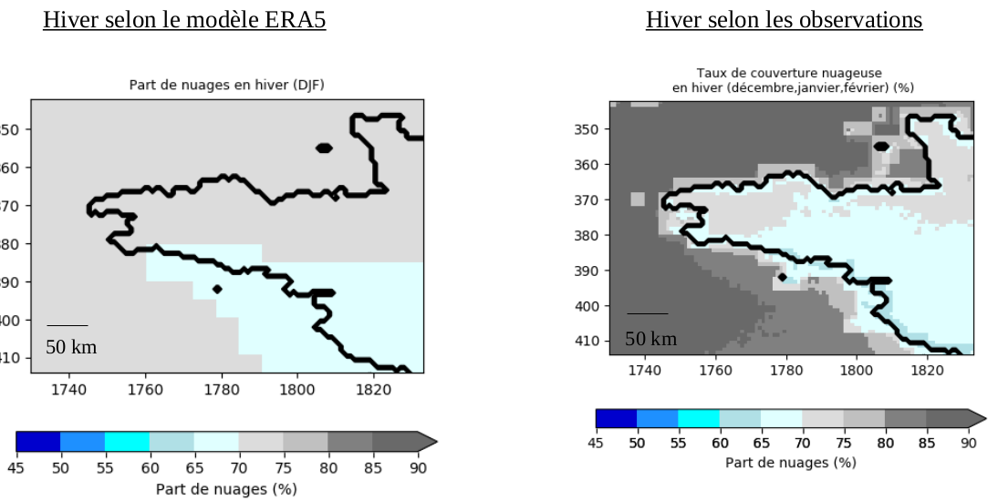
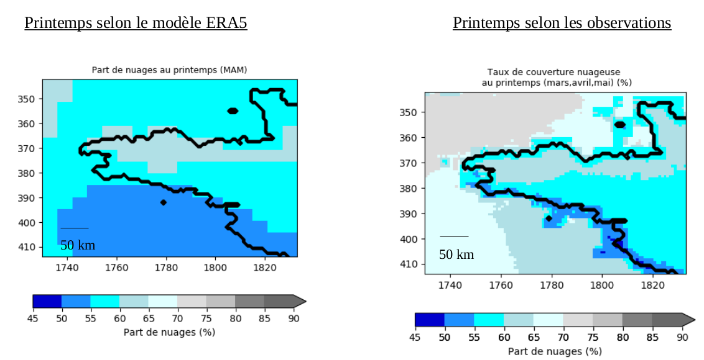
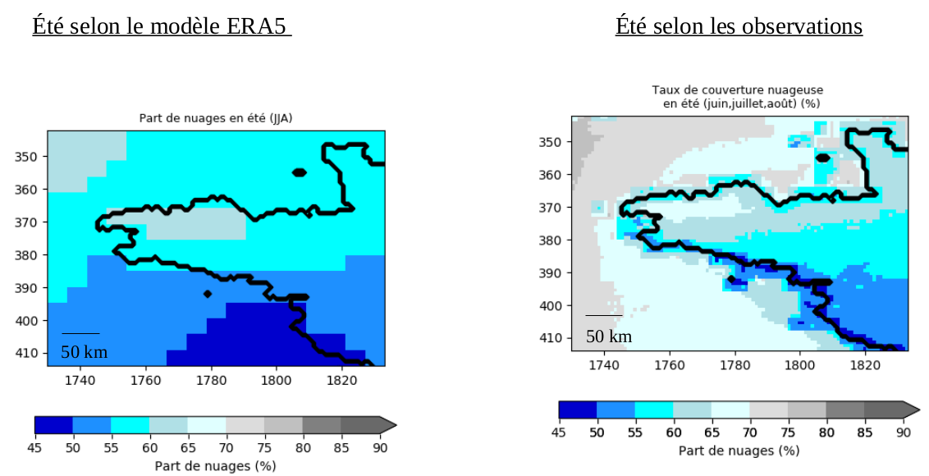
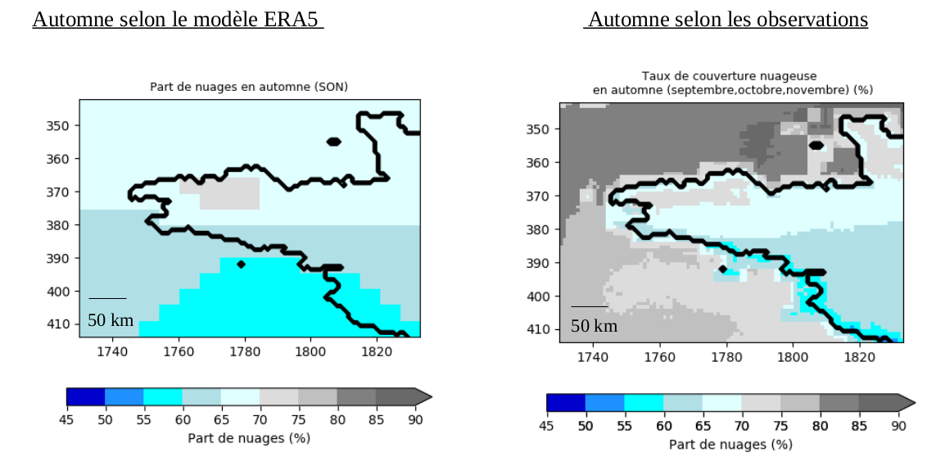
Cloud Distribution in ERA5
Cloud Frequencies with Cloud Mask over Brittany (France) comparison with ERA5 re-Analysis
WINTER
SPRING
ERA5
obs
ERA5
obs
SUMMER
Autumn
obs
ERA5
obs
ERA5
Notes:
Winter/SPRING/SUMMER/FALL : ERA5 underestimate Cloud Cover over Manche seas (North West) and Atlantic ocean (West) (10%)
Continental fraction are usually weel represented

Slide 29
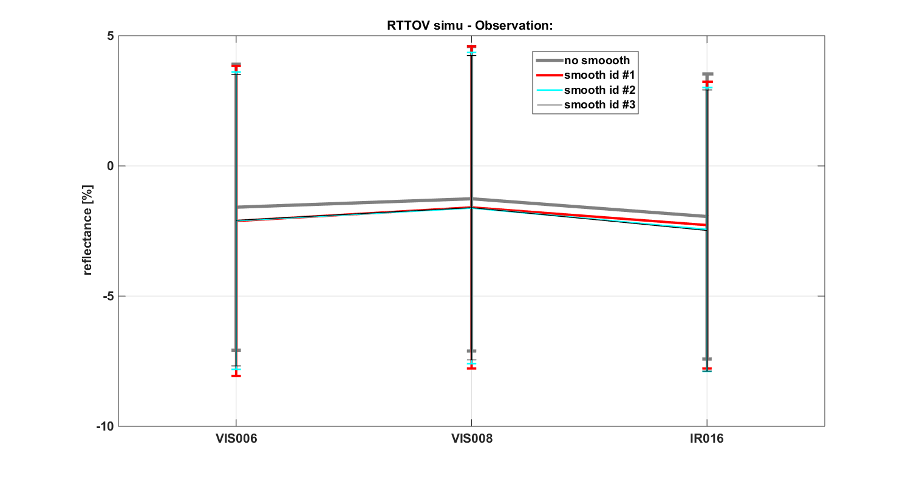
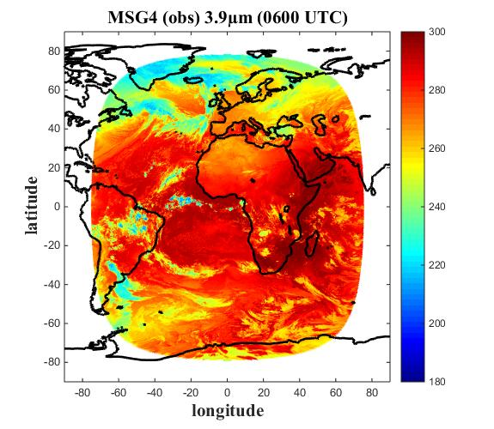
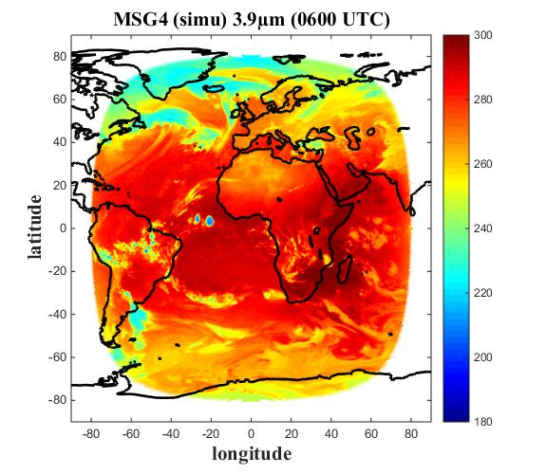
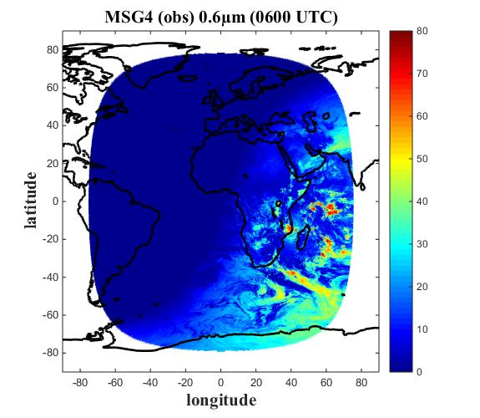
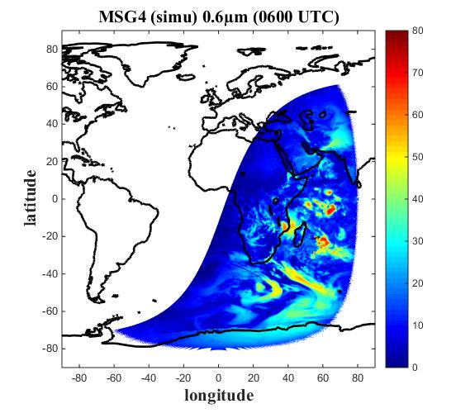
Cloud Distribution in ERA5
Cloud cover with Cloud Mask : MSG vs ERA5+RTTOV
MSG Observations
ERA 5 + RTTOV
Error over all MSG disc
With RTTOV (SAFNWP : https://nwp-saf.eumetsat.int/site/)
We use the ERA5 Re-analysis to compute MSG type observations
MSG
Reflectance:
Vis 0,6µm
Vis 0,8µm
NIR 1,6µm
TB:
IR 3,9µm
WV 6,2µm
WV 7,3µm
IR 8,7µm
IR 9,7µm
IR 10,8µm
IR 12µm
IR13,4µm
ERA5
Surface (mandatory) :
RH, T (2m), T skin, P surface, SST
Levels :
P, T, QV, IWC, LWC
RTTOV
137 Model level (0,25x0,25)

Slide 30
Cloud Distribution in ERA5
Cloud cover with Cloud Mask : MSG vs ERA5+RTTOV
With RTTOV (SAFNWP : https://nwp-saf.eumetsat.int/site/)
We use the ERA5 Re-analysis to compute MSG type observations
MSG
Reflectance:
Vis 0,6µm
Vis 0,8µm
NIR 1,6µm
TB:
IR 3,9µm
WV 6,2µm
WV 7,3µm
IR 8,7µm
IR 9,7µm
IR 10,8µm
IR 12µm
IR13,4µm
ERA5
Surface (mandatory) :
RH, T (2m), T skin, P surface, SST
Levels :
P, T, QV, IWC, LWC
Cloud Products :
CMA (cloud Mask)
CT (cloud Classification)
CTTH (Cloud Top Height)
CMIC (Cloud µφ)
RTTOV
NWCGEO

Slide 31
Cloud Distribution in ERA5
Cloud cover with Cloud Mask : MSG vs ERA5+RTTOV
MSG-Cloud Mask: Cloudy Pixels= 5979017*
Cloudy no cloud
Nb clouds MSG ∩ ERA5 & RTTOV = 57%
Nb clouds missed by ERA5 & RTTOV = 43%
Nb of False Alarm by ERA5 & RTTOV = 8% (regards to*)
(⁺Total-number of pixels ~10821955)

Slide 32
Cloud Distribution in ERA5
Cloud classification with Cloud Type: MSG vs ERA5+RTTOV

Slide 33
Cloud Distribution in ERA5
Pixels to pixels comparison
PDF
Lost clouds are :
very low clouds
very high opac clouds
Fractional clouds
High semi-transparent clouds
Cloud Less well represented is very high opac clouds
Mid level clouds, high opac clouds & high semi moderately thick clouds
RTTOV+ERA5
MSG 4

Slide 34
PROSPECTIVES
THANK YOU for Your Attention
Because of their spatial and temporal resolution SAFNWC products (some) can be useful data for
Climatology
Weather Forecast evaluation
While other SAFNWC products could benefit multiple comparison with other retrieval technics and observations that could help their improvement
Research and development phase for SAFNWC are planned over a period of 5 years : we are actually in the phase 4 :
Up coming of vMTG day1 (2024): after commissioning phase of MTG (start in the mid o 2023)
Version MTG day2 (2026):
Microphysic day and night (CMIC), Product at visible resolution (1km @ nadir), Improvement of handle multi-layer clouds, Cloud top height for fractionnal clouds, Flag Stratiforme/cumuliforme clouds
Scientific studies :
Use of machine learning
Use of hyper spectral MTG launch (2025)
Visiting scientist program and Master student application for internship are welcom

Slide 37
SOME COMPARISON (比較)
Comparison of PCPh and CRRPh with precipitation radar network over Spain (C Band)
NIGHT (晚)
DAY (天)
Notes:
PCPh day algorithm shows the product is able to detect little precipitation areas located in several regions of the Iberian Peninsula: in the mountains of León, south of the Pyrenees, the central part of the Iberian Peninsula and in between the Cape of Gata and the Cape of Palos
Figures 32 show a night scene where, overall, almost all precipitation areas depicted in the radar image are detected by PCPh. It can be noticed that PCPh night version tends to show larger precipitation areas than the radar (False alarms increases). At night time, it can also be observed that PCPh do not reach some high values of probability of precipitation compared with day time PCPh algorithm. This can be attributed to the lack of the visible channels and the cloud microphysics. Although a simulation of the VIS0.6 and the Cloud Water Path is done at night time, this simulations are not perfect. That is possibly the reason why PCPh night algorithm tends to provide lower values.
Since Microphysical Cloud Top parameters used by PCPh and CRRph have been computed only for sun zenith angles lower than 70º, this validation has been undertaken under the same condition. Both PCPh and CRRPh products assign NO DATA value to those pixels with undefined phase according to the phase output of the CMIC product, which means that no information on whether the cloud consists of water or ice is available. Those pixels have been excluded in the algorithm validation.
Figure 44 is an example of active convective nuclei with high rain rates associated to them. CRRPh detect the precipitating areas and assign high rates in the same areas the Spanish radar does.

Slide 38
SOME COMPARISON (比較)
Comparison of PCPh with precipitation radar network over Spain (C Band)
Lower are the probability higher are the POD but higher are the FAR
Day time precipitation are better detected with smaller FAR than night time
Notes:
Question for AEMET Does PCPh depend only on CMIC phase ?
What could explain thes difference between day and noght for FAR ?

Slide 39
SOME COMPARISON (比較)
Comparison of PCPh & CRRPh with precipitation radar network over Japan
[mm/h]

Slide 40
MORE
Bias of clouds brightness temperatures simulations with the help of CloudSat coïncident measurement

Slide 41
MORE
Bias of clouds brightness temperatures simulations with the help of CloudSat coïncident measurement

Slide 42
MORE
Pour les nuages opaques :
RTTOV calcul les overcast; tableaux de radiance pour un nuage opaque à chaque niveau de la PNT
La pression de sommet des nuages correspond au meilleur ajustement entre les radiances à 10.8m et 12.0µm mesurées et simulées.
Le traitement est effectué à chaque pixel SEVIRI.
+
+ Radiances overcast
+ Radiance mesurées
+
+
Tb [K]
+
+
Overcast : le nuage est un corps noir qui ne laisse rien passé du flux venant du dessous, la radiance au sommet de l’atmosphere depend de la reflectance/emittance au sommet du nuages et du transfert radiatif entre le sommet du nuage et le sommet de l’atmosphère
+
+
+
P° (Niveaux models)
Pour les nuages bas fractionnés
Aucune méthode n’est disponible.
Pression estimée entre
Notes:
42
Les canaux IR 10.8 et 12.0 sont contaminés par la surface et les canaux sondeurs ne sont pas affectés par les nuages fractionnés, contrairement aux semi-transparents

Slide 43
MORE
Pour les nuages élevés semi-transparents :
Une correction de semi-transparence est effectuée en utilisant
une paire de radiances infrarouges:
-une fenêtre atmosphérique: 10.8µm et
-un canal sondeur (13.4µm, 7.3µm ou 6.2µm)
La méthode s’appuie sur le fait qu’un nuage à température radiative donnée dans le canal fenêtre affecte d’autant plus fortement le canal sondeur que ce nuage est élevé
Il existe une relation linéaire entre les 2 radiances (10,8µm, et le canal sondeur) pour un nuage sur un seul niveau
La méthode repose sur les simulations RTTOV.
Le traitement est réalisé par boîtes de 4x4 pixels SEVIRI (ajustable)
Notes:
43
Dans le ces des nuages semi-transparents, les températures de brillance du canal T108 sont contaminées par la surface. On ne peut donc pas l’utiliser comme pour les nuages opaques.
On applique alors une correction de semi-transparence

Slide 44
MORE
Overcast à 7,3µm et 11µm (simulé)
Nuages semi-transparent localement (mesuré)
L’intersection donne la pression de sommet de la couche semi-transparente
Notes:
44

Slide 45
MORE
Observations radar nuages (94GHz)
SEVIRI le 13 aout 2010 durant la campagne Megha-Tropique 2010 au dessus de Niamey (NIGER)
Z [dBZ]
N(D) [#/L/µm]
Difficulté : généralisé une observations ponctuelles (très rare)

Slide 46
SOME example ()

